Slide 1
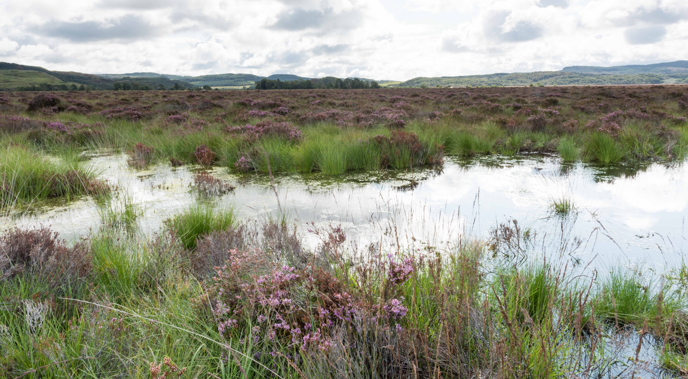
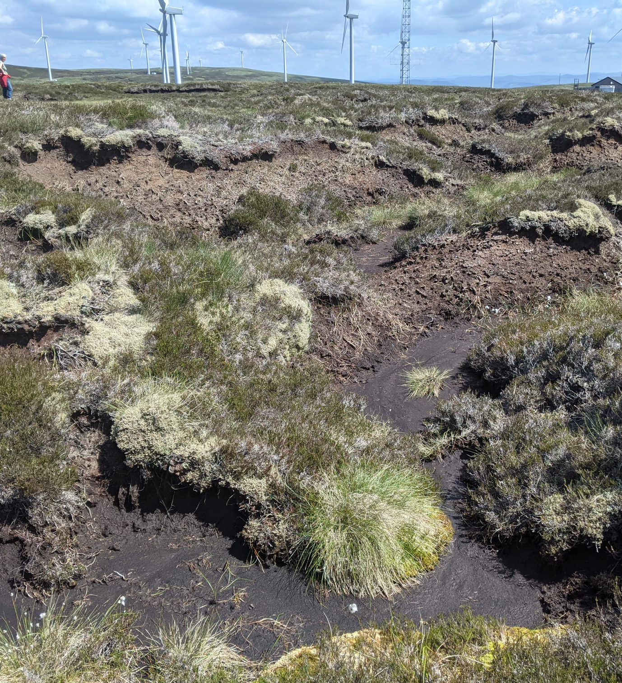
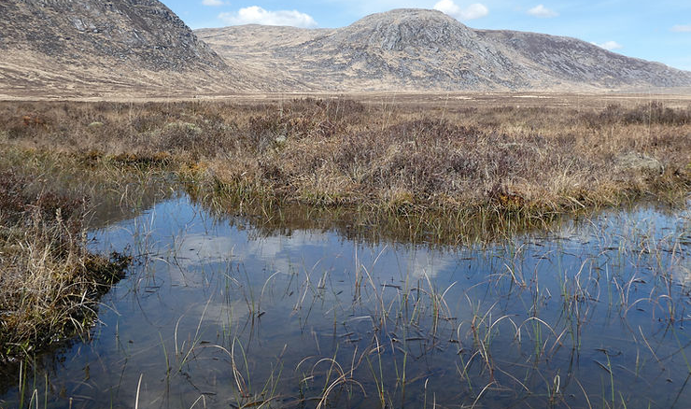
Land use on Peatlands
Peatland Mini Module
Notes:
Introduce the lesson

Slide 2


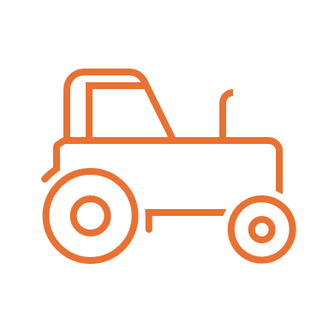


Land Use
Land use refers to how people use different areas of land for various purposes
Recreation: parks and sports fields
Commercial: shops and businesses
Farming: crops and livestock
Residential: houses and schools
Protected areas: national parks and conservation areas

Slide 3
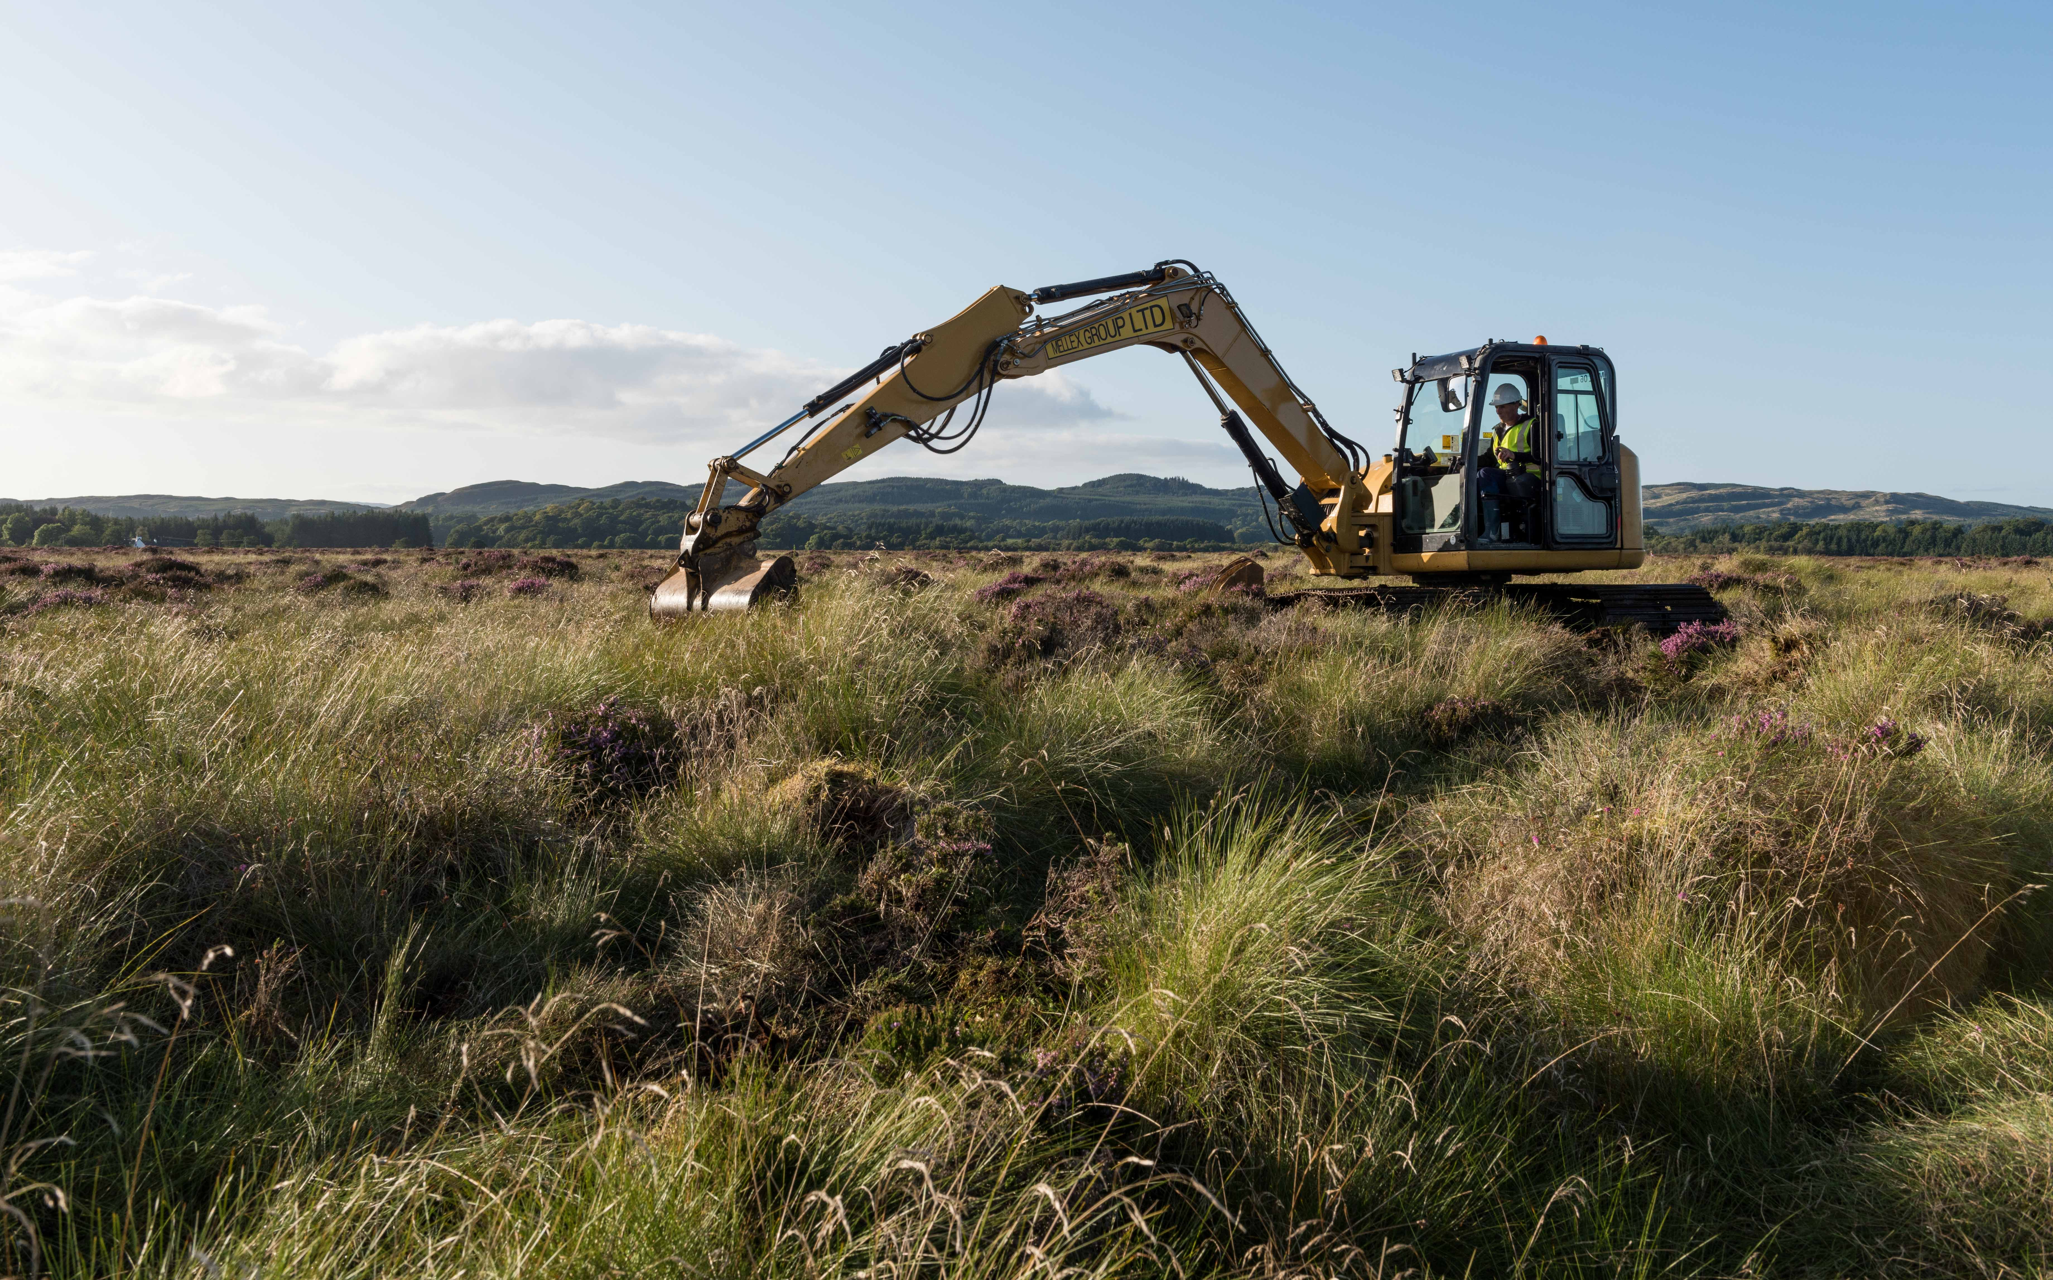
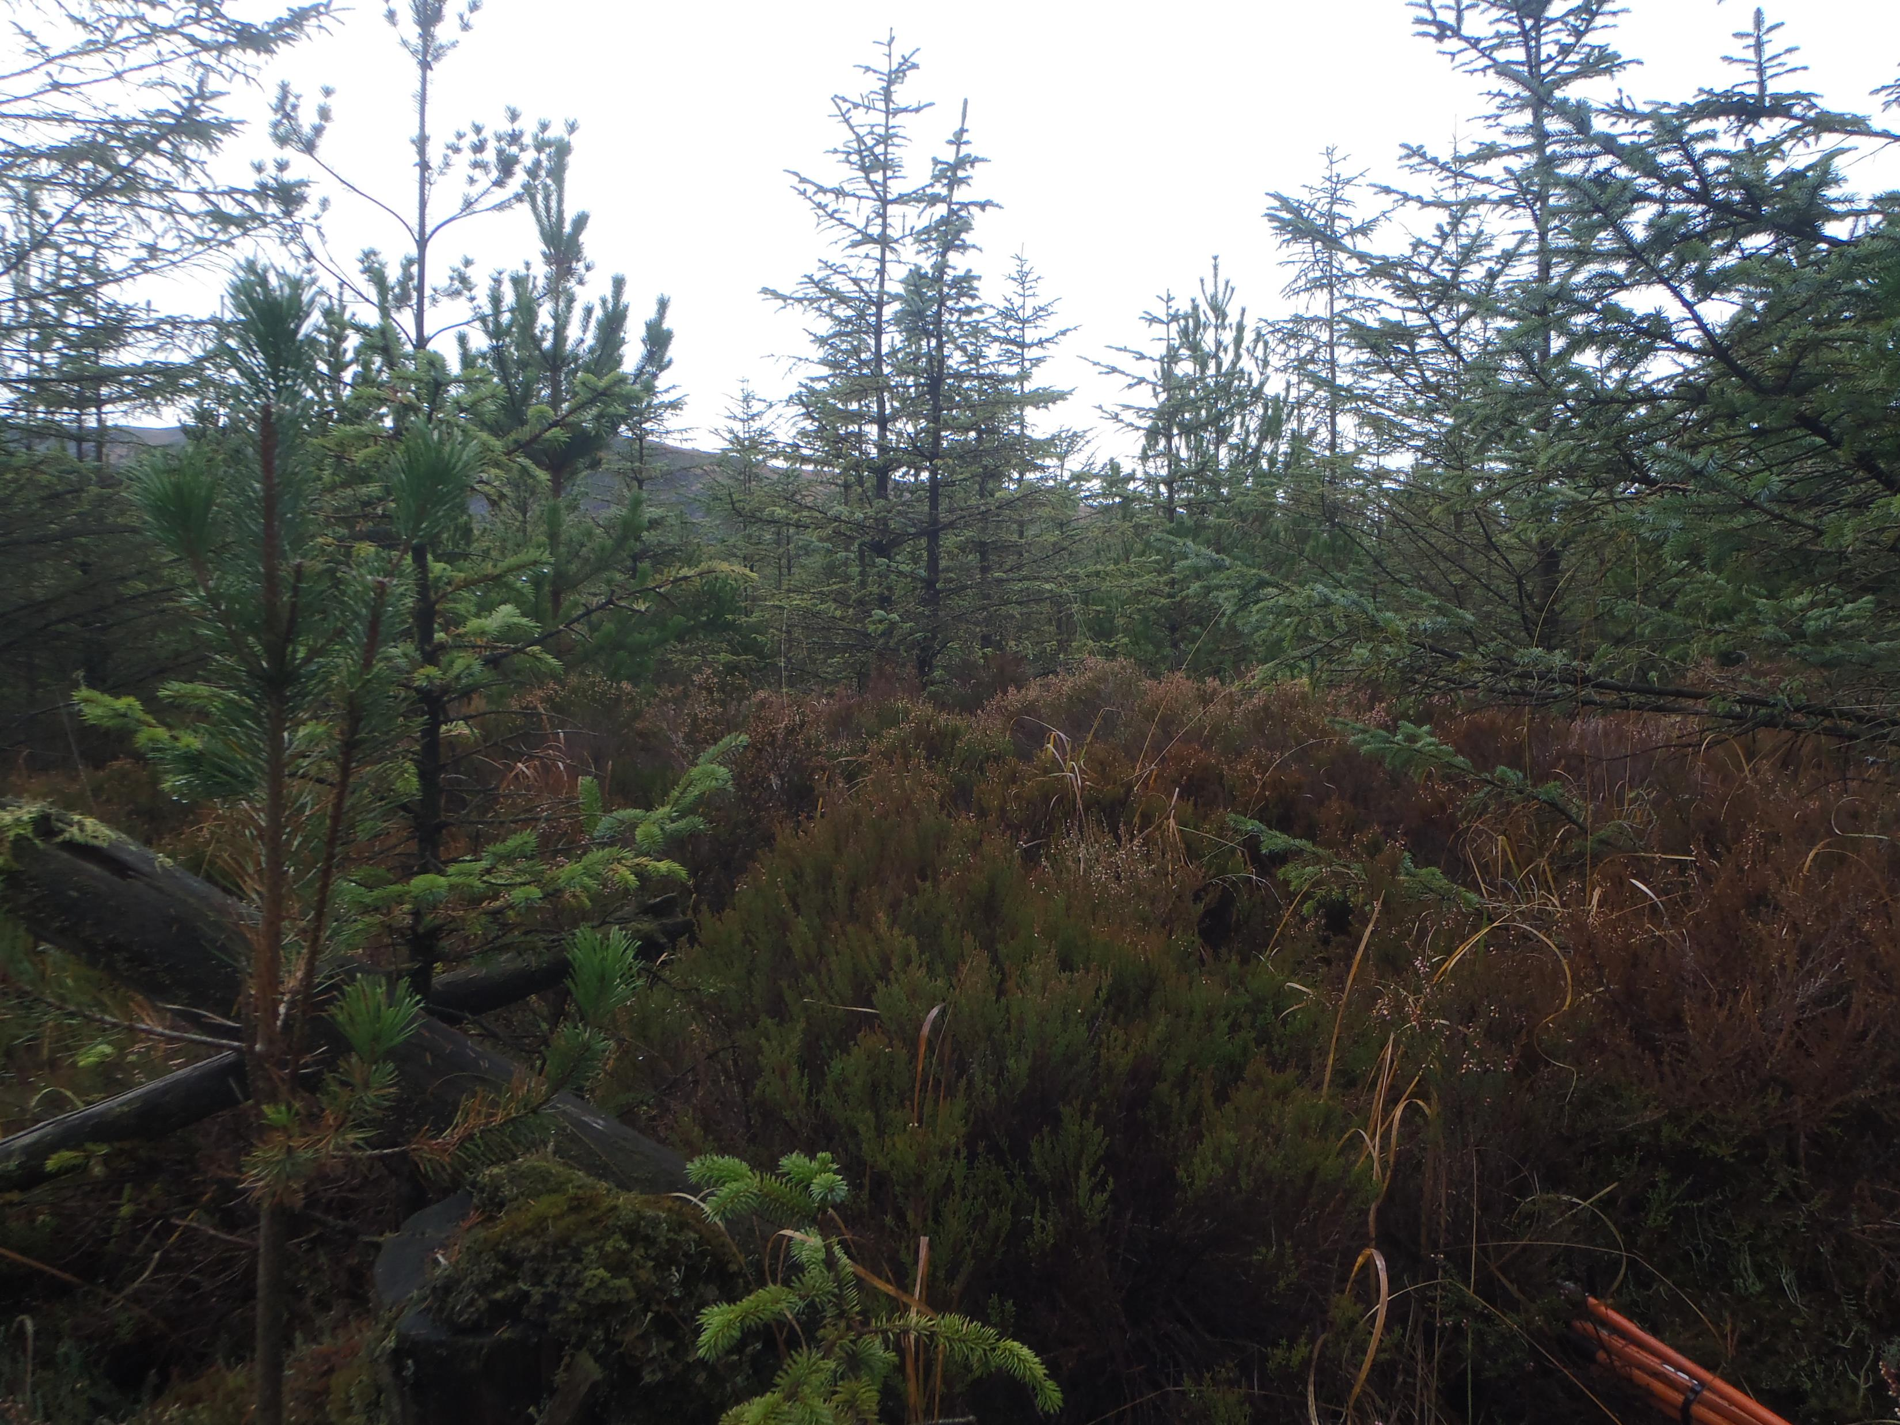
Peatlands and Land Use
Peatlands are a type of wetland made up of a soil called peat, which forms in places where the ground is wet for most or all of the year. This means that dead plants don't break down and instead become peat.
They have been used in lots of different ways, past and present. There are positives and negatives to the different land uses.

Slide 4
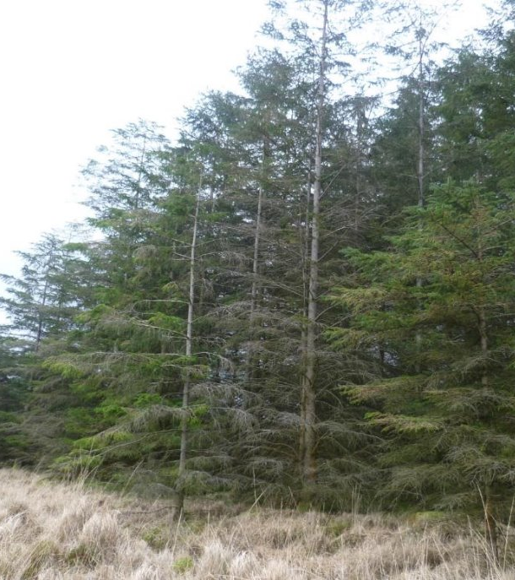
Forestry
Forestry is the planting and managing of forests and trees
Forests have been planted on peatland across the UK for many years, to provide wood for construction, fuel, and paper.
Forests with lots of different types of trees are great for wildlife and are places we can all enjoy. Who has been to one?
But planting on peatlands can cause problems!

Slide 5
Forestry on Peatlands
Positives of Forestry on Peatland | Negatives of Forestry on peatland
Improves biodiversity: On damaged peatlands, mixed forestry may support species and create diverse habitats | Drying the peat: Planting forests requires draining the peatland, which dries and damages the peatland
Supports Rural economies: Forestry provides jobs | Loss of carbon storage: Draining peatlands for forestry releases stored carbon, contributing to climate change.
Provides Timber: Timber is an important building material | Loss of biodiversity: Trees can block sunlight and can prevent the grown of peat-forming plants
Different sources say biodiversity can be improved or lost when planting trees on peatland. The sources have their own reasons why they believe different things – it's important to notice when sources disagree with each other, especially when they write information as if it is a fact.

Slide 6
Group Task
Land use types:
Forestry
Farming
Game Keeping
Nature Reserves
Peat Cutting
Research a land use and find out:
  What is the land use?
  What are the benefits of the land use?
  What are the negatives of the land use?
Make a PowerPoint presentation about your land use, and its positives and negatives, just like the forestry example.
Present to the class!
Learning Intentions We are learning to create a powerpoint and present them

