Slide 1
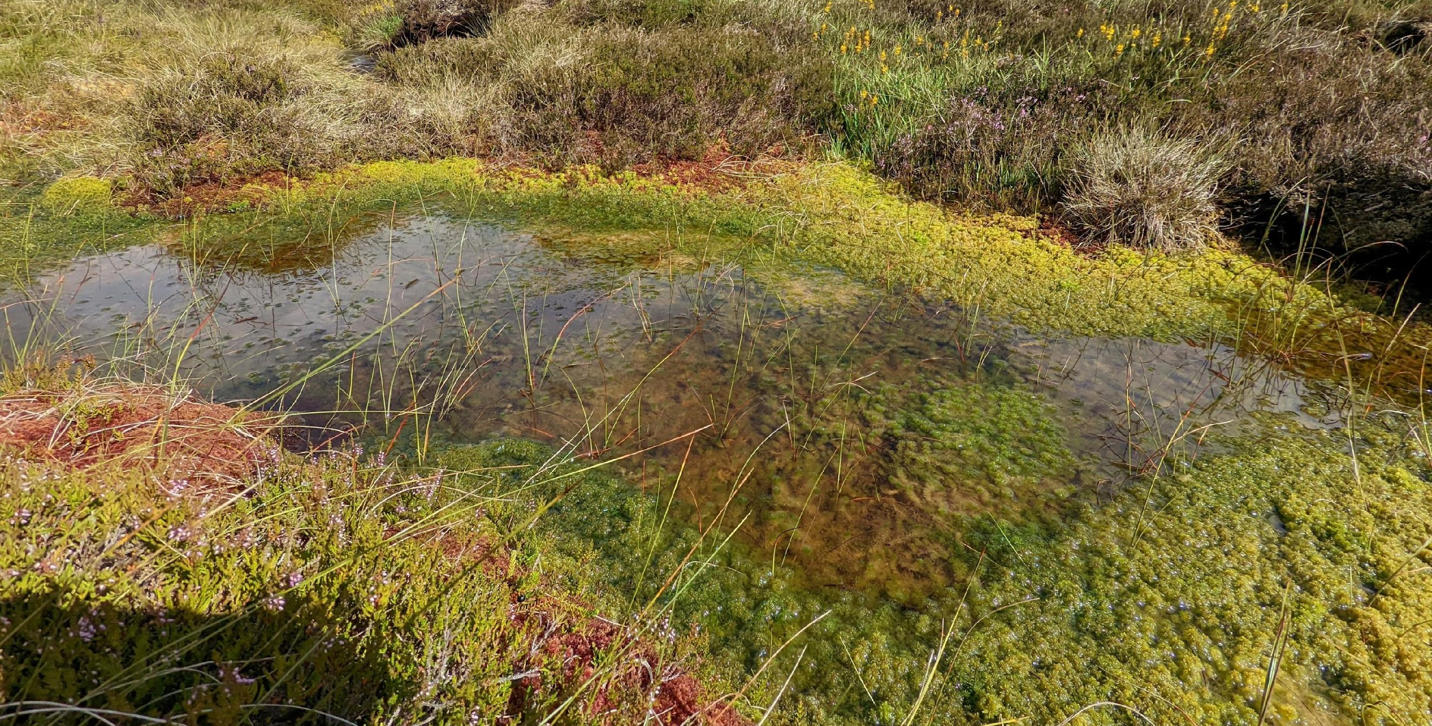
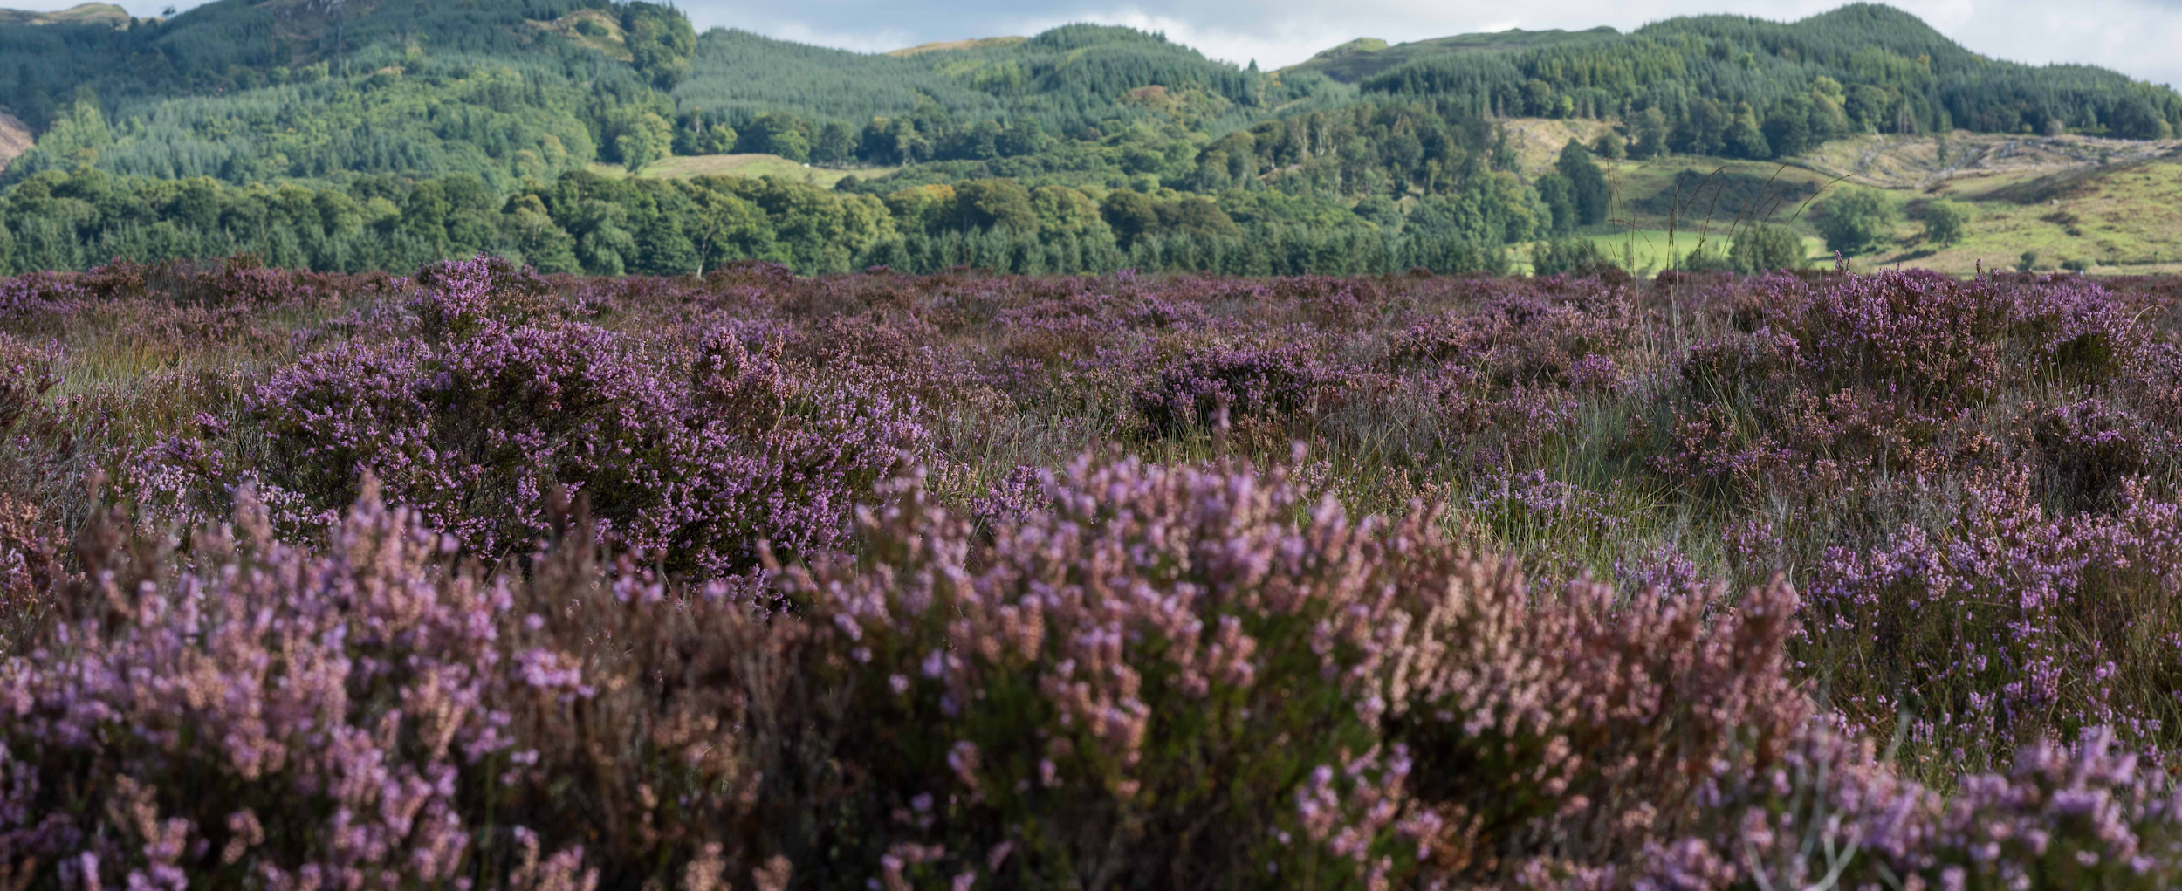
Our Peatlands
Remember, peatlands are areas where the soil is very carbon rich, called peat.
Peatlands are a type of wetland, and should be wet most or all of thel year round.
20% of Scotland’s land is peatland!

Slide 2
Damaged peatlands
Our peatlands have been damaged by humans and animals. We drain the water away to use the land for other purposes, like farming, forestry, or buildings. Sometimes, lots of deer or farming animals can trample the ground too.
Think about grassy areas which lots of people use. Sometimes, the grass dies and just mud is left. This may even happen on your school grounds! That field is damaged, in the same way peatlands can be.

Slide 3
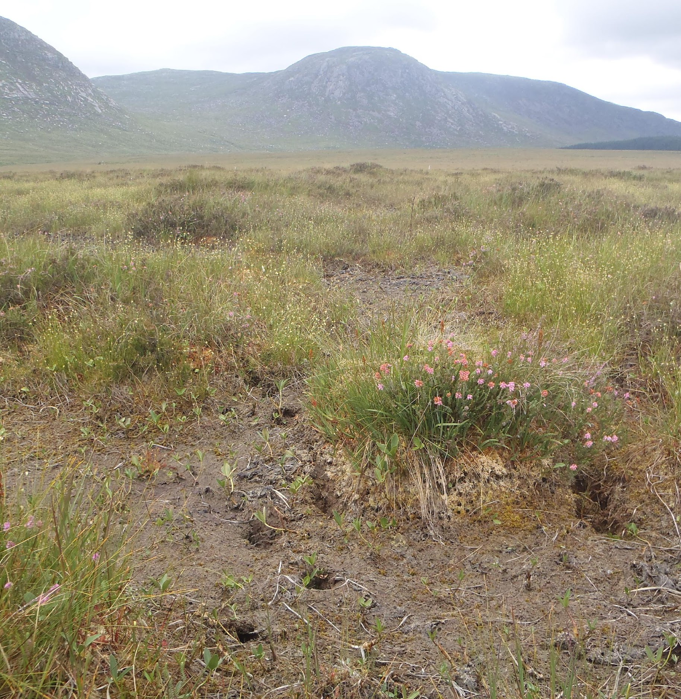
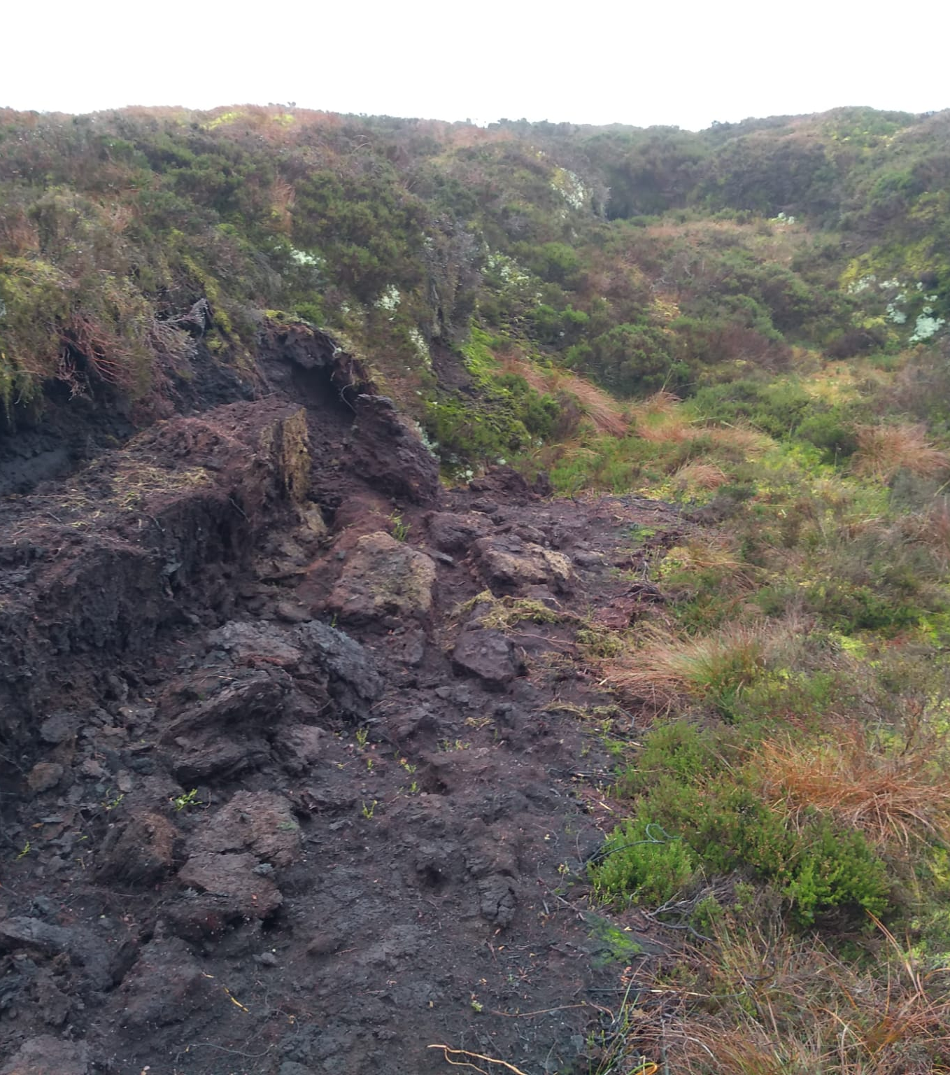

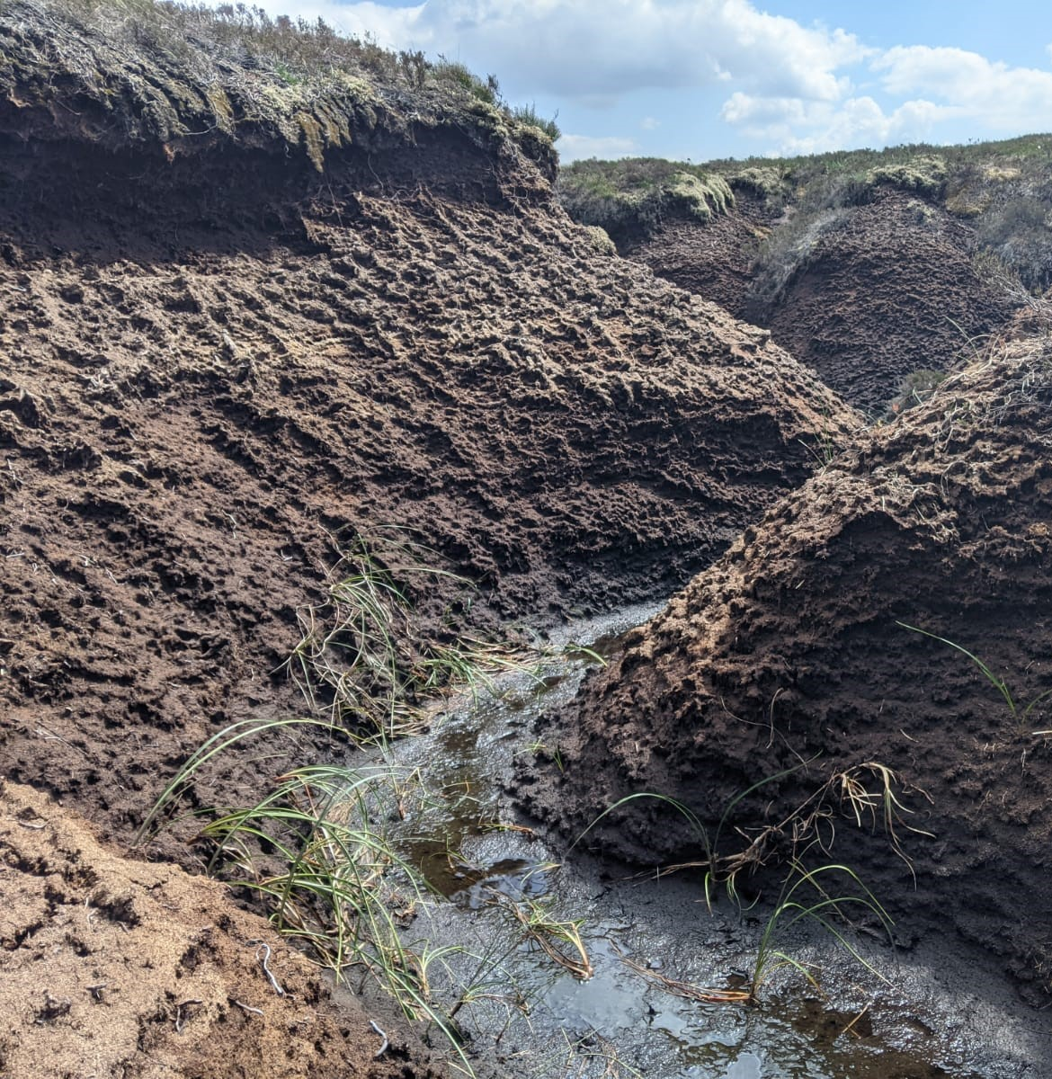
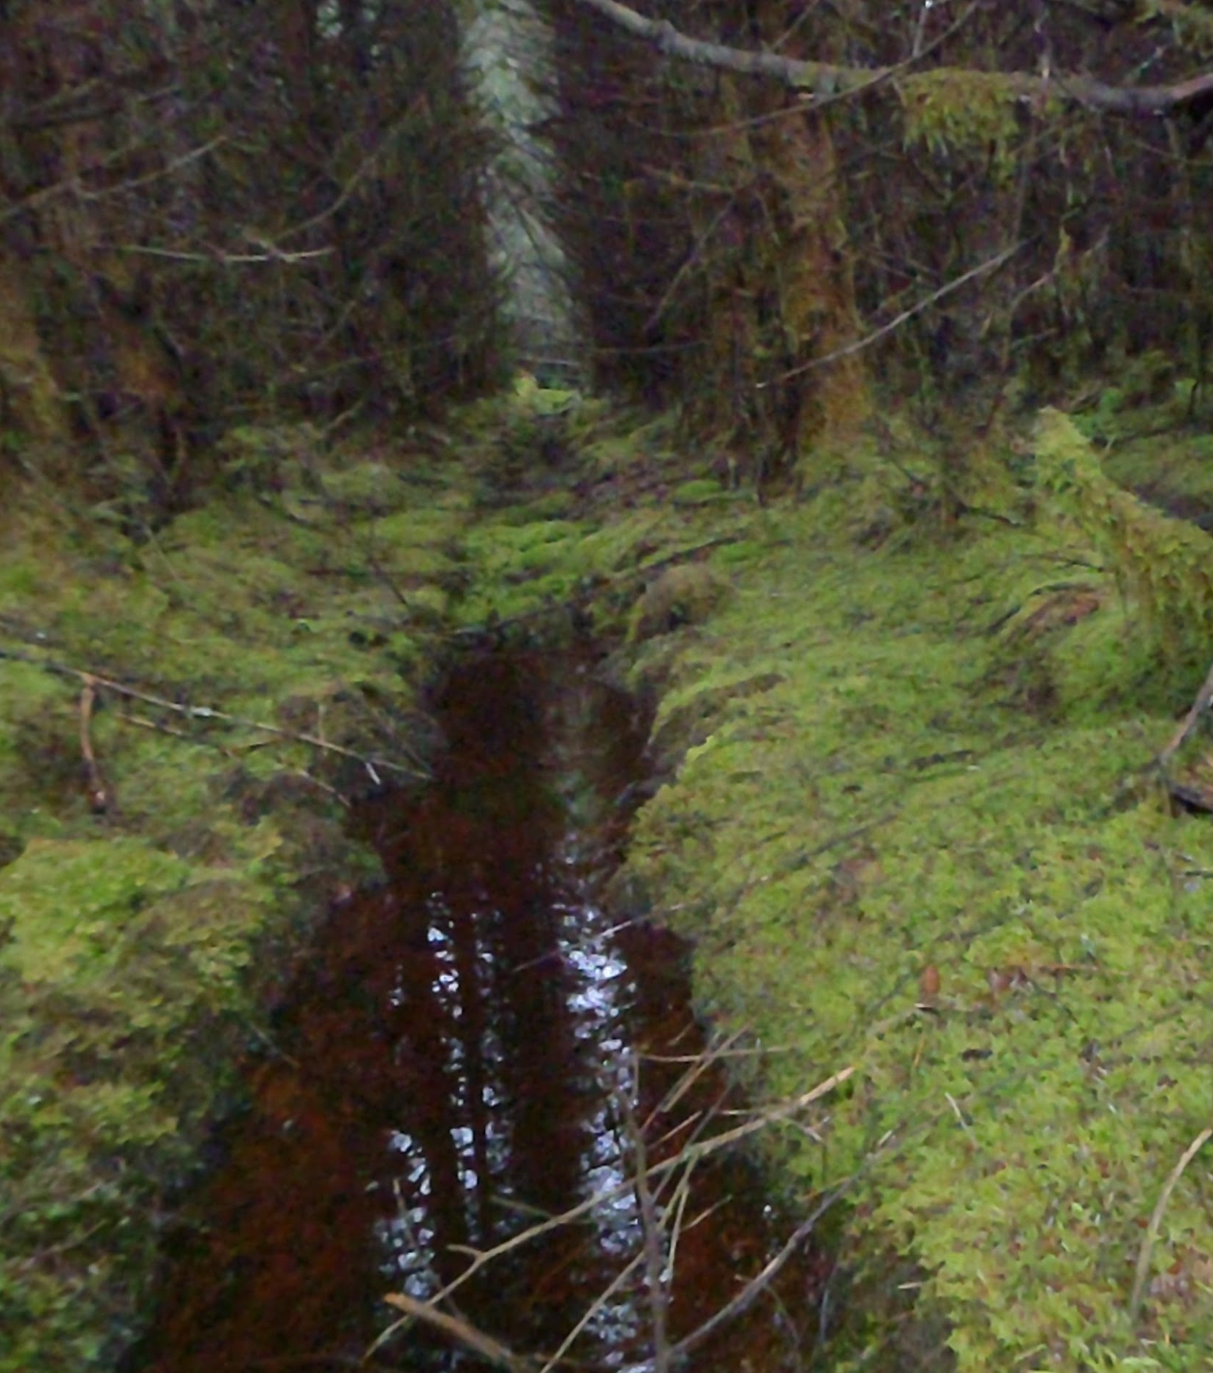
We have different names for different types of damage.
Top Left – Bare Peat (the plants have died and left the soil bare)
Top Right – Hag (a mini cliff of exposed peat)
Bottom Left – Gully (a valley of exposed peat)
Bottom Right – Drain (manmade cut in the land for water to drain, which might turn into a gully)

Slide 4



Damaged peatlands make climate change and water quality worse.
People are working across Scotland to repair these damaged areas and help the peatland be healthy again.
Each type of damage needs different methods of repair, and each peatland as a whole needs different approaches!
It can be like a complex puzzle to work out the right way to repair each peatland.

Slide 5
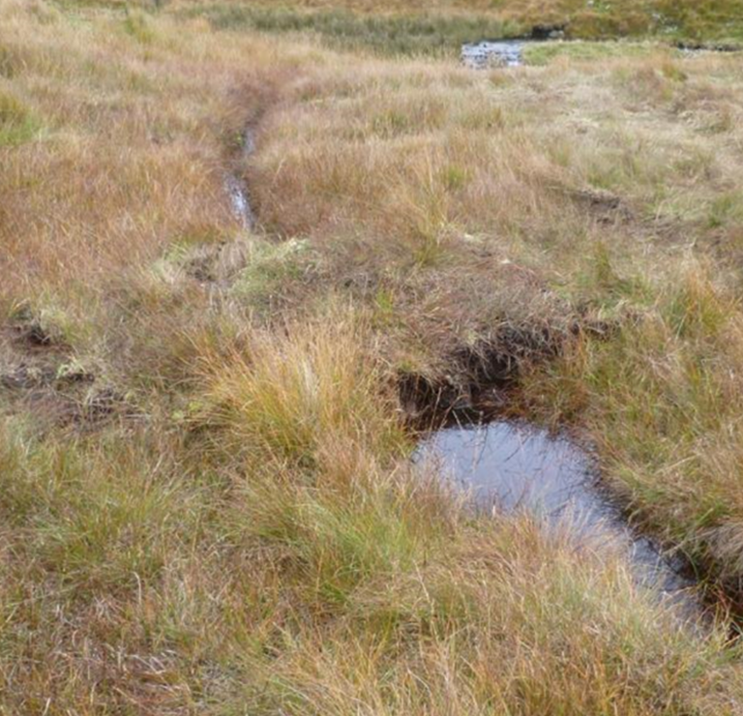
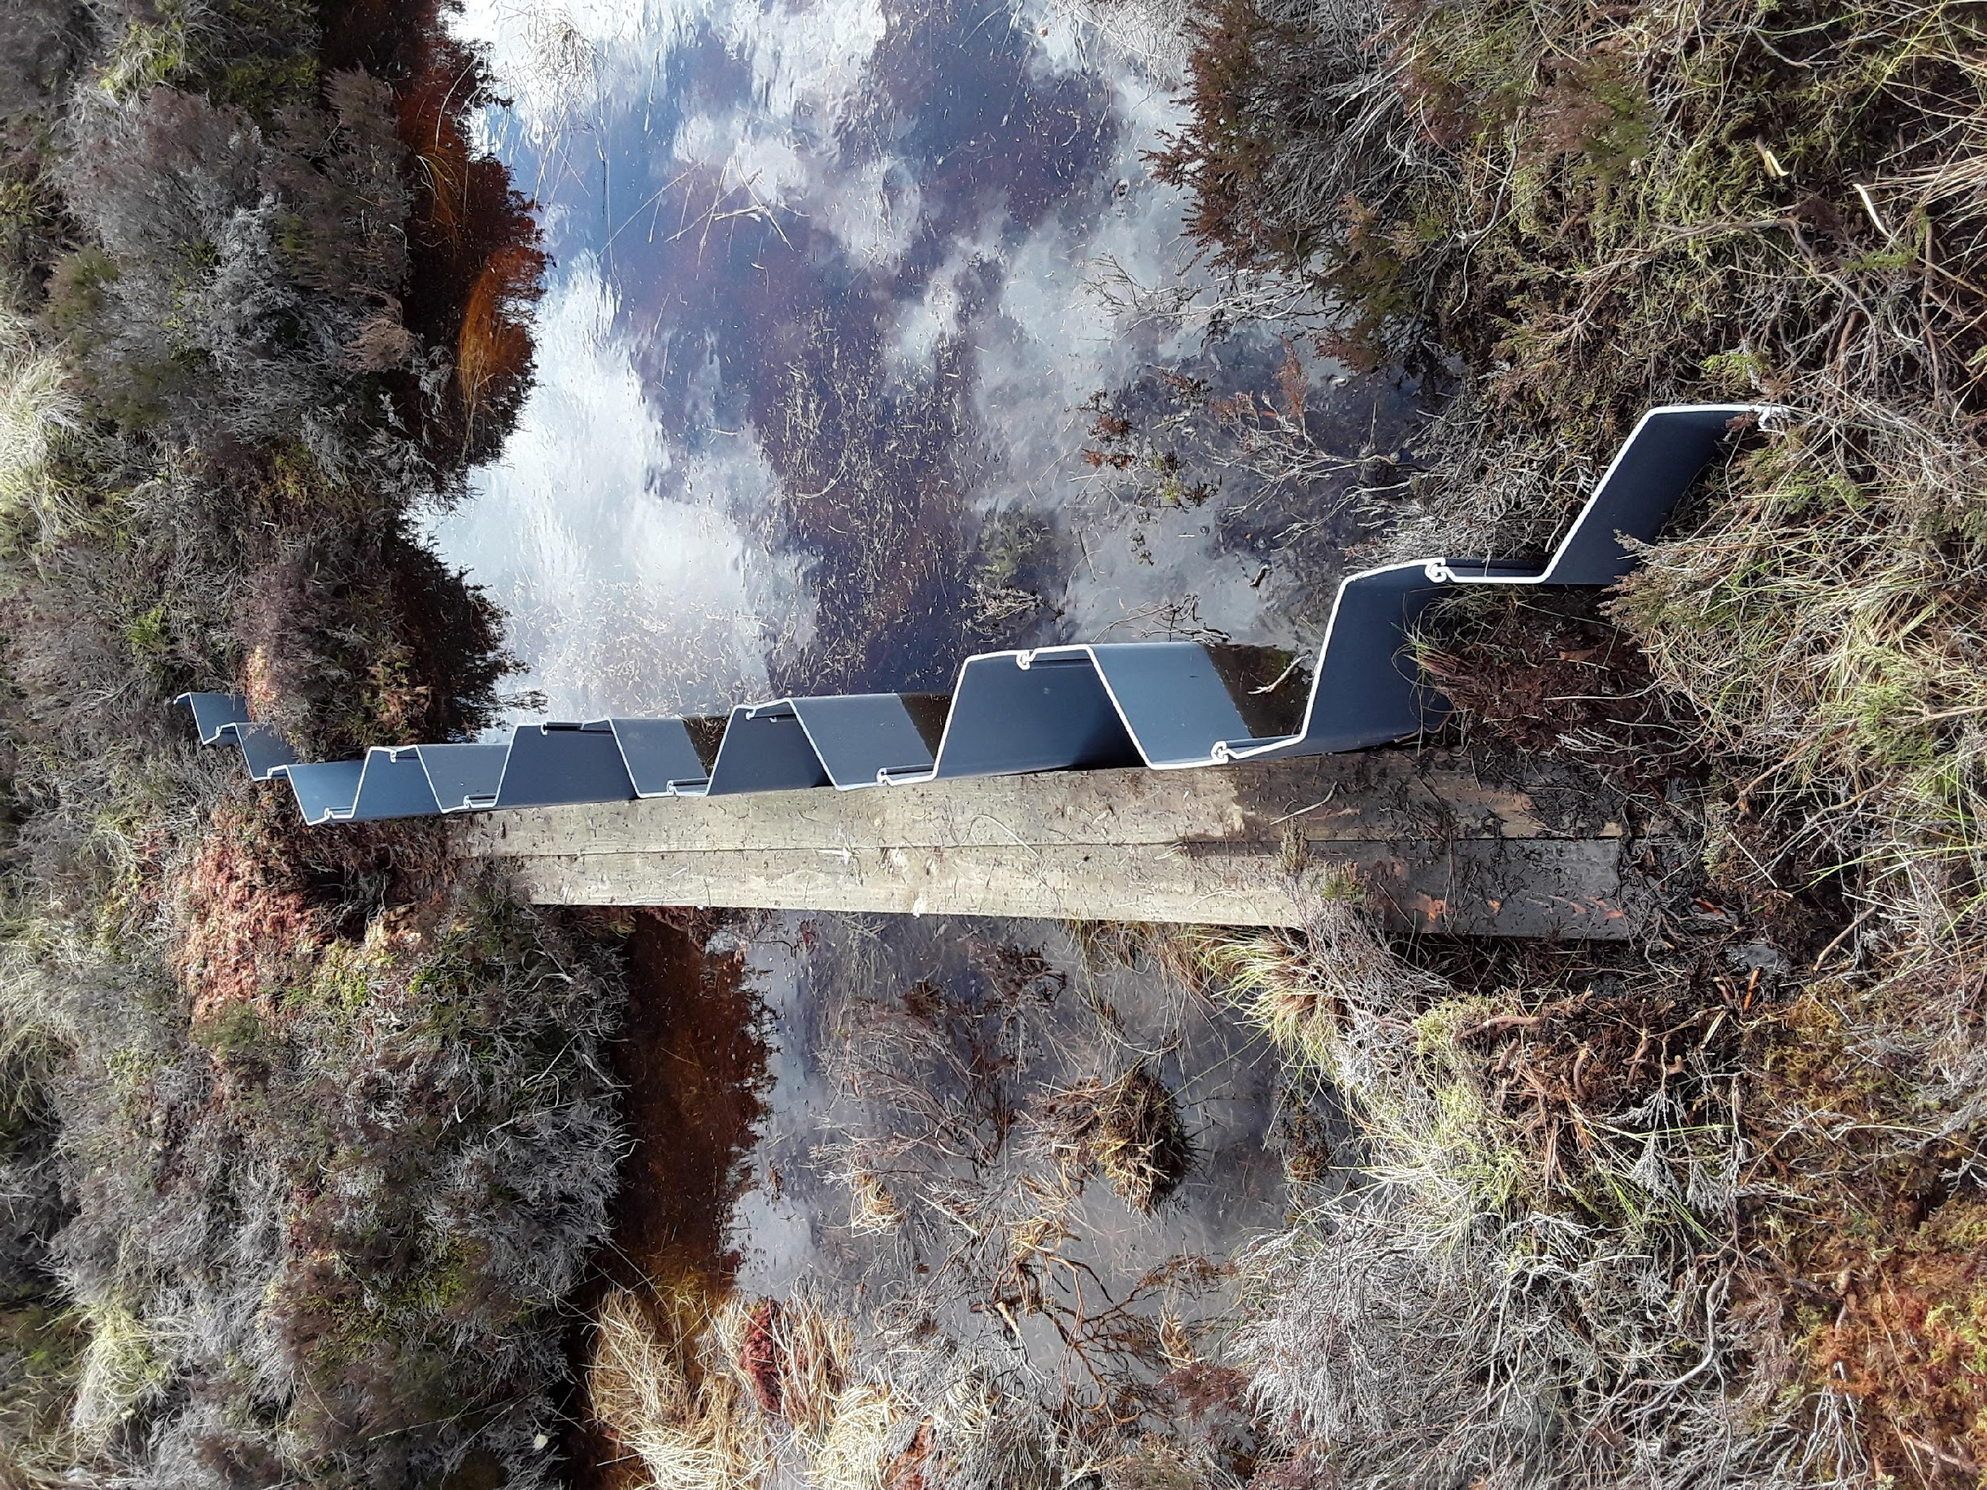
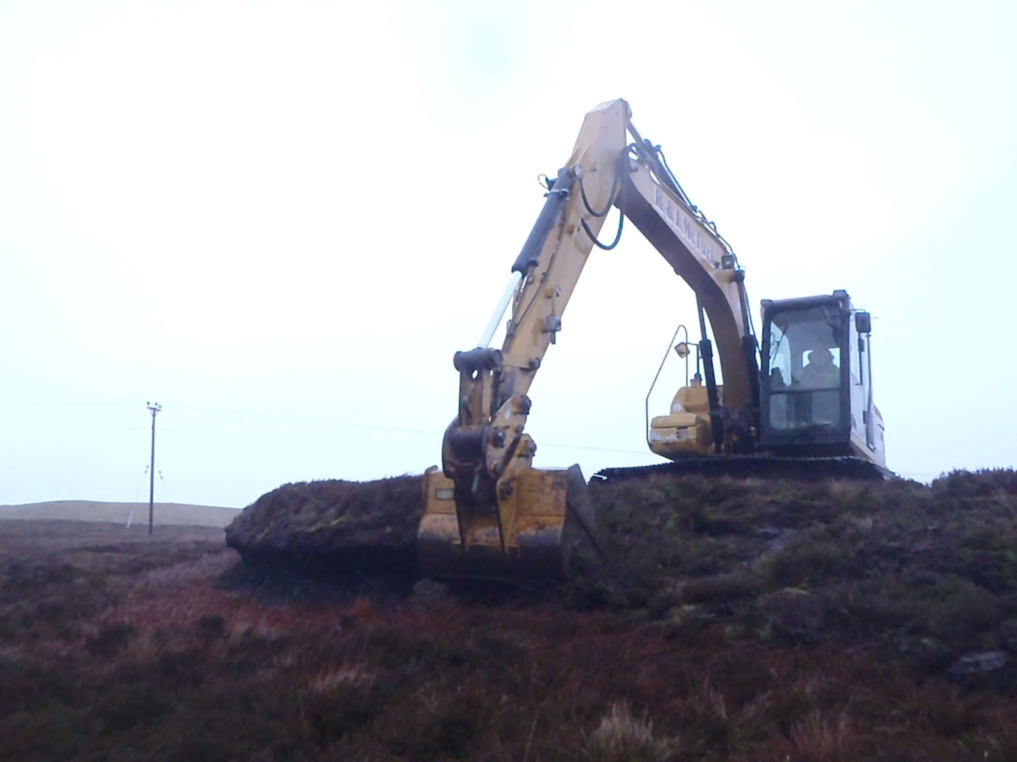
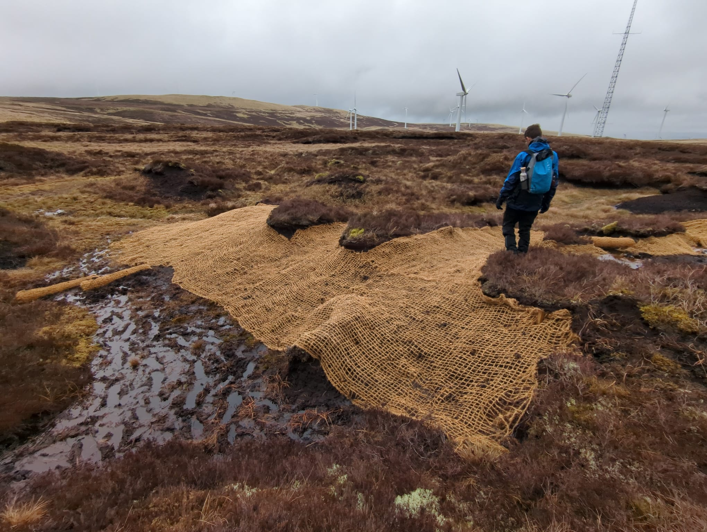
We try to stop water flowing through peatlands too quickly, by blocking the drains (top left, peat dam. Top right, plastic dam). We have to use different methods depending on the damage.
Steep hags and gullies are made less steep by diggers (bottom left)
We might put thick nets over bare areas to help protect them and put peatland plants in them to help the vegetation return.
There are just some of the methods we use.

Slide 6




Fixing the damage done is a complex puzzle…
First, people need to map and survey the peatland. They will see how deep the peatland is and note as much of the damage as possible.
They will make a plan and find contractors, who use machines like diggers, to do the work.
The contractors get their machines on site and follow the plan, with regular check ups from the planners.
The work has to get done before birds start breeding, as a lot of peatland birds nest on the ground.
Finally, the planners and contractors agree that the work is done. They might visit the peatland again later to check on how the peatland is recovering.

Slide 7



In your lesson…
You will be working through problems as if you’re the planner in this process. You’ll be finding out how much everything costs and making sure you can afford to repair the peatland.
You might be surprised by some of the things the planners and contractors have to think about, and charge for!
Can you successfully repair a peatland fully with the money you have?

