Slide 1


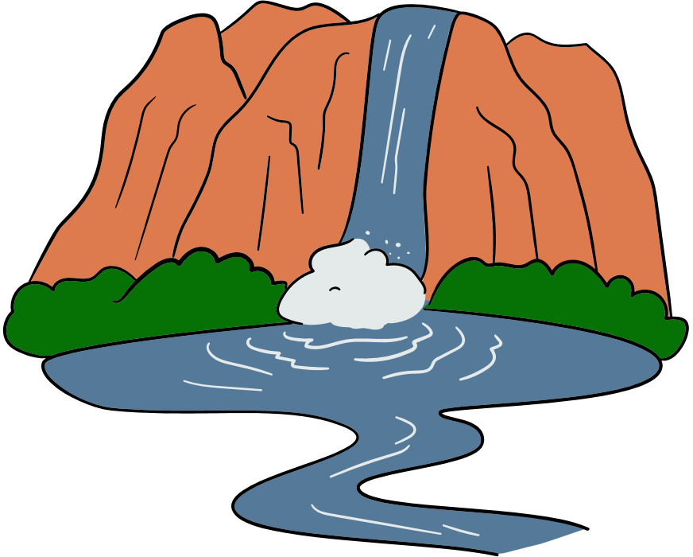
Healthy Rivers
& why they matter

Slide 2




Success Criteria
I can find the numbers I need in the table, list, or graph.
I can multiply numbers correctly.
I can say what my answer means in the real-world situation

Slide 3




The importance of rivers
For us
For nature
For water
So many animals and plants live in rivers and will suffer if rivers are unhealthy. Can you name some?
Water needs to move from the land to the sea so that it can cycle through our world and keep life healthy.
Humans need and enjoy healthy rivers for water, washing, fishing, swimming, and other sports.

Slide 4
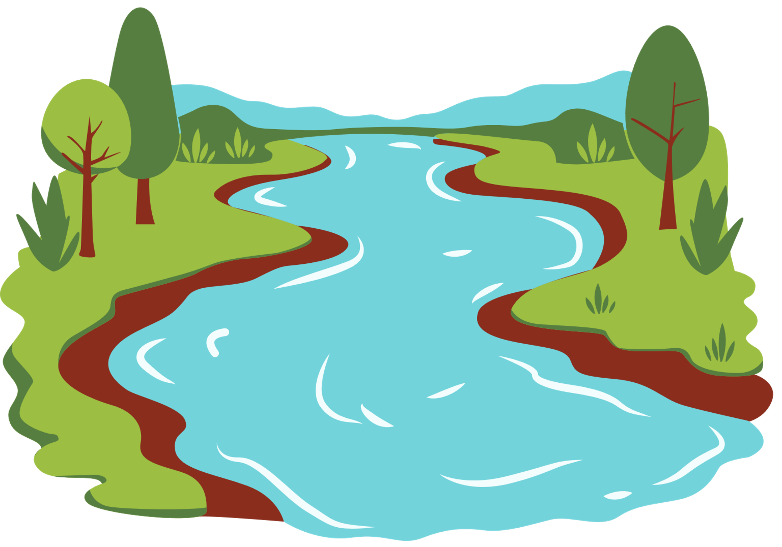


What makes rivers unhealthy?
Sewage, waste, or litter from businesses, water companies, or people are sometimes put into our water, even though this is often illegal or not advised.
If the land around rivers is damaged, soil can be washed into the rivers which can cover plants and small animals.
Climate changes increase water temperature and cause droughts or floods.
Fertilisers from farmland can drain into nearby rivers and unbalance the ecosystem.
People changing the natural path of the river can upset the ecosystem - by moving rocks, or straightening huge sections with machines.

Slide 5



How can we tell when rivers are unhealthy?
Sometimes we can see it - there might be litter, flytipping, an unusual colour like browny water rather than clear, a lack of plants and animals. Sometimes we can even smell it!
Sometimes it can be hard to see. Scientists can take samples of water or try to survey the invertebrates living there and use that to rate the river’s health.

Slide 6
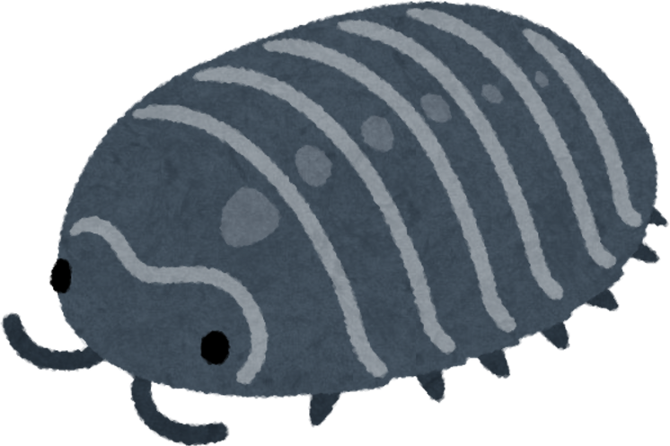

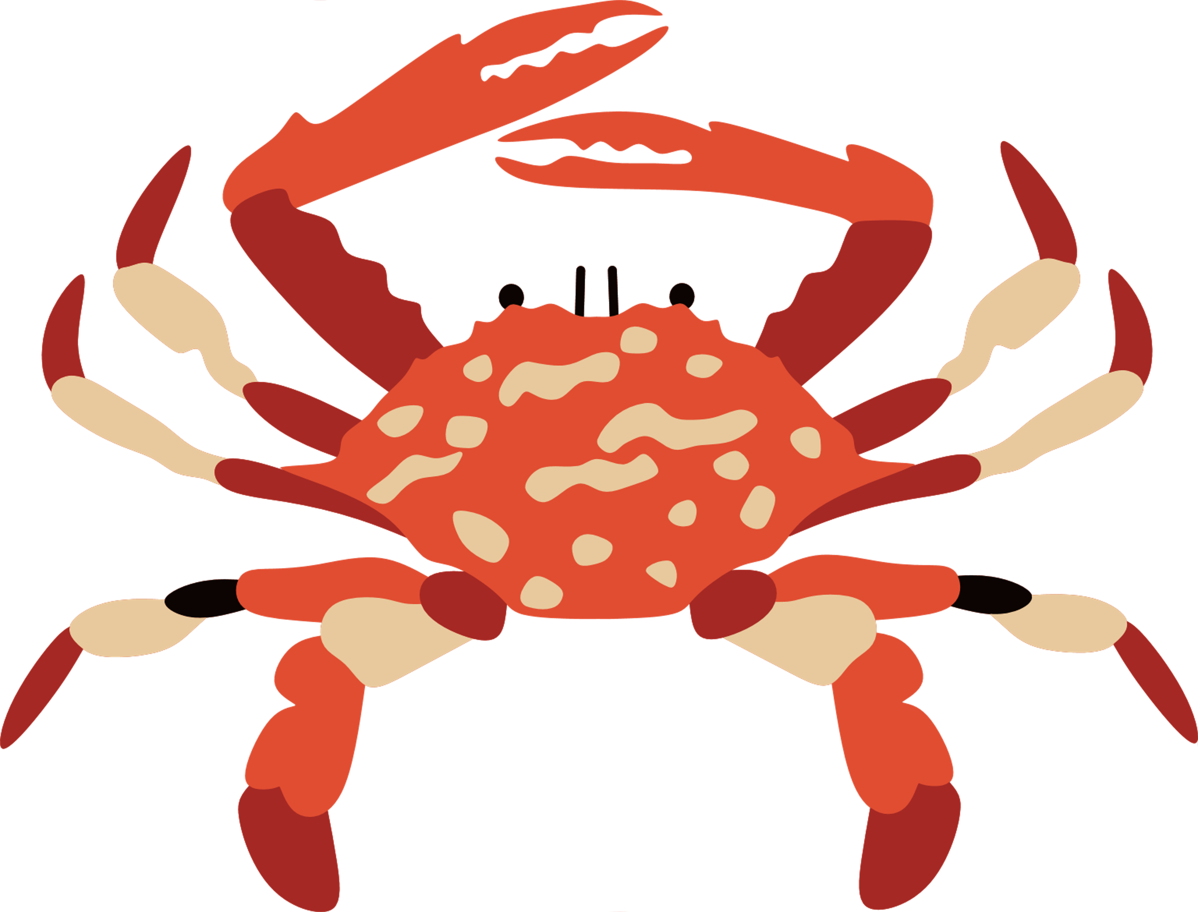
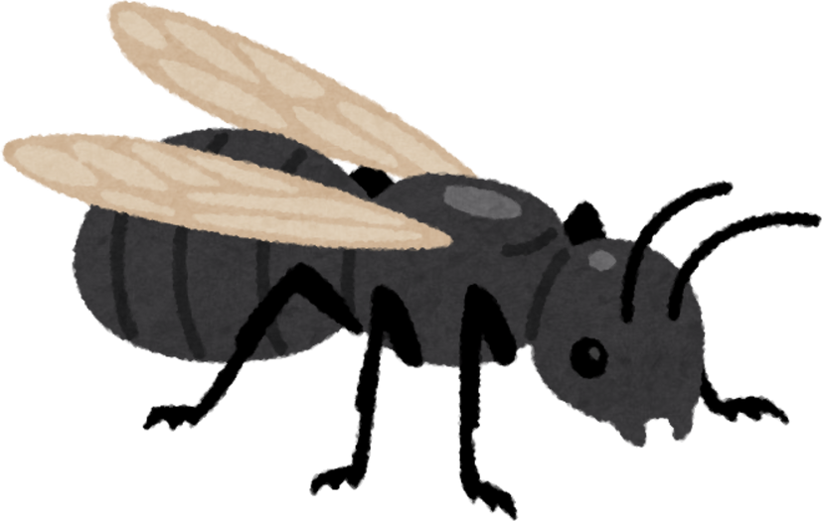
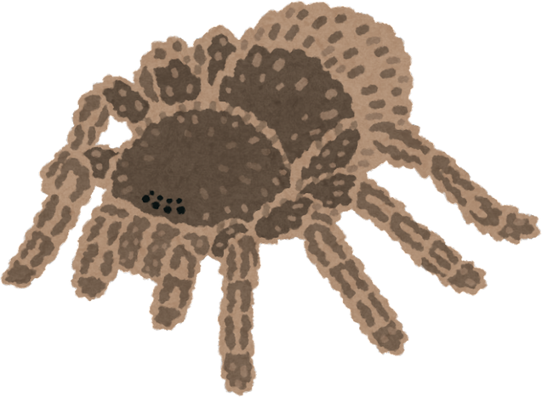
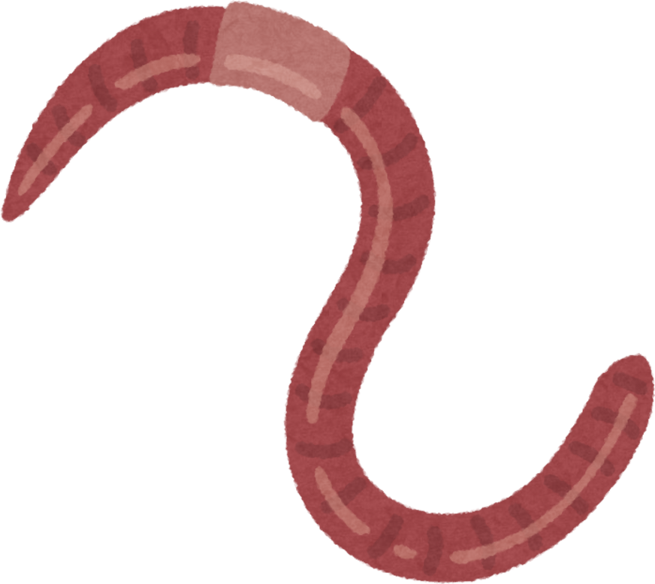

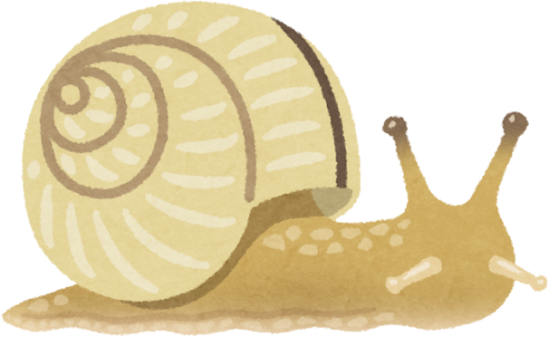

WHat is an invertebrate?
An animal without a backbone - 95% of animal species are invertebrates.
Examples include worms, starfish, beetles, crabs, flies, octopus, and more. Can you think of any?

Slide 7
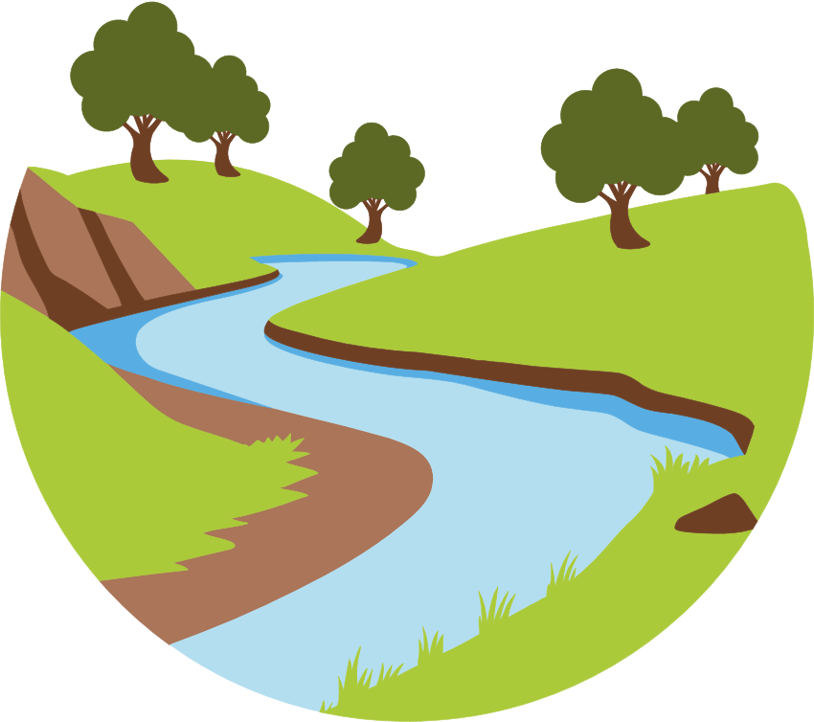
Using maths to rate the healthiness of rivers
Scientists have come up with a way of using maths to calculate how healthy a river is.
They have given different invertebrates a number which says how much pollution they can survive.
Those that can survive lots have a low number, and those that cannot have a high number.

Slide 8
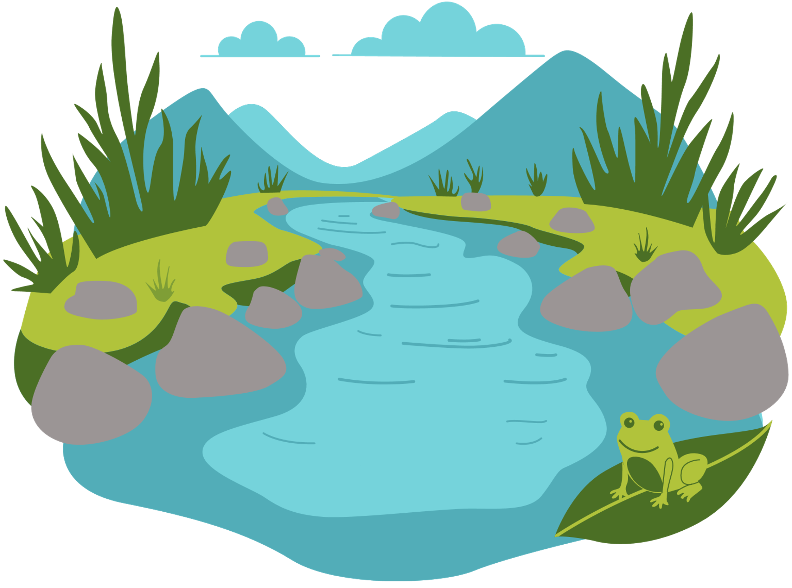

Maths and rivers continued.
Scientists sample an area of the river and gather invertebrates.
They then add up all the scores of each type to get one final number for the river.
They multiply the number of each type with its score - remember, invertebrates that can survive pollution have a low score.
Scientists then identify them all and count how many there are of each type of invertebrate, e.g. worm or beetle
If the score is low, the river is unhealthy. If it is high, the river is healthy.

Slide 9





Let’s have a go!
Your worksheets compare two different rivers - can you use the method described to find out which river is healthier?
You may want to recap multiplication strategies as a class first.

Slide 10
Understanding if a river is healthy or not means we can work on protecting it and its wildlife - with this type of survey we could even see which areas of the river need the most help.
Some of the things we can do to help rivers include:
Picking up our litter
Writing to our MSPs asking them to protect rivers
Raising money for local organisations which help rivers

Slide 11
Success Criteria
I can find the numbers I need in the table, list, or graph.
I can multiply numbers correctly.
I can say what my answer means in the real-world situation

