Slide 1
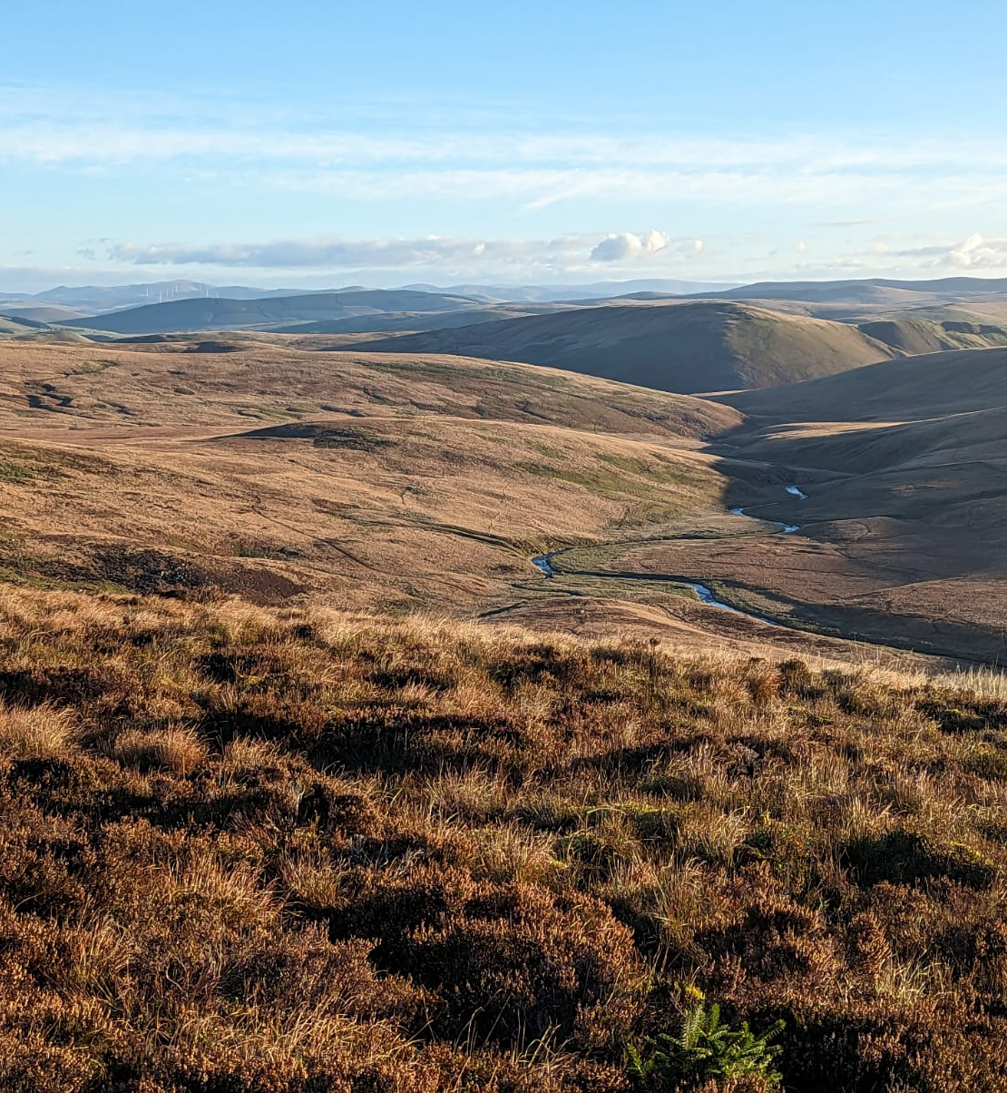
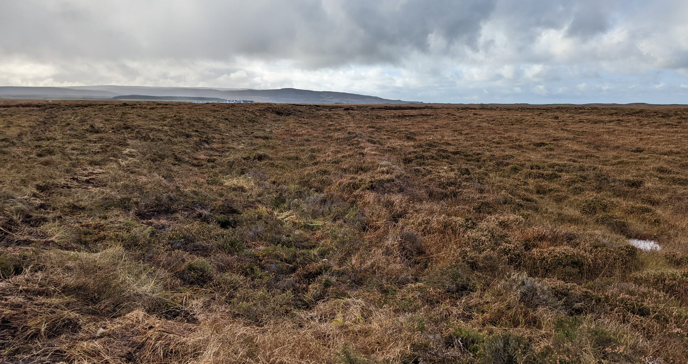
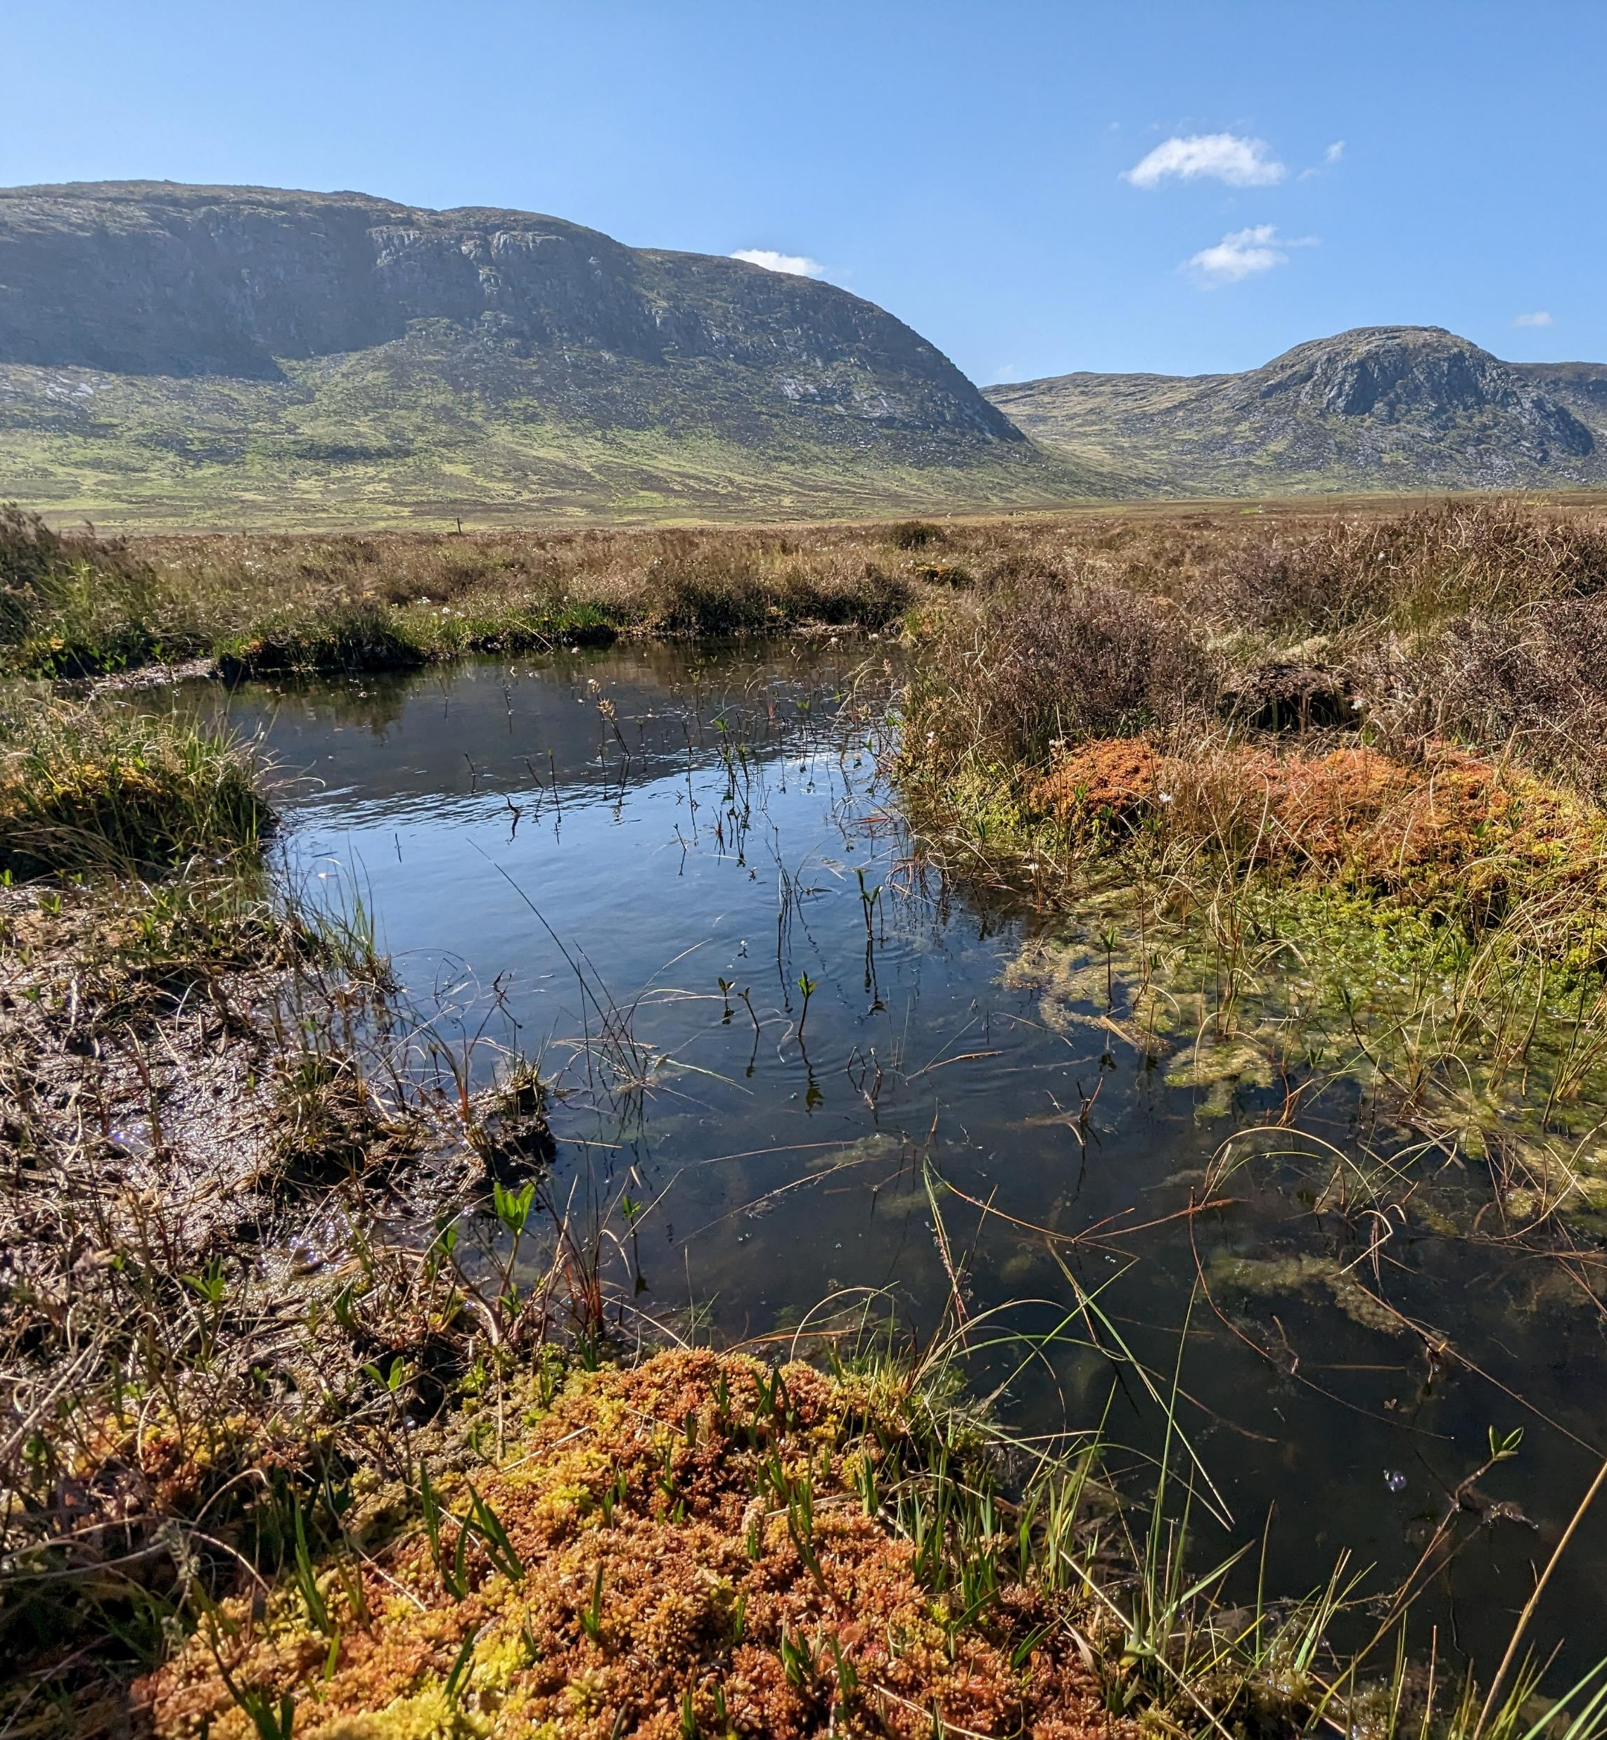
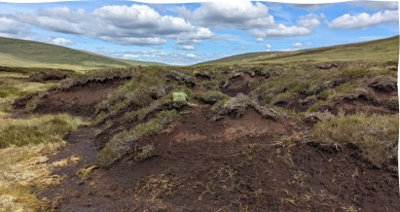
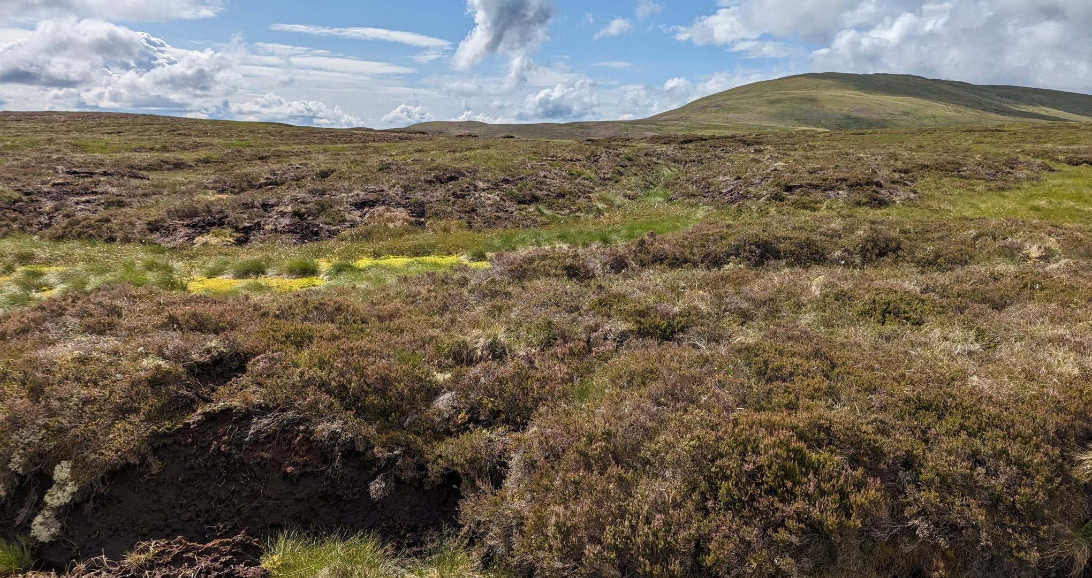
What is a Peatland?
Notes:
Ask the pupils what a peatland is? Ask what they already know and understand about peatlands. There answers should indicate how much detail to go into during this presentation.

Slide 2
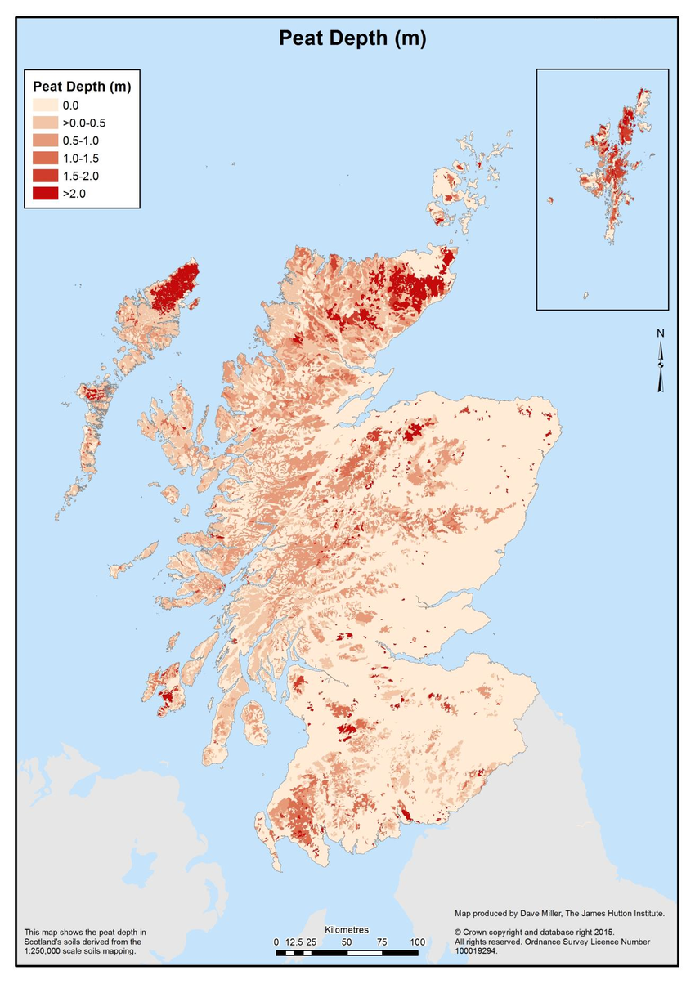
Peatlands
A Peatland is a wetland habitat. Wetlands are areas that do not drain well and are full of water most or all year round.
Peatlands are found all over the world! They cover 20% of Scotland's land surface. The darker red in this map means there is deeper peat.
Peat soil is made up of plants and other organic matter that have not fully broken down because of the wet conditions
It takes 1000 years to form 1 meter of peat!
Notes:
Make sure the pupils understand how peat ifs formed. That the wet habitat stops plants from breaking down completely when they die and instead they form Peat!

Slide 3
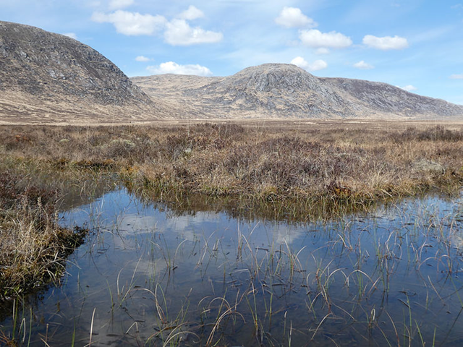
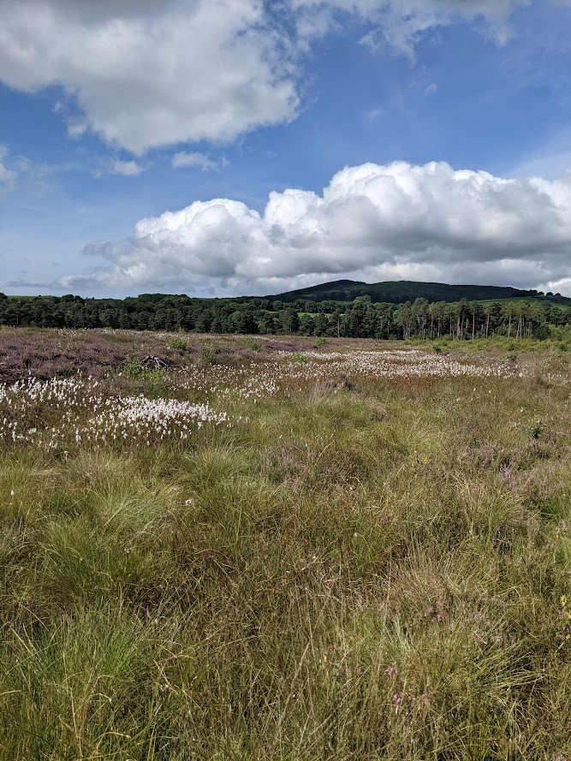
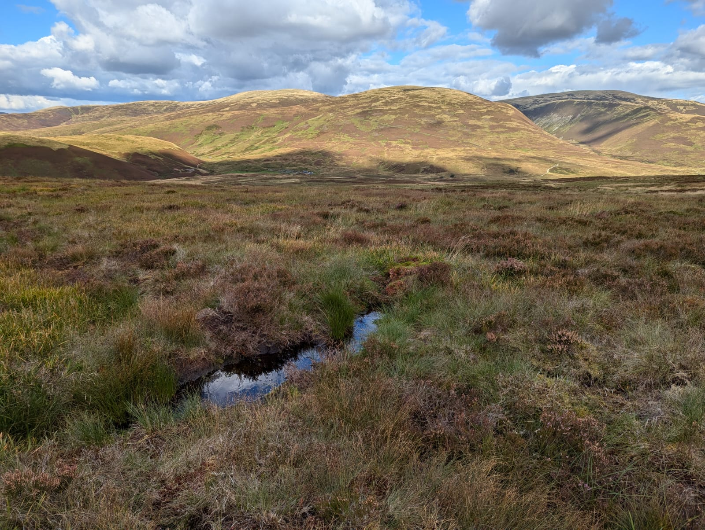
Peatlands are important habitats!
Peatlands are great for biodiversity and provide a home for many plants and animals.
A healthy peatland can improve water quality and reduce flooding.
Peat stores carbon and helps to fight climate change!

Slide 4
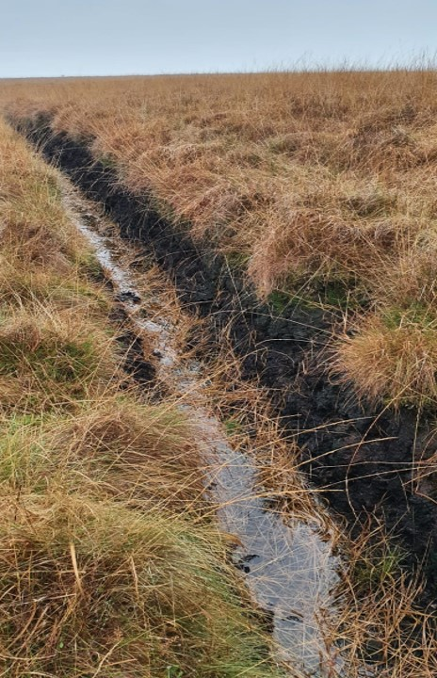
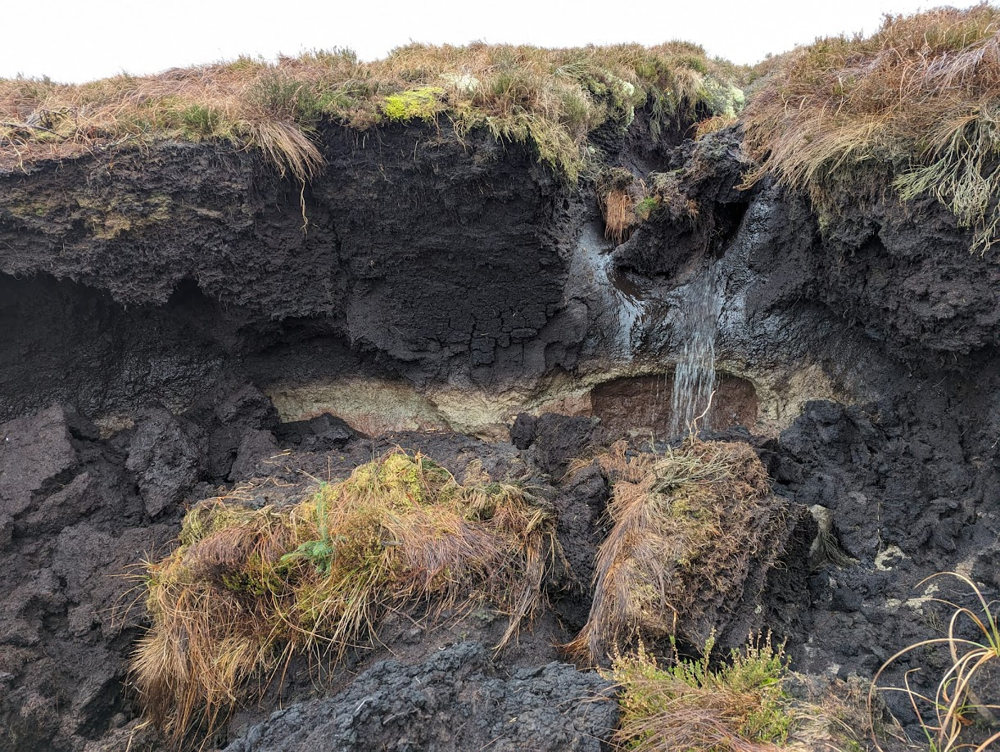
Peatlands need protecting and restoring!
BUT… a lot of peatlands have been damaged and drained over the years
An unhealthy peatland can release carbon dioxide into the atmosphere and contribute to climate change
Peatlands need restoring to be wet and healthy again!

Slide 5
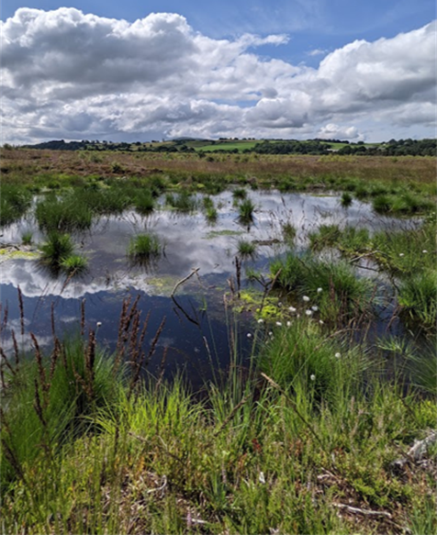
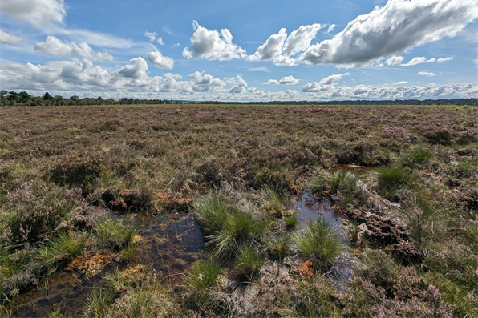
Features of a Healthy Peatland
Bog pools are found on healthy peatlands, they are important for wildlife.
Peatlands are wide, open, and mostly flat, helping them hold lots of water and provide a home for special plants and animals. They are a mixture of moss, cotton grass and heather covering the dark peat soil

Slide 6
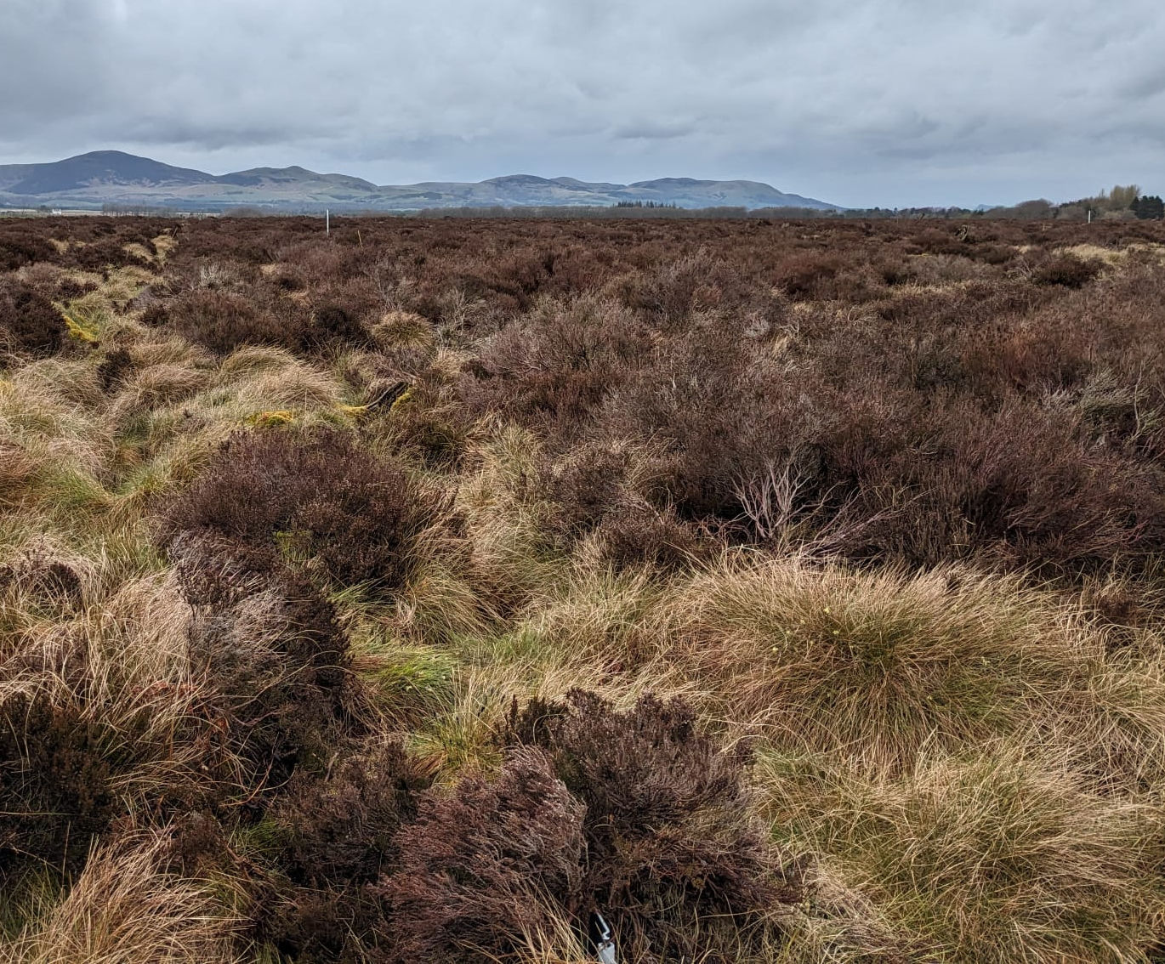
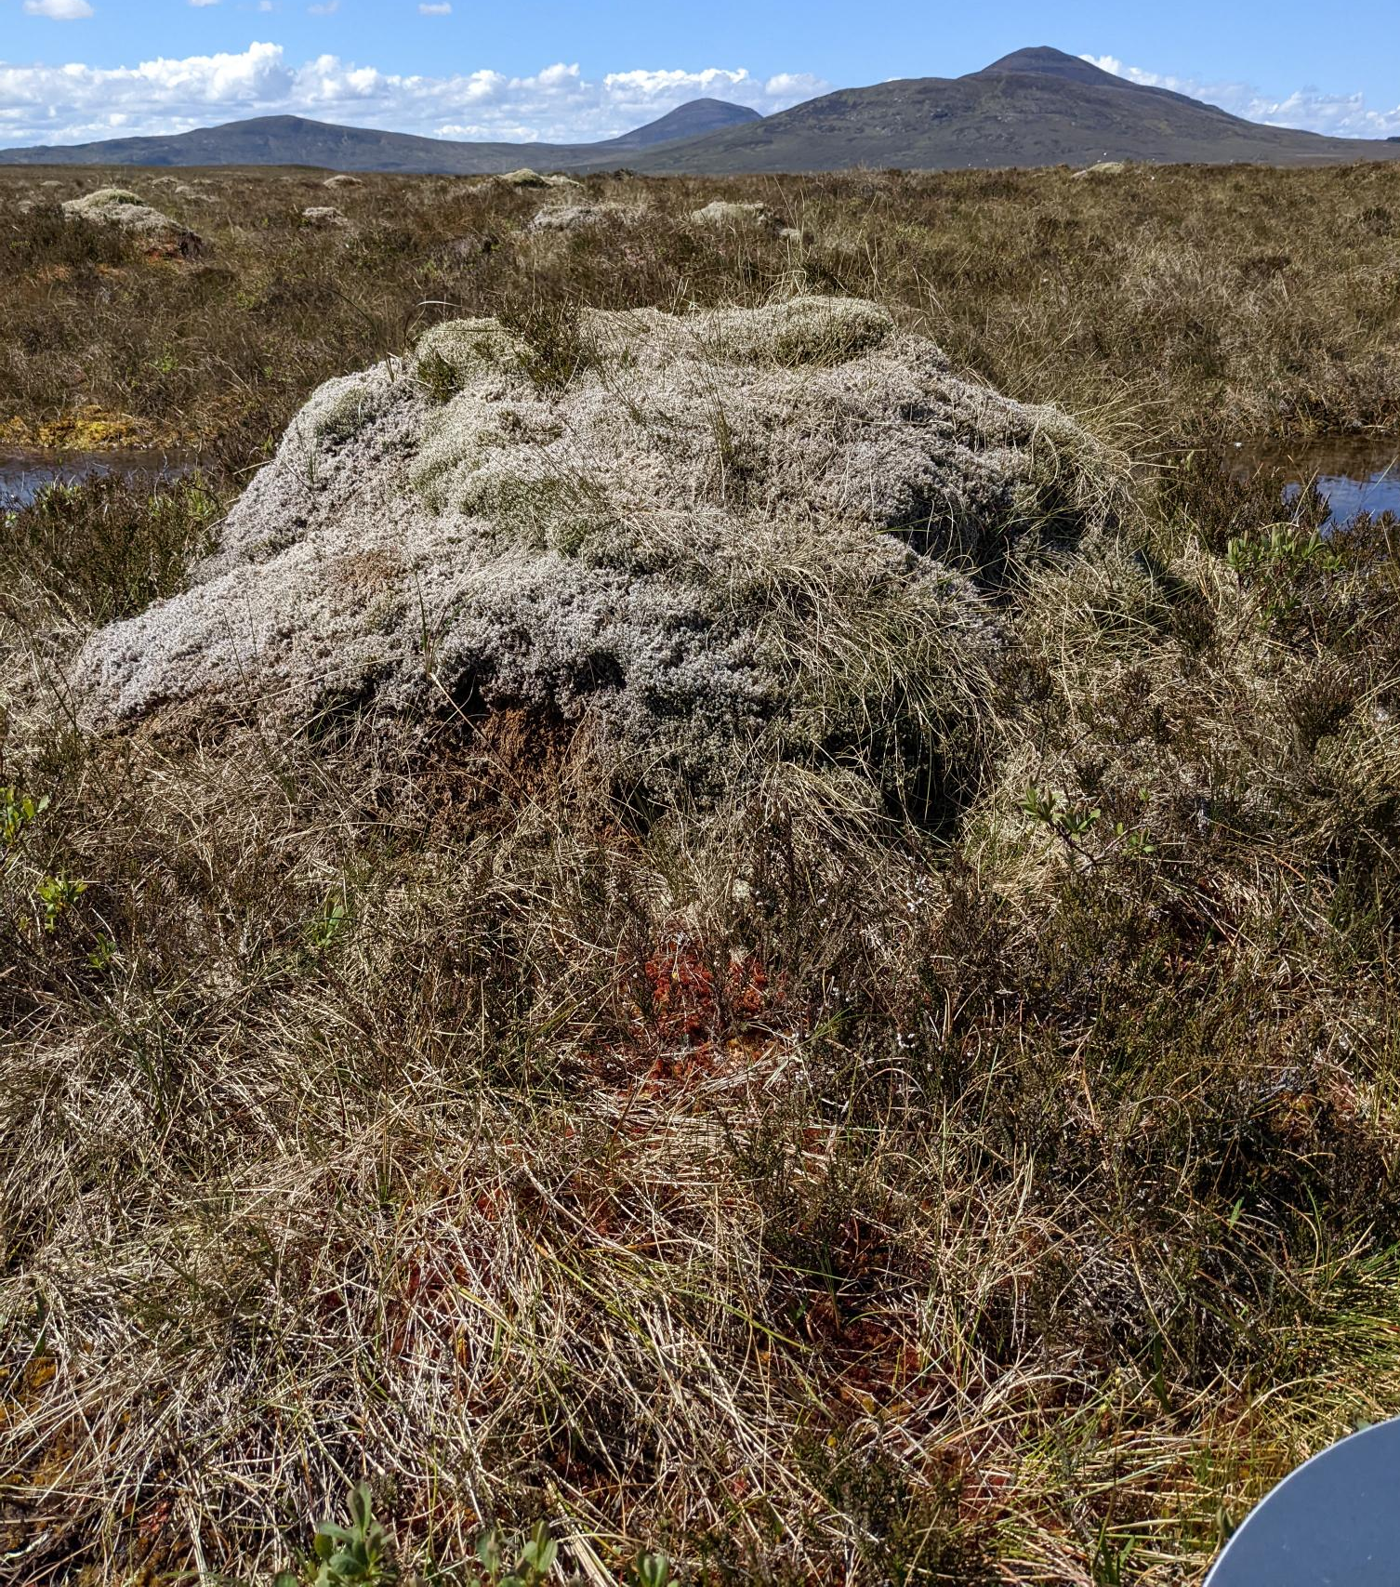
Features of a Healthy Peatland
Hummocks are raised mounded areas of moss and soil.
Hollows are lower areas where water collects.
Peatlands have lots of these next to each other, creating an uneven surface.

Slide 7
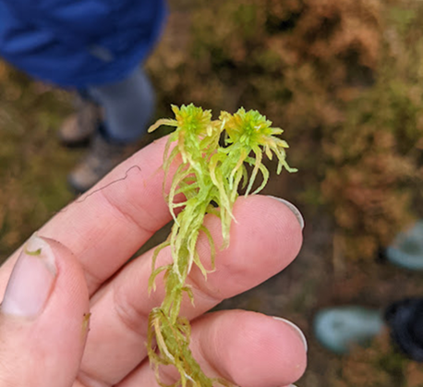
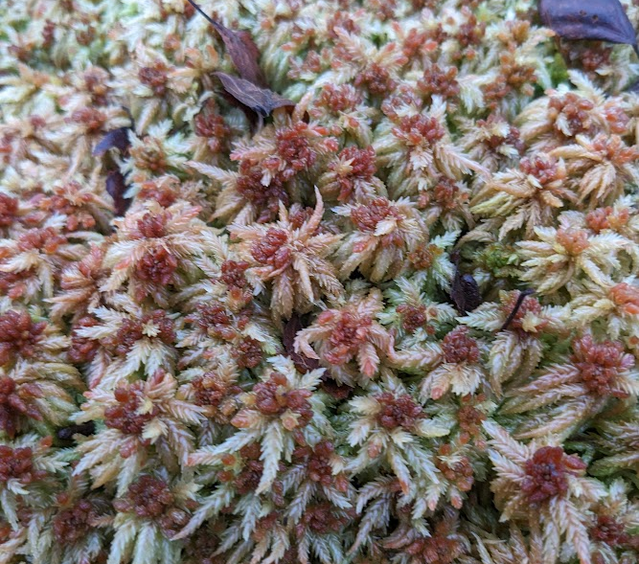
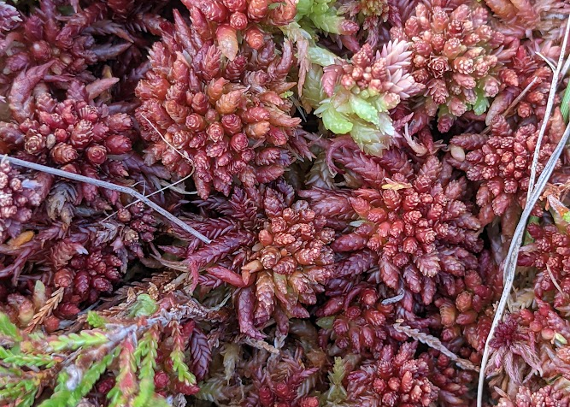
Sphagnum
Peatlands have lots of special species. Here are some of them!
Sphagnum is special a type of moss found in peatlands. It forms peat.
They form multi-coloured carpets and grow without roots, absorbing water and nutrients through their leaves.
Sphagnum is nature's sponge! It can soak up 20 times its weight in water and has even preserved ancient treasures (and people) in peat bogs for thousands of years!

Slide 8
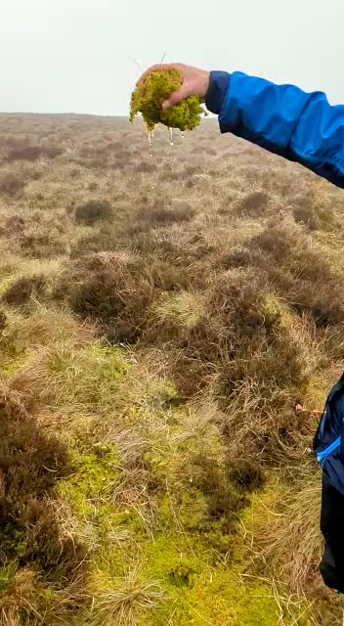
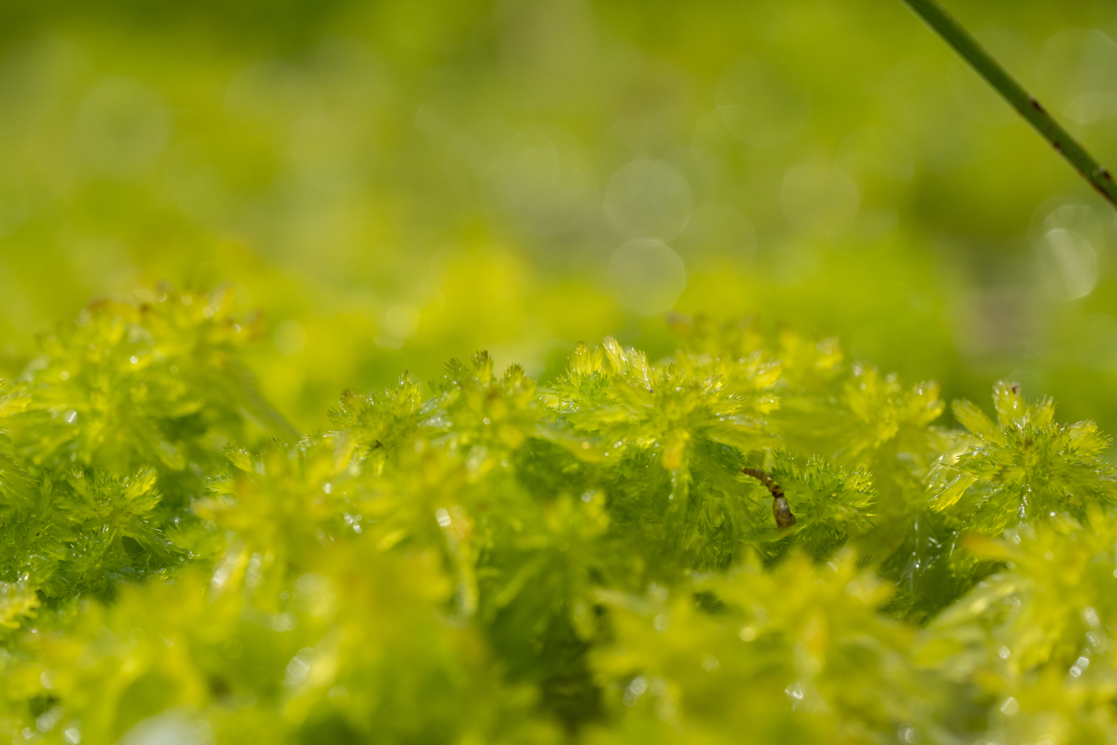
Did you know?
Sphagnum is more liquid than milk!
When dried, it can absorb lots of liquid. It has been used for wounds in wars because of this.

Slide 9
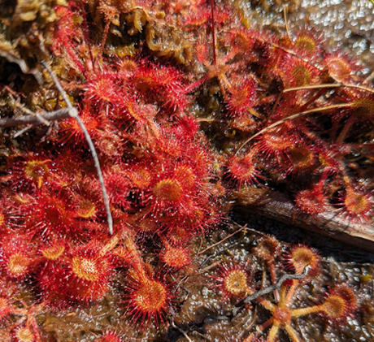
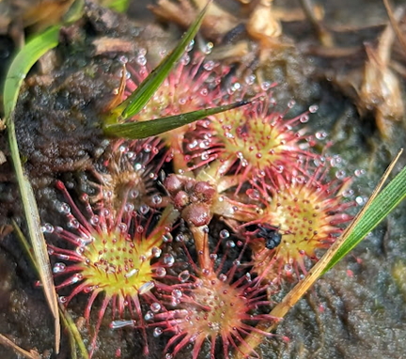
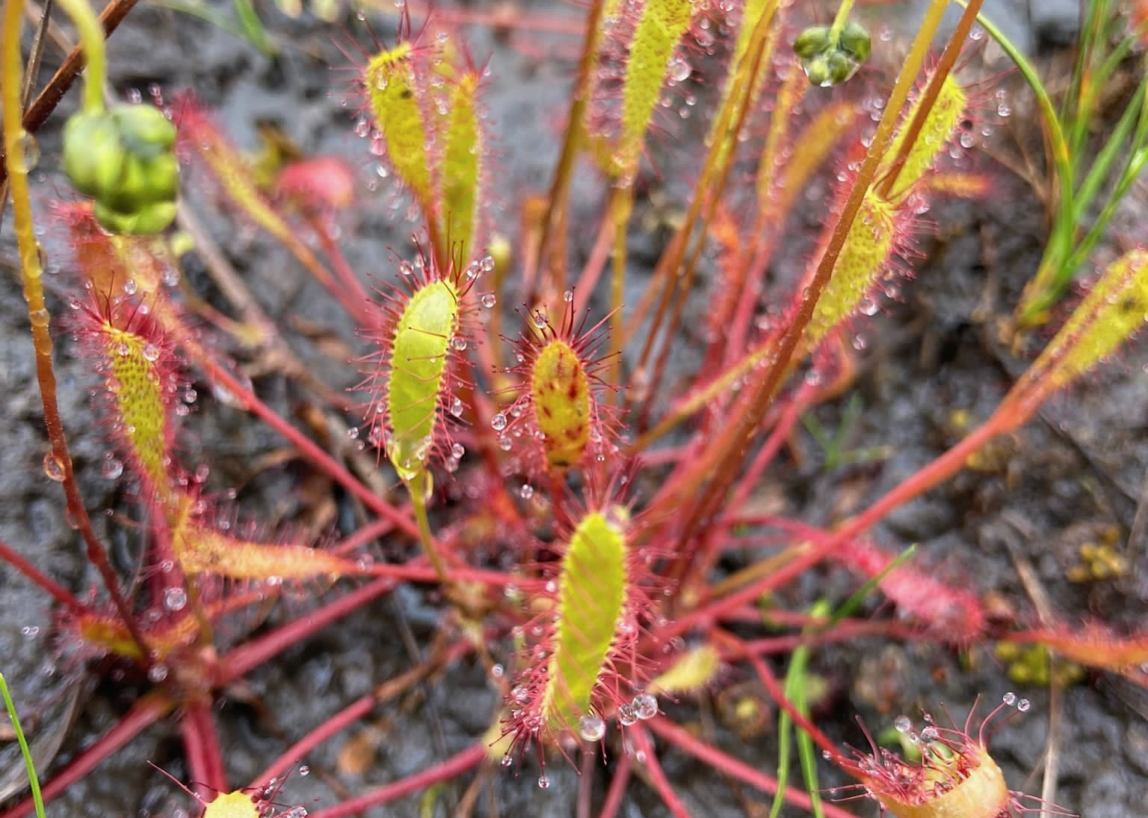
Sundew
The sundew is a beautiful plant found on peatlands
It has red slender stems. The leaves are covered in red hairs and it has white or pink flowers in summer.
Sundews eat insects like a Venus fly trap! Sticky fluid on its leaves traps insects, then the whole leaf wraps around the insects and it eats them.

Slide 10
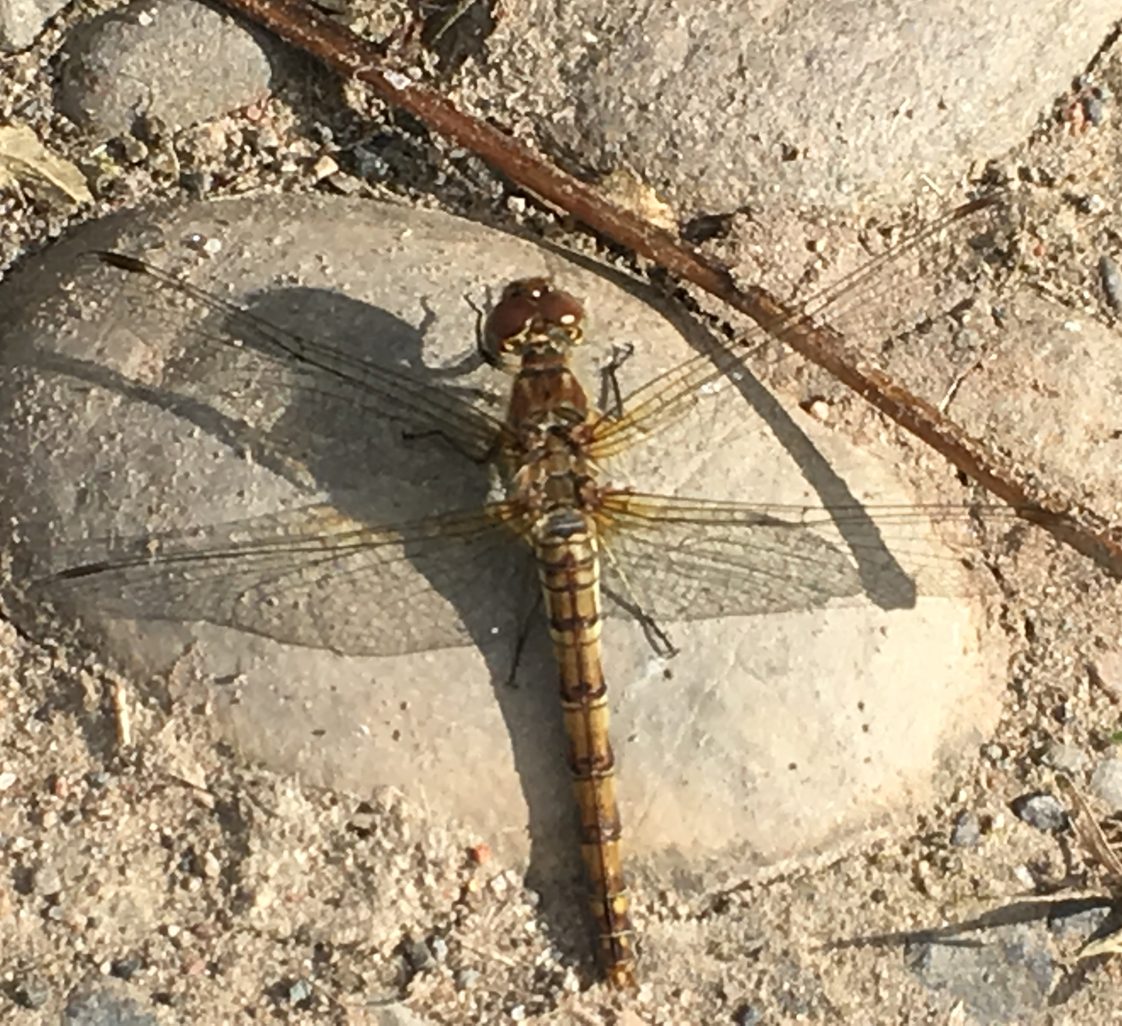
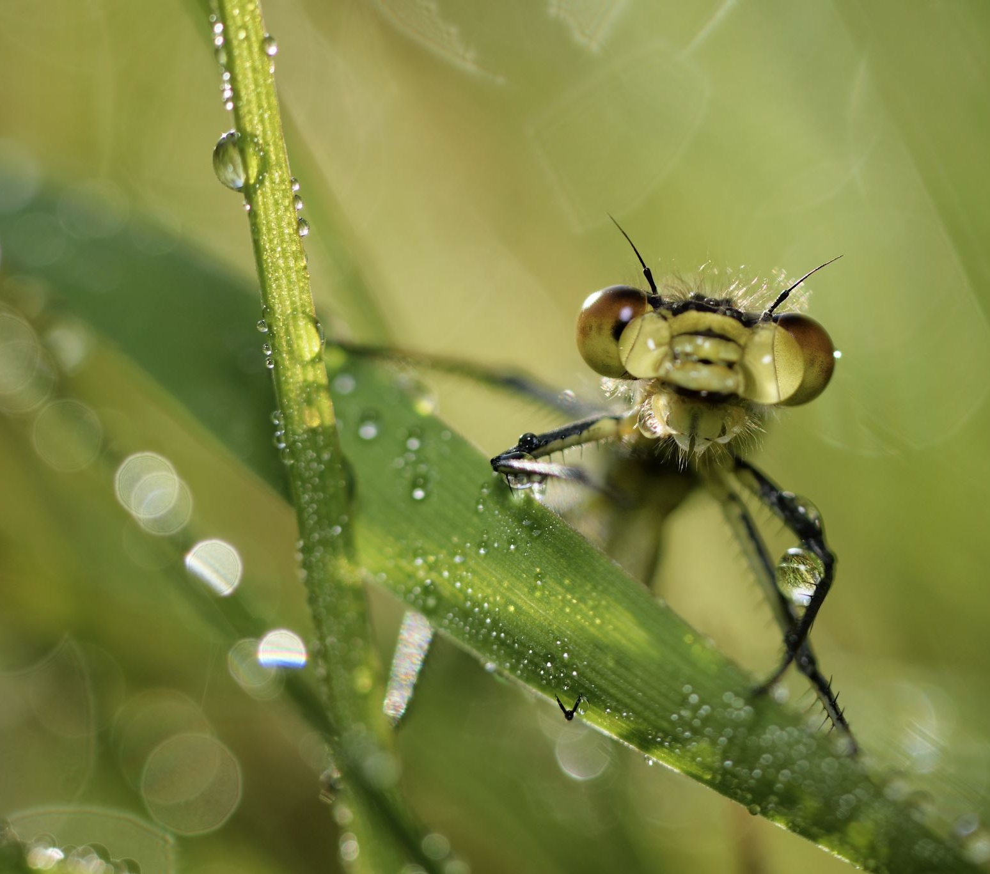
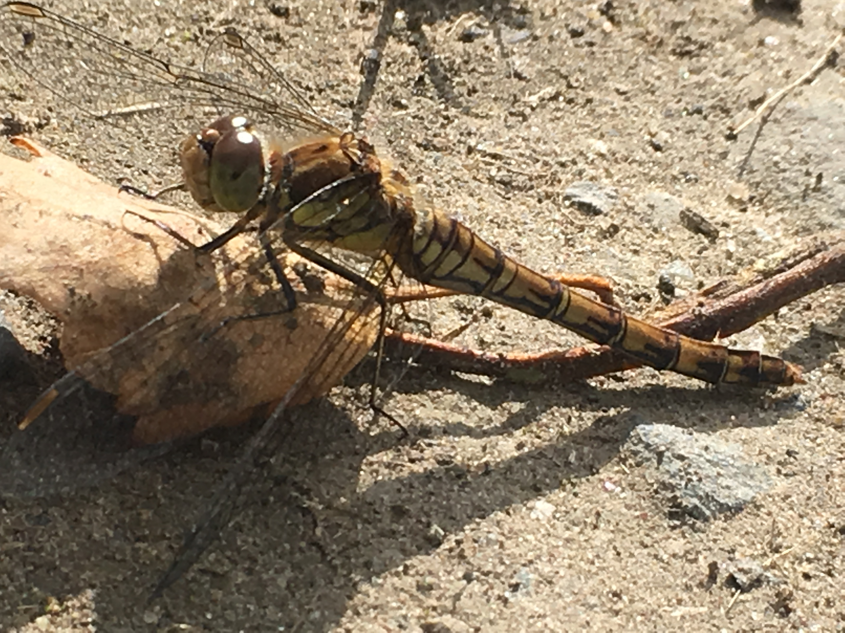
Dragonfly
Dragonflies are colourful insects. They come in green, blue, and red, and have big, bulging eyes.
They start their lives in the water before becoming flying adults.
Dragonflies have been around for over 300 million years—long before the dinosaurs—and ancient species had wingspans up to two feet!

Slide 11
Tick off the features you have on your habitat model:
Species and Features: You must have both features and at least three species in your peatland model. | Group 1 | Group 2 | Group 3 | Group 4
Feature: Pools of open water
Feature: Hummocks (raised mounds of vegetation/soil)
Sphagnum Moss
Sundew
Dragon Fly
Hen Harrier
Adder
Cotton grass
The Golden Plover
Heather

