Slide 1

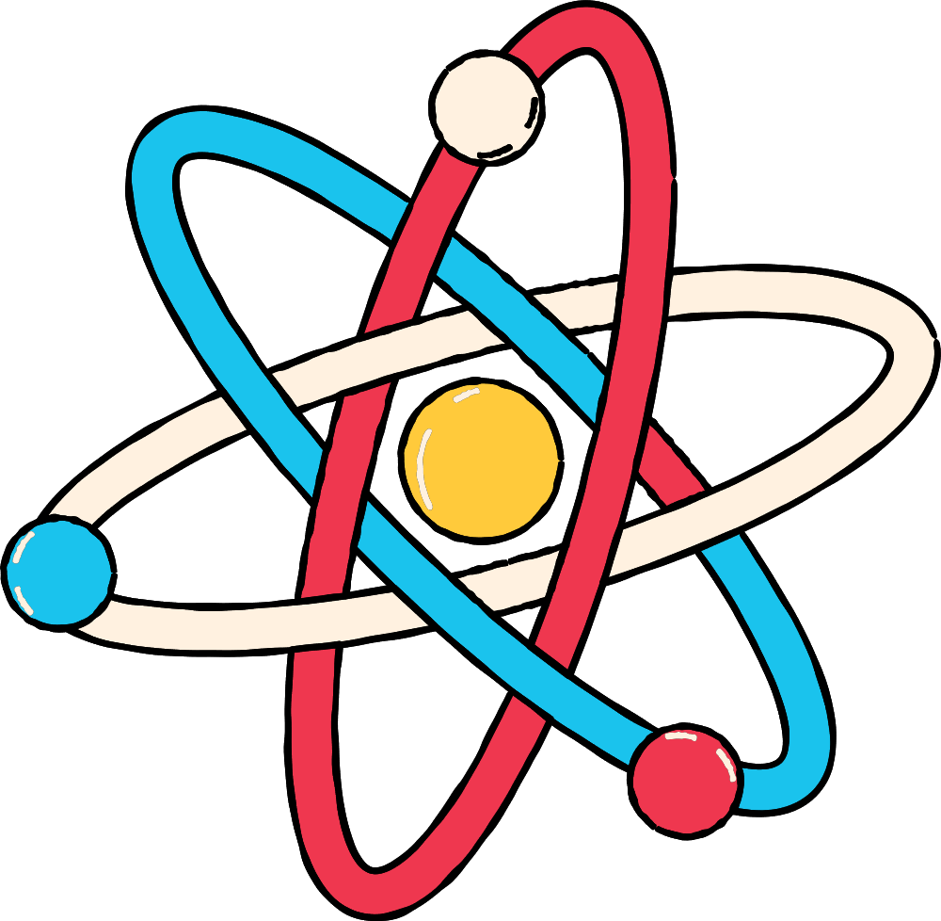


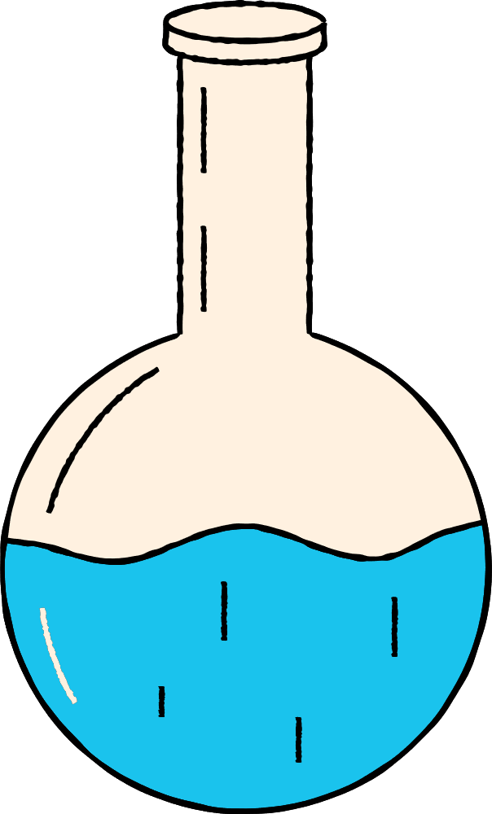

OCEAN
ACIDIFICATION
Let’s do a science experiment!

Slide 2
Step by step...
The background
The experiment
The results

Slide 3




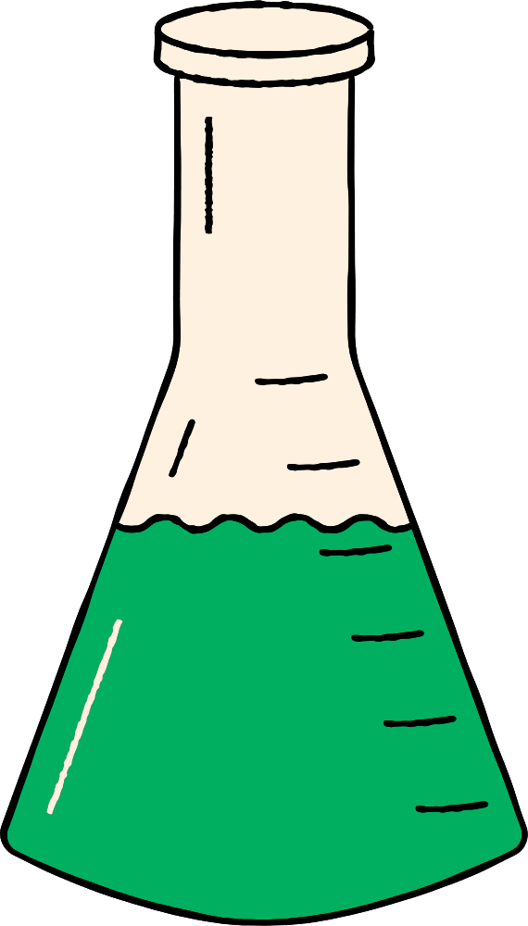

We are learning to carry out a scientific experiment to replicate a real life problem.
We are learning to apply results from a scientific experiment to the real world.
I can make assumptions about what results a scientific experiment will have
I can write down accurate weights including decimal points and the correct unit of measurement
I can discuss how my results relate to the real world

Slide 4
First things first...
What is climate change?
Why is it happening?
What are the consequences?

Slide 5
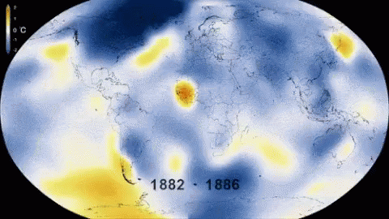
Slide by Shalla Gray

Slide 6
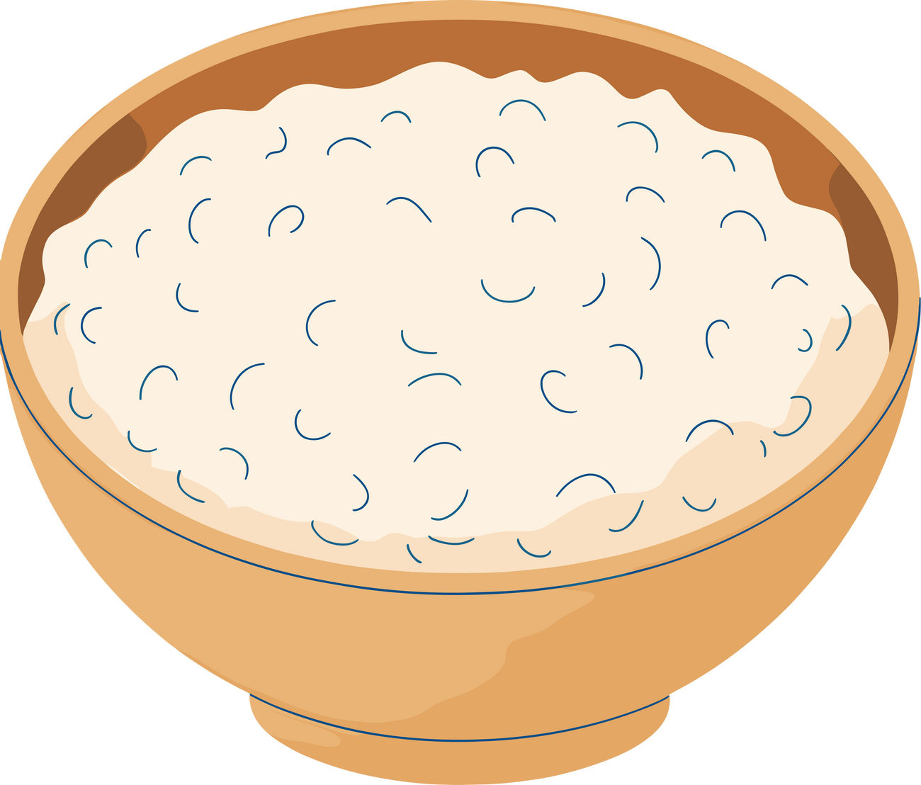


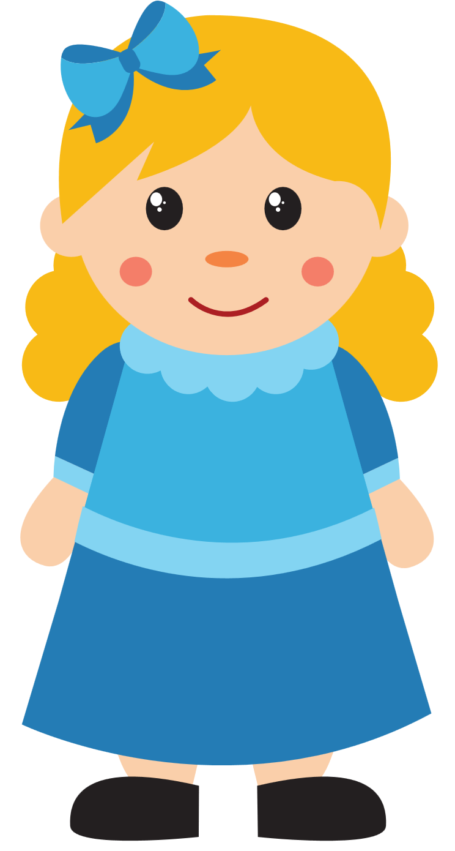
Who knows the story of goldilocks and the three bears?
What happened with the porridge in this story?

Slide 7
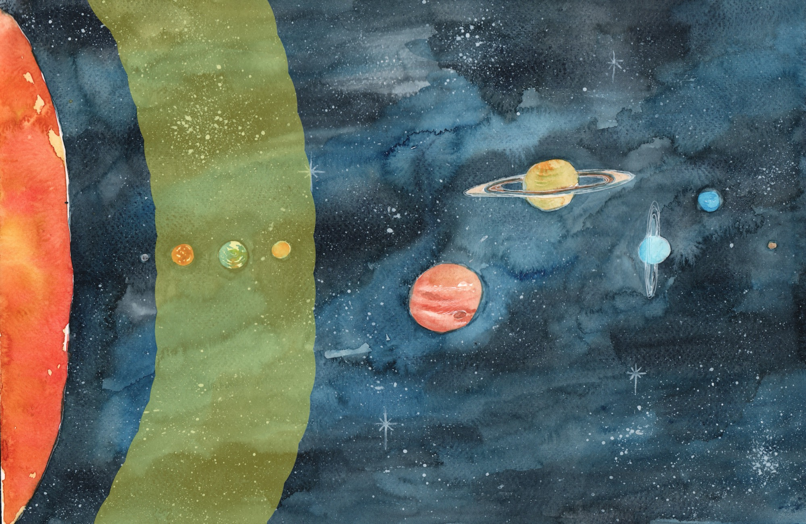
Goldilocks Zone
Slide by Shalla Gray

Slide 8
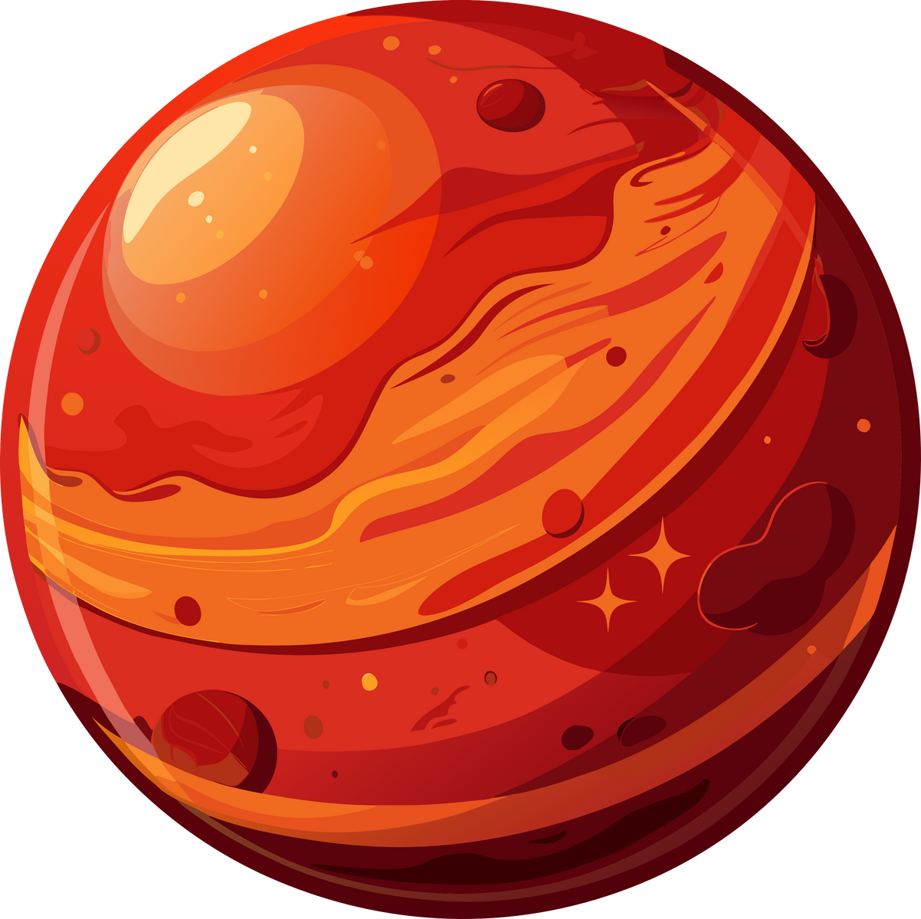

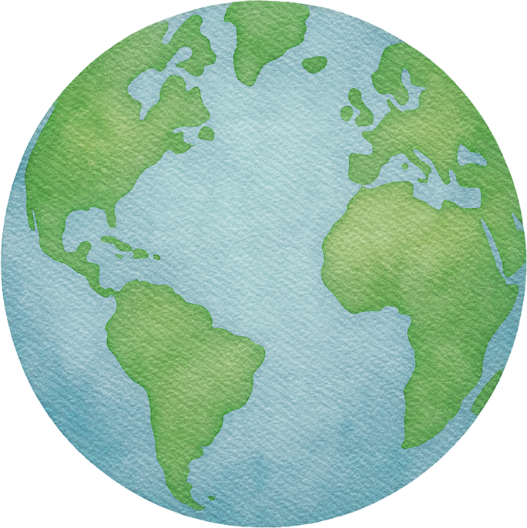
What’s the goldilocks zone and why is it important?
This zone is the space around a star where, if a planet exists there, liquid water can theoretically exist - the temperature is just right (not too hot, not too cold). We think we need that for complex life to evolve.
In the Milky Way, we have three planets in this zone - but only one with life (Earth!). The reason is down to our atmosphere (the air around and above us until space).

Slide 9


Atmospheres...
The atmosphere can change a planet’s temperature a lot!
How cold would Earth be without an atmosphere? Write your answer down on your whiteboard - make sure it is a minus number!
Closest wins...
-18 degrees celsius!
Without an atmosphere, Earth would be too cold for liquid water. This is because the sun’s energy would just be lost to space - let’s see how that works.

Slide 10
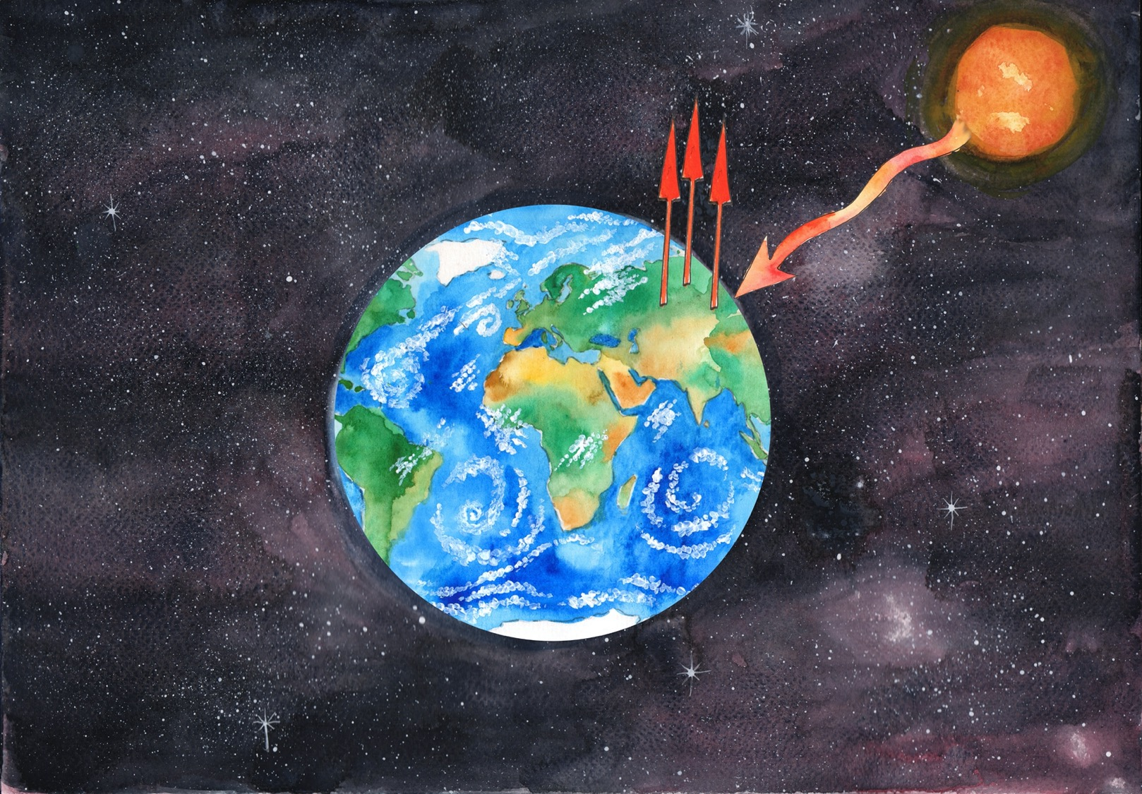
Without an atmosphere, the sun’s heat is lost to space
Slide by Shalla Gray

Slide 11
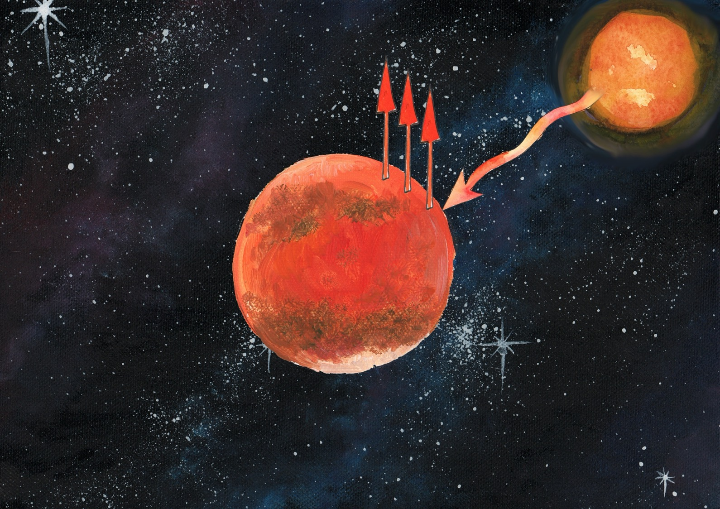
Slide by Shalla Gray

Slide 12

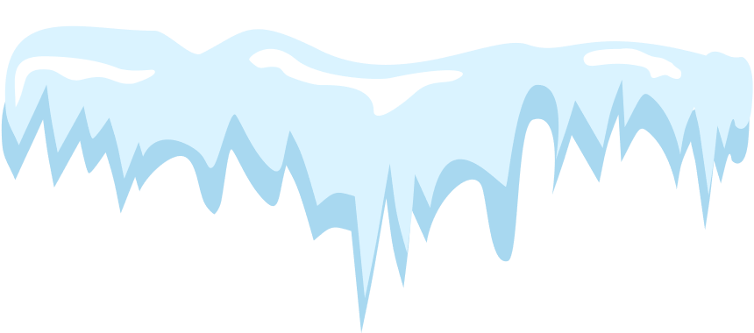


But what about Mars?
Mars is also in our goldilocks zone, but it’s further from the sun than Earth and doesn’t have much of an atmosphere. It is colder than Earth would be - let’s guess again! Closest wins...
The answer is...
-63 degrees celsius!
So we can see that having an atmosphere can change a planet’s temperature quite a lot... But what happens if a planet has too much of an atmosphere?

Slide 13
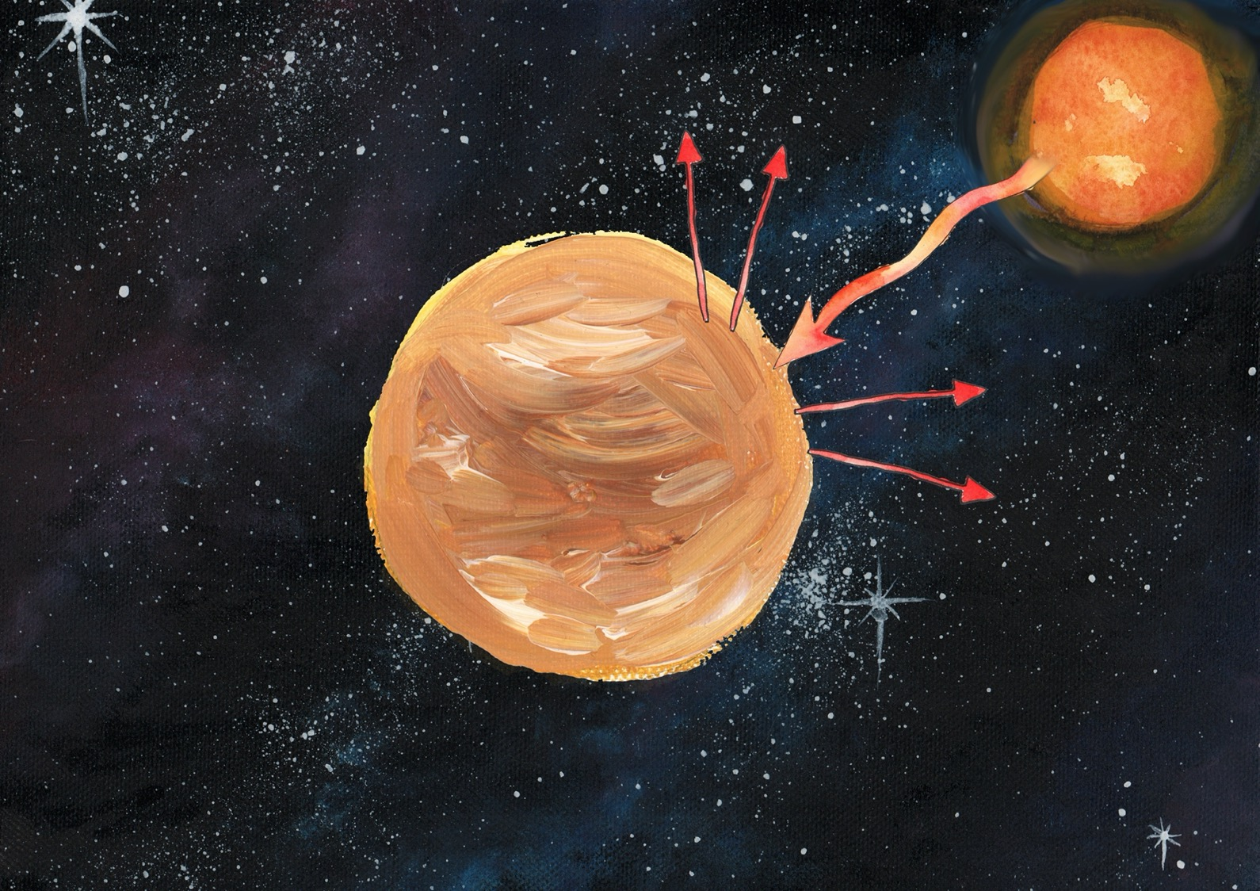
Slide by Shalla Gray

Slide 14

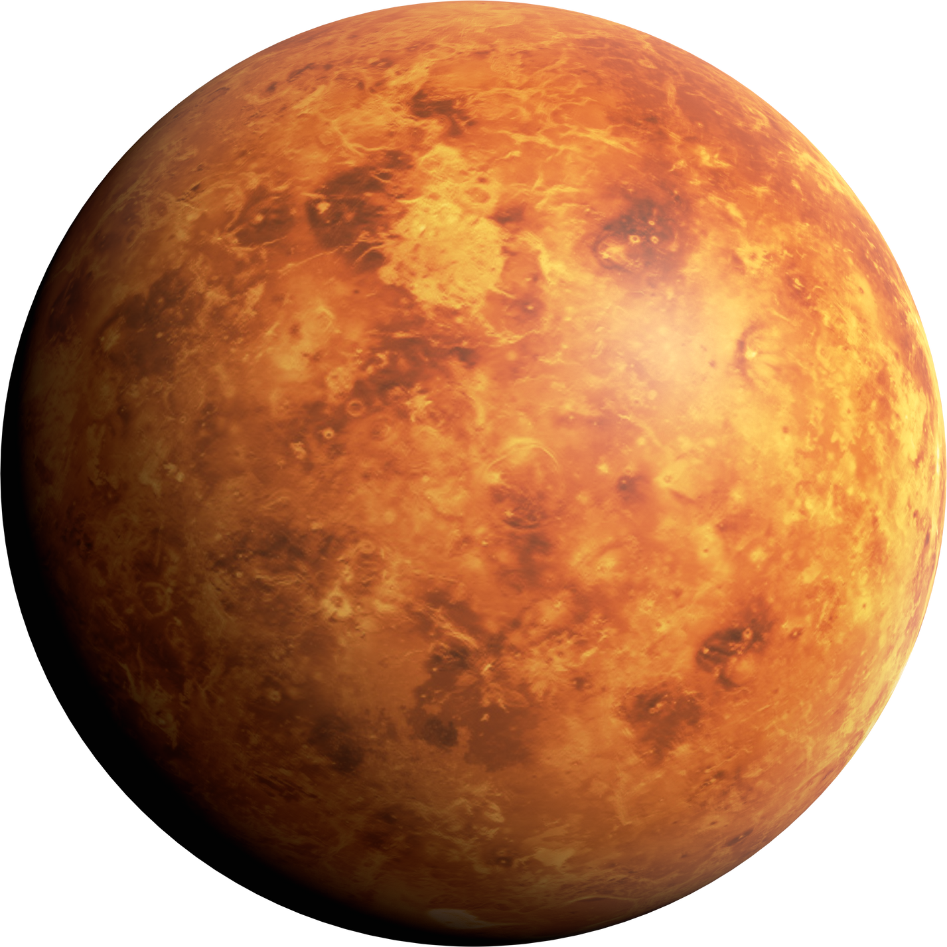

Venus is close to the sun and has a very thick atmosphere. It’s a hot planet! How hot do you think it is, on average?
The answer is...
462 degrees celsius!
Venus is the hottest planet in the solar system, even though Mercury is closer to the sun. That’s the power of the atmosphere!
Venus

Slide 15
What temperature is Earth on average?
Actually, the Earth has since warmed a bit higher than that, and our average is now around 15.3 degrees celsius.
It may not sound like much, but this warming is happening very quickly for the timescale that Earth and its life is used to.
Luckily, Earth has an atmosphere that isn’t too thick and isn’t too thin. It keeps us warm like a blanket - without it, Earth would be -18. How hot is Earth actually?
The answer is...
14 degrees celsius!

Slide 16

Why is the Earth warming?
Our atmosphere is made up of gases, including a group called greenhouse gases.
Who has been inside a polytunnel or a greenhouse? Was it much warmer inside than outside? Yes! Greenhouse gases bounce the sun’s energy around rather than letting it go straight into space. We need some of them, because otherwise we’d be -18 degrees! But now there are too many in our atmosphere, which means the sun’s energy bounces around too many times and sticks around much longer.

Slide 17
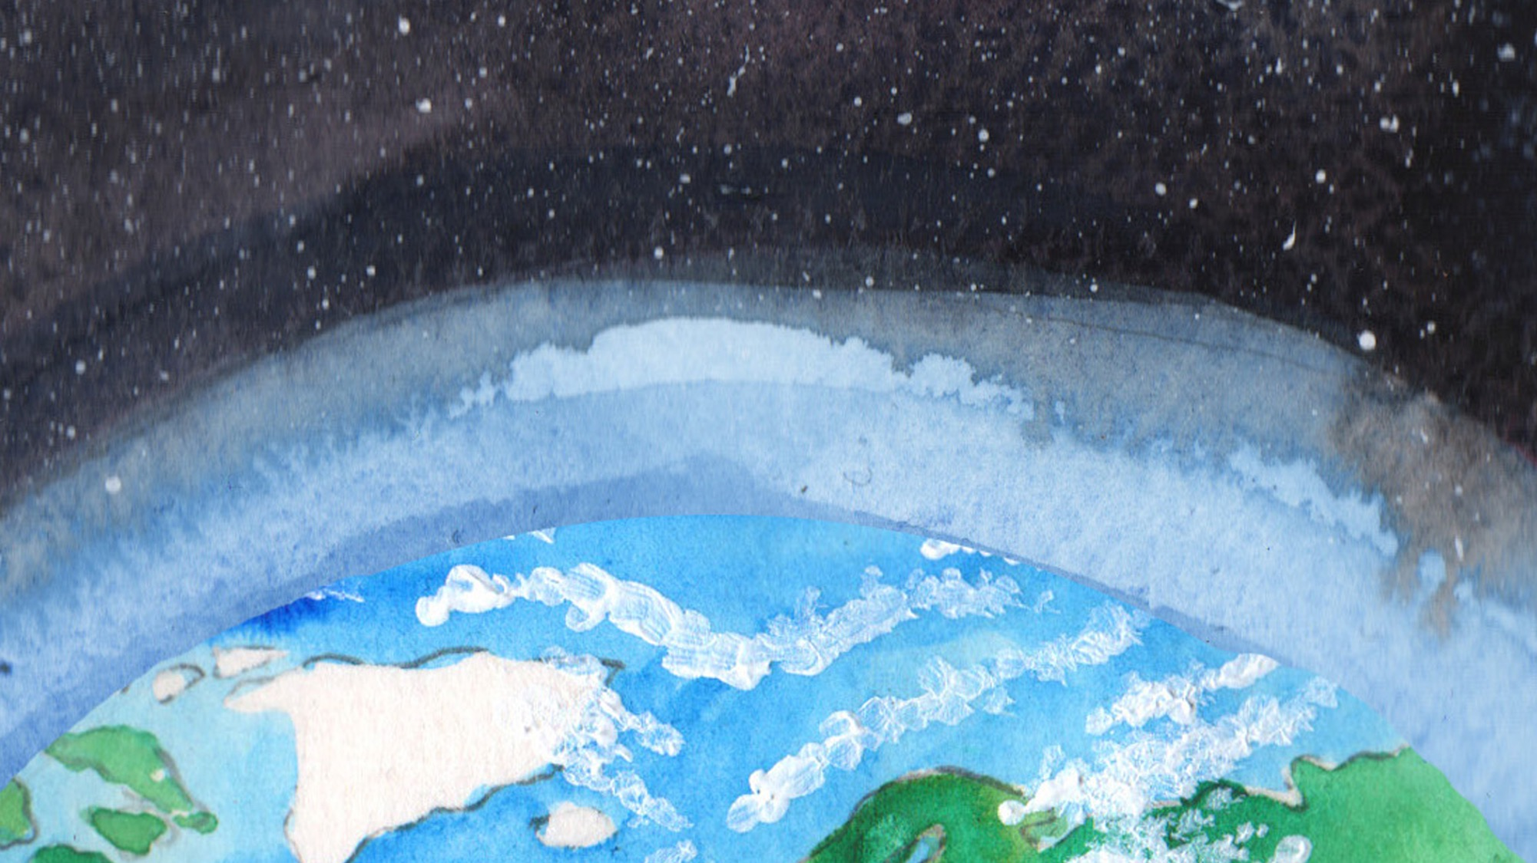
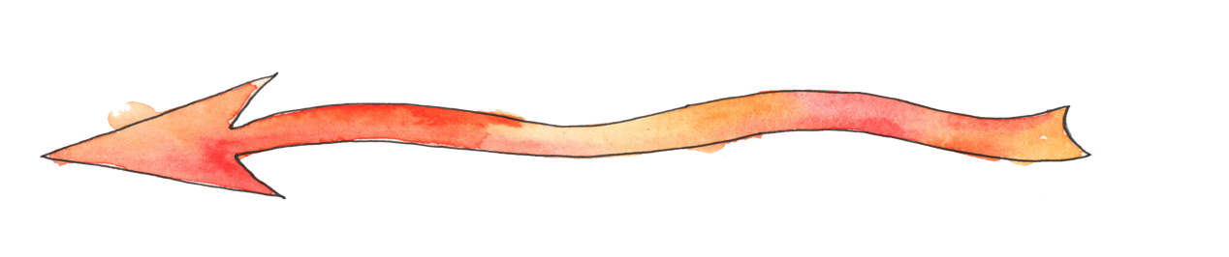
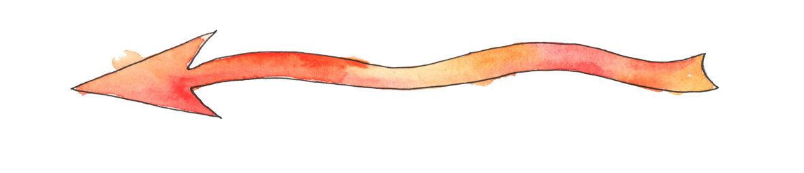
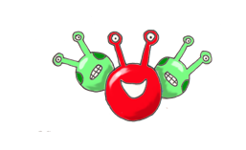
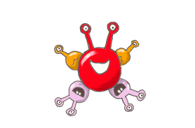
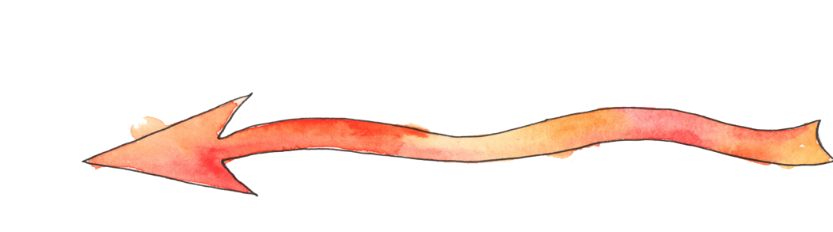
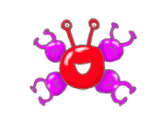

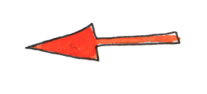
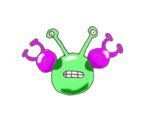
Slide by Shalla Gray

Slide 18

Slide by Shalla Gray

Slide 19
Why are our greenhouse gases increasing?
Gases like carbon dioxide and methane are increasing because of us.
Human actions like burning fossil fuels, damaging our soil with intensive farming, or cutting down trees all cause carbon dioxide to increase in our atmosphere.
A third of this carbon dioxide that we release has been absorbed by our oceans, and we’re going to find out what happens next with today’s experiment.

Slide 20
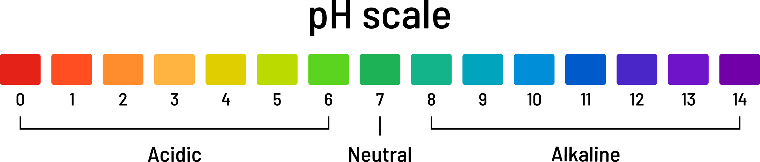
CO2 reacts with water to form a weak acid
Common acids include lemon juice and vinegar.
Common alkalines include toothpaste and soap.
When we want to measure how acidic or alkaline something is we use the pH scale. Special liquids can react with acids/alkalines and turn different colours, which we’ve put into a scale.

Slide 21
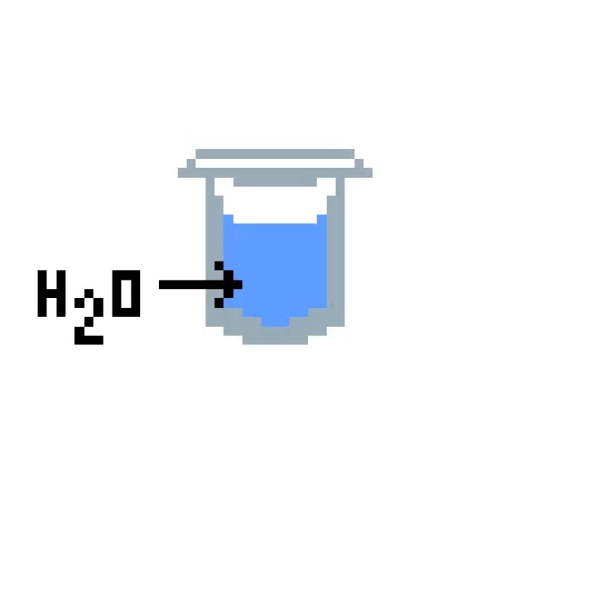

Slide 22

If CO2 is making our oceans more acidic, that means the pH is going further to the left on this scale. What impact would this have on our sea life? Let’s find out.
THE OCEAN
VINEGAR
TAP WATER

Slide 23
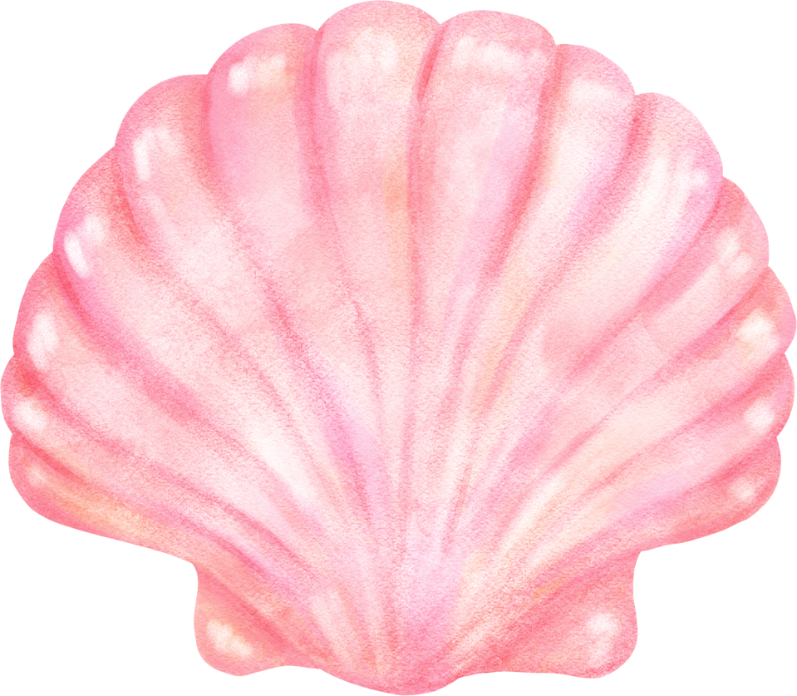
Divide into pairs and split a whiteboard down the middle with a 1 and a 2. Make sure you know which number you are.
Get two beakers/cups/containers and put enough water in number ONE to cover a shell. Do the same with vinegar for number TWO.
DON’T put your shells in yet!
What does acid do to sea shells?

Slide 24
It’s time for our hypothesis...
In science experiments, we always set out to test a theory and say what we think is going to happen.
Time for you to come up with some theories! What do you think acid will do to sea shells? Write your hypotheses on the board.
To make sure our results are clear, we will compare them to shells in water. To prove our theory, something must happen to the shell in the vinegar but NOT in the water.
What does acid do to sea shells?

Slide 25
Next, weigh your seashells. Everyone should have one. Make sure you’re accurate and write down the number exactly, with the decimal point and the unit of measurement (g) included, on the correct side of your whiteboard (pupil 1 writes weight in side 1, and pupil 2 writes in side 2).
Then write down any observations which will help you see if your theories are correct or not. For example, you might need to write down the colour of your shell if you think that will change.
Once everyone has weighed their shells, start a timer for 15-20 minutes and put your shells in together.
What does acid do to sea shells?

Slide 26
How many actions can you think of that people can take to help tackle climate change or help the environment?
While we wait, let’s brainstorm...

Slide 27

Wear second-hand clothes from older siblings/cousins/friends
Turn off the lights and electronics when I don’t need them on
Put on a jumper instead of turning the heating up
Turn off the tap when I brush my teeth
Try to repair things that are broken rather than throw them away - clothes, toys
Encourage wildlife to use my garden
Cycle or walk rather than drive
Tell people about climate change and environmental issues like litter
Eat vegetables
Pick up litter
Put ten fingers up, and put one down for each action you take...

Slide 28
Can we pledge to take an action for our world?
Either individually or as a class, pledge an action you can start doing that will help the environment. It could be one of the actions on the last slide, or...
... your class could try to increase the biodiversity of the school grounds, ask parents/adults to turn their car off when waiting for you afterschool, run an awareness campaign encouraging people to cycle to school, or do a class litter pick.

Slide 29
Scotland has reduced our yearly climate impact* by 51%...
And the government has pledged to reduce them by 100% by 2045!
This will include individual actions to reduce our own impact - by buying and using less, repairing more, reusing what we can, and recycling what we can’t.
Everything around us is made from precious resources and energy - we can’t live as wastefully as we do now. We need to treat what we have as precious as it is!
Did you know?
*Carbon emissions

Slide 30
Time to finish our experiment!
Can we prove any theories yet?
After discussing this, table by table, take your beakers to the sink and pour out the liquid, making sure not to confuse your shells or let them go down the sink!
Dry off your shells - but remember what we said about precious resources! Don’t use more paper towels than you need, and share if you can.
Weigh your shells again.

Slide 31
Time to finish our experiment!
Hands up who was number 1...
... keep your hand up if your shell seemed to gain weight?
Hands up who was number 2...
... keep your hand up if your shell seemed to lose weight?

Slide 32
Number 1 (water)
Can anyone think of a reason why the shell in our water gained weight?
To find out, weigh an empty beaker. Then, fill it with water and tip the water out. Weigh it again... It’ll be higher!
Water has a weight - and unless you were very good at drying your seashell, even a small amount of water will affect the final results.

Slide 33
Number 2 (vinegar)
If one of your theories was that the vinegar would disintegrate, break down, or erode the seashell, you were right!
Let’s take a closer look...
This extra weight would also be seen on number 2, but the amount of shell eroded by the vinegar was much more than any leftover vinegar would weigh.

Slide 34
Acid reacts with our seashell...
Acid (H+) + seashell (CaCO3) = CO2 + H20 + Ca2+
Remember, adding carbon dioxide to our water causes acid to form.
And we can see now that acid breaks down our seashell - making it lose weight.
This is what we mean by Ocean Acidification, and why it is a problem.

Slide 35
Our ocean is at a higher pH than tap water - it’s slightly alkaline, which is the opposite of acidic.
However, it is becoming more acidic over time. Although it isn’t anywhere near vinegar, it still means our shelled life spends more energy making and repairing their shells. This means they have to eat more, if they can - and they can’t always.
This experiment was a simplified and fast way of seeing results.
But wait... our ocean isn’t vinegar!

Slide 36
We are learning to carry out a scientific experiment to replicate a real life problem.
We are learning to apply results from a scientific experiment to the real world.
I can make assumptions about what results a scientific experiment will have
I can write down accurate weights including decimal points and the correct unit of measurement
I can discuss how my results relate to the real world
Did you achieve all the success criteria?

