Slide 1





META SKILLS
Let’s GO!

Slide 2



INTRODUCTION
Meta skills are:
•Skills that everyone has to some level
•Skills that can be learnt in one place and applied in others
•Skills that help us in our lives, friendships, and future jobs

Slide 3


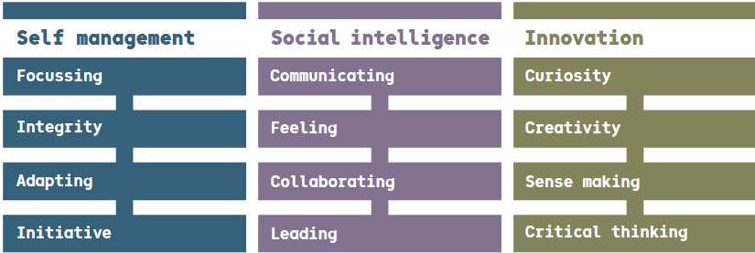

THERE ARE 12 MAIN META SKILLS

Slide 4


FILL IN THE BLANKS
Let’s define the meta skills together.
F
I can focus on my task and avoid .
Focussing
I
I am reliable, , and fair. I follow the rules of .
Integrity
A
I am_______________ and can deal with the __________________.
Adapting
I
I can for myself. If I see something that needs to be done, I do it.
Initiative
Trustworthy Think Distractions Games Unexpected Flexible

Slide 5
FILL IN THE BLANKS
Let’s define the meta skills together.
C
I can listen, talk, , and ask .
Communicating
F
I feel for others and can recognise my own feelings.
Feeling
C
I can work in a team by sharing work______________and taking turns.
Collaborating
L
I can others to play games or work on tasks.
Leading
Organise Explain Fairly Empathy Questions

Slide 6
FILL IN THE BLANKS
Let’s define the meta skills together.
C
I have a desire to and find answers.
Curiosity
C
I can think of new ways to solve and use my .
Creativity
S
I can make sense of ________________ and solve __________________.
Sense Making
C
I can form after thinking about and evaluating information
Critical Thinking
Imagination Information Opinions Learn Problems

Slide 7

LET’S DIVE DEEPER!
COMMUNICATION 1
COMMUNICATION 2
Finger Maze!
Using things from your pencil cases, make a small maze for a partner on your table while their eyes are closed! Then instruct their fingers to walk through it without hitting the obstacles.
Telephone!
Can this whispered phrase reach the end of the class unchanged?

Slide 8


CREATIVITY
Let’s see how good we are at thinking outside the box with this shape challenge.

Slide 9
ADAPTING
Can we solve this Wordle game by adapting to new information as we go?
https://www.nytimes.com/games/wordle/index.html

Slide 10



https://connectionsgame.org/game/?MWD87V
SENSE-MAKING
https://connectionsgame.org/game/?MWD87V
https://connectionsgame.org/game/?F1X573
https://connectionsgame.org/game/?3PUWZ4
Easy
to
Hard
Load up the first game on your device
Try the second, harder game!
Try making your own!
Select 4 things which look to be in the same category as each other
This one will require a bit more thought - it could be tricky but with trial and error you can do it!
If we have time, you can make your own game with 4 lots of 4 categories - make sure they don’t overlap. Then send it to a friend to try.

Slide 11
WHICH 3 DO YOU THINK YOU’RE BEST AT?

Slide 12
FINAL CHALLENGE!
Can you choose one meta-skill and explain why it’s important in life?
Creativity | Collaboration | Sense Making | Communication | Feeling | Leading | Adapting

Slide 13
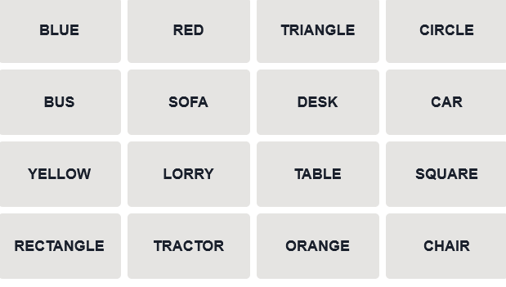

Slide 14
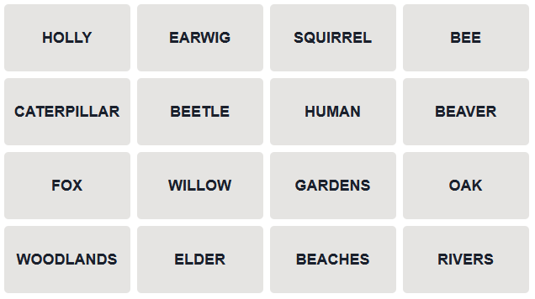

Slide 15
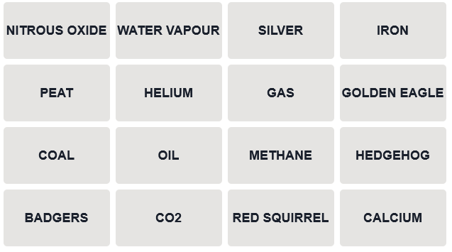

Slide 16





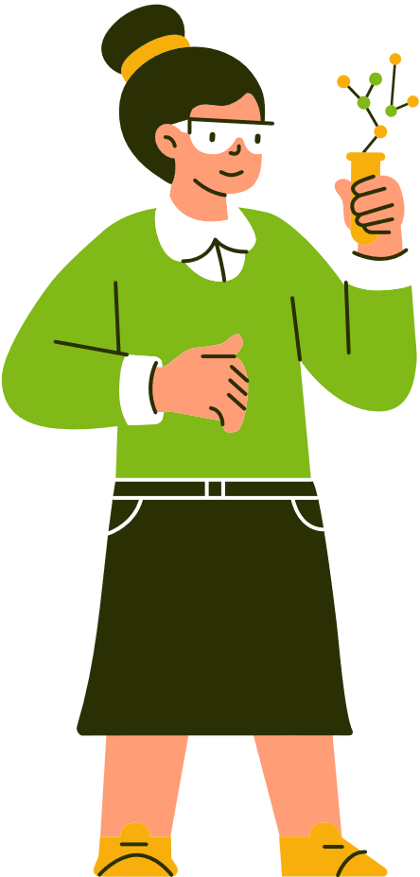






Looking at Careers in
water

Slide 17



Learning Points
1
2
3
You will do a personality quiz to see what job might suit you, and create a job profile
We’ll learn about careers in the aquatic sector
We will think about meta-skills involved and also look at new technologies being used

Slide 18
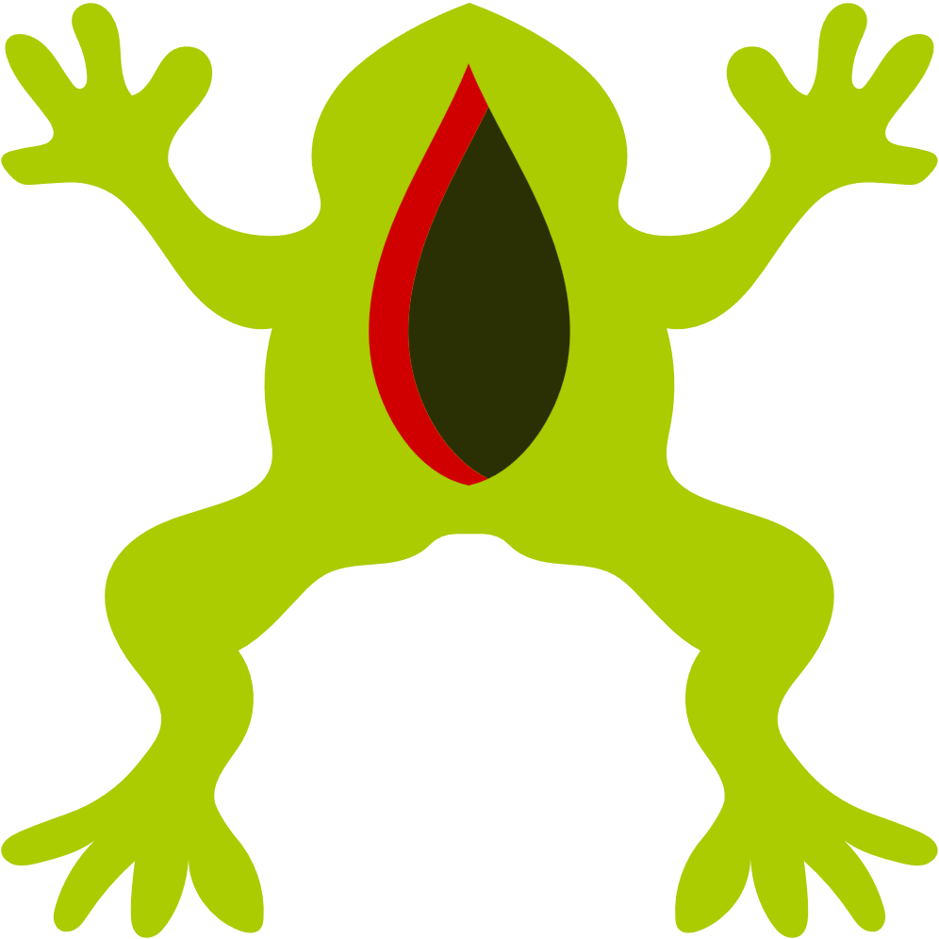


Why Water?
Water is necessary to every living thing, and we need to make sure that the water around us is not too little and not too much - think about droughts or floods! We need to make sure it’s clean, it can support lots of life like fish and dolphins, and we need to understand the ecosystems that live within water environments. We need to know how climate change will impact our water in all the ways we mentioned above.

Slide 19
Why Water?
Marine biodiversity encompasses everything from the smallest plankton to the largest whales, supporting ecosystems and economic resources that humans rely on for food, medicine, and oxygen production. Human impacts have caused disruption and extinctions to this life - we need to know how to protect rather than harm marine wildlife.

Slide 20

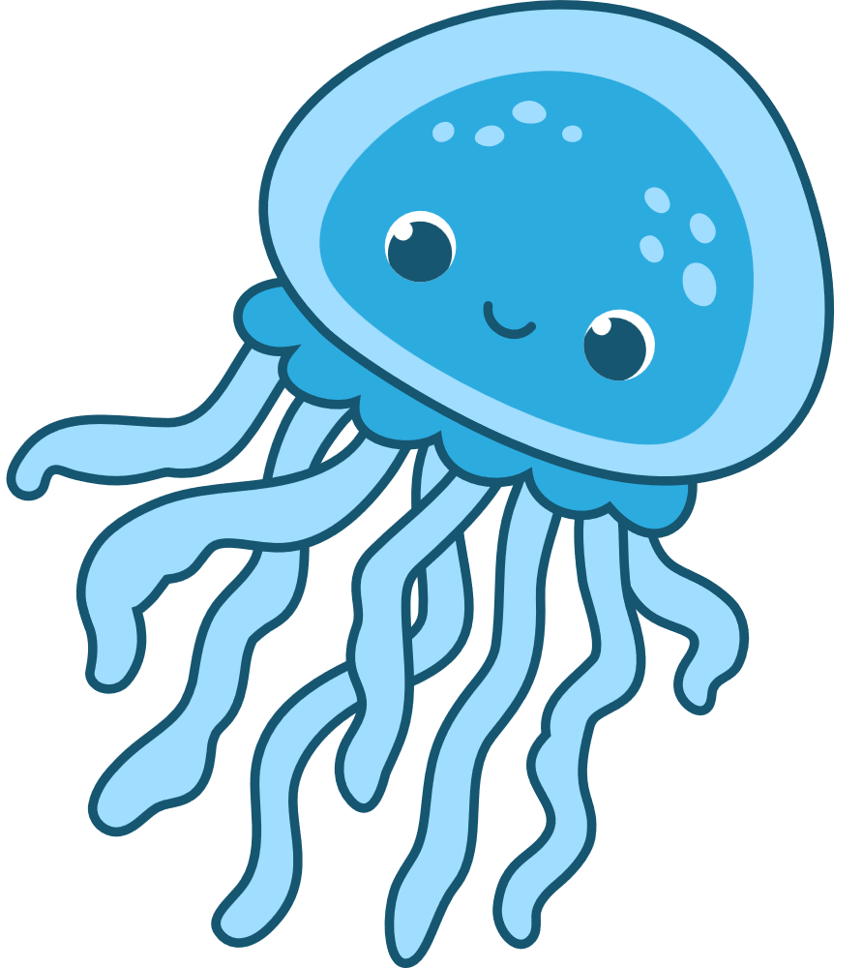


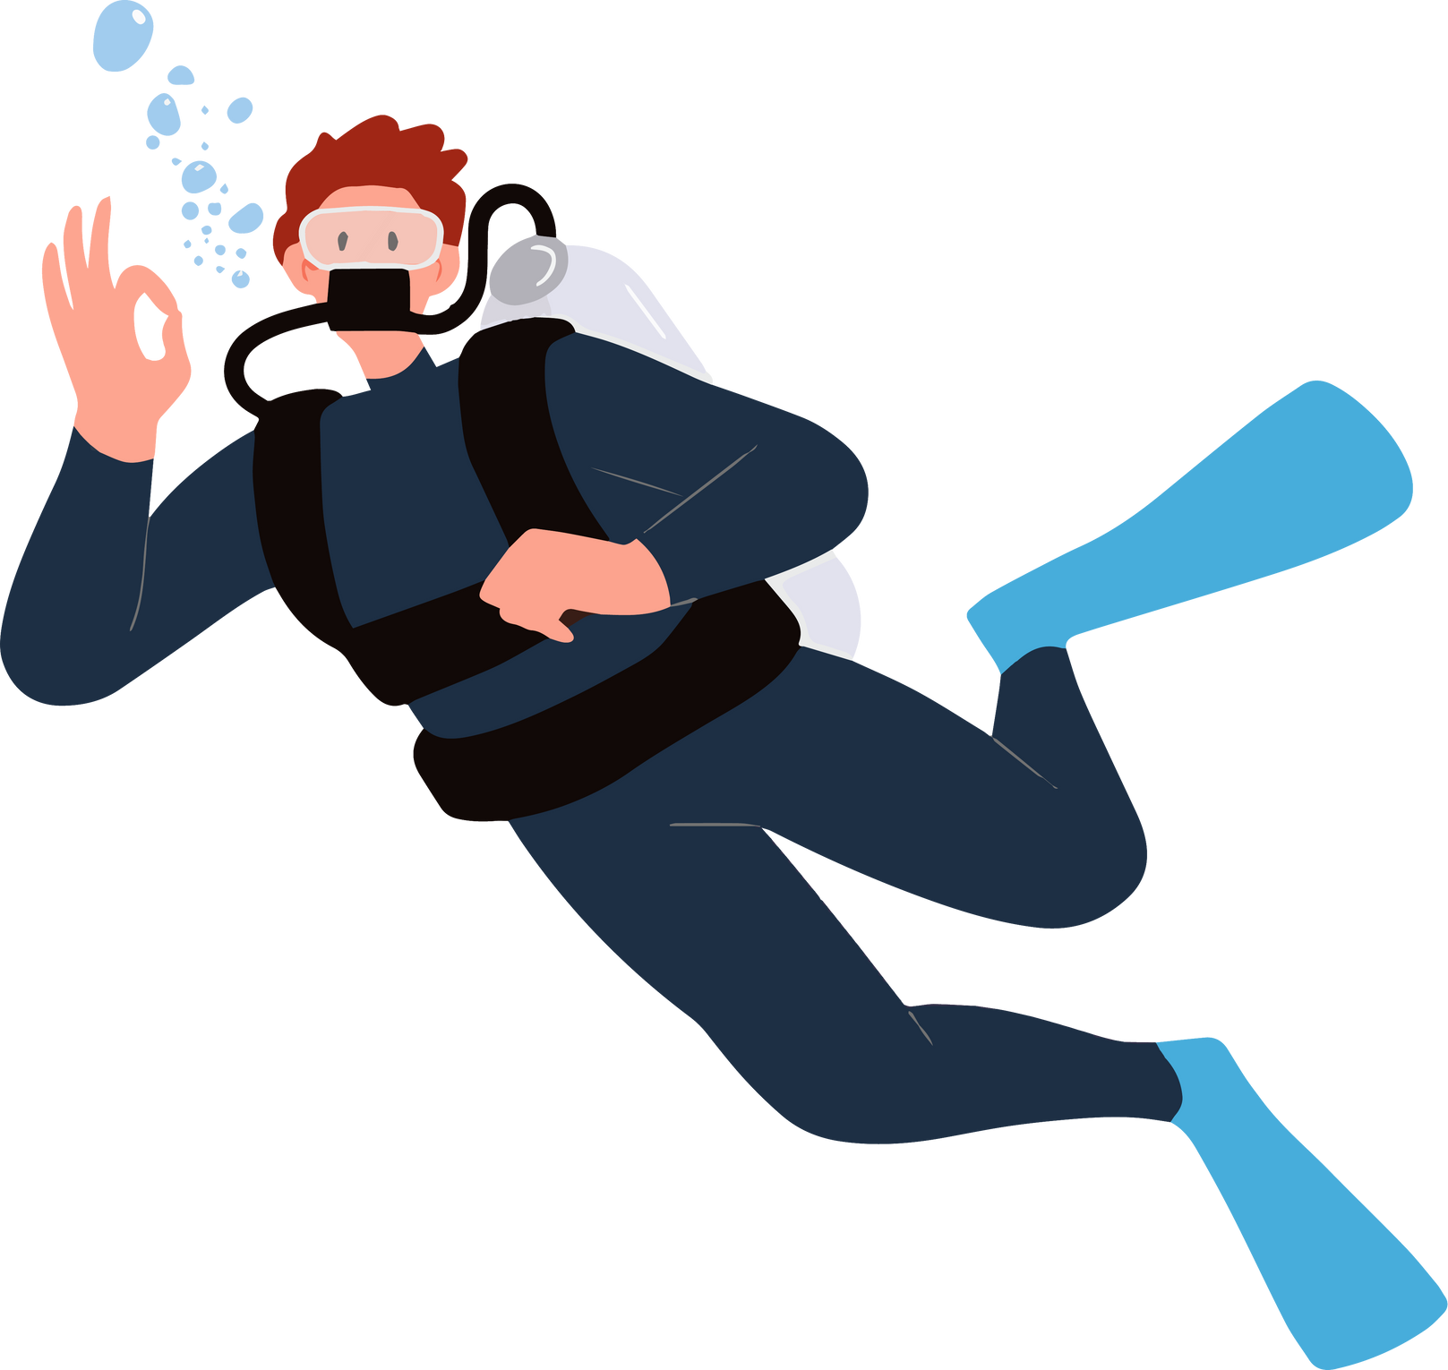
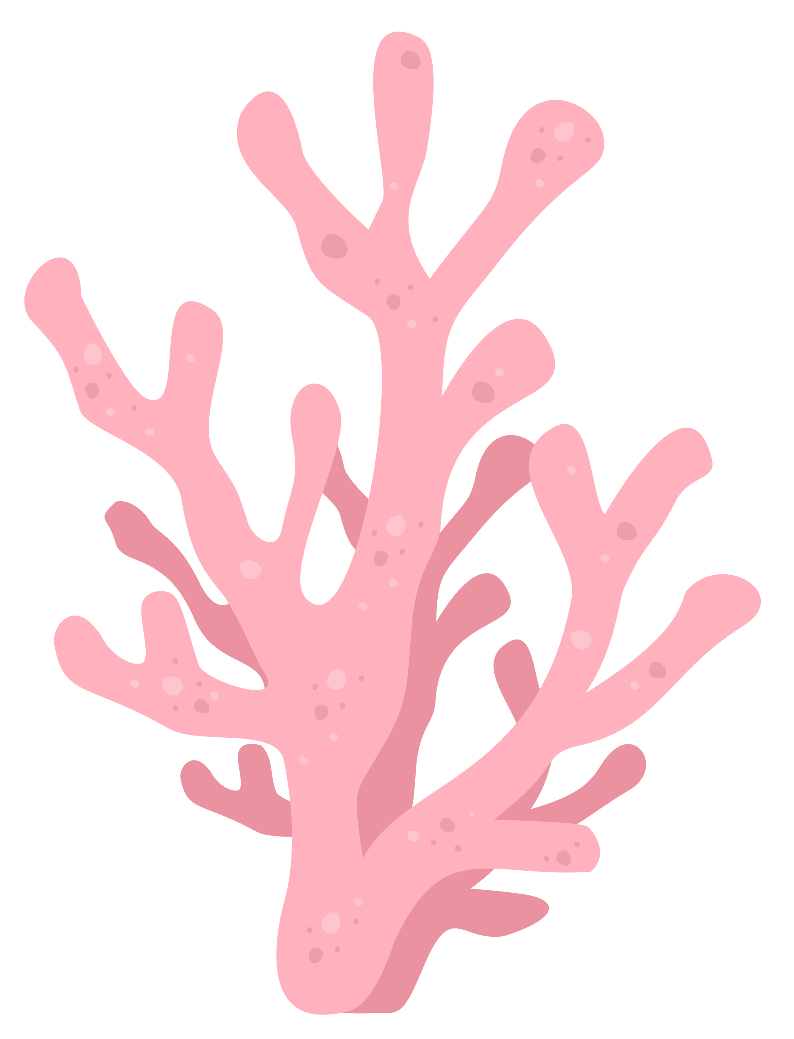

Areas of Work
Working with water is more than whales and SCUBA diving! What other jobs or hobbies rely on water? Let’s brainstorm!

Slide 21
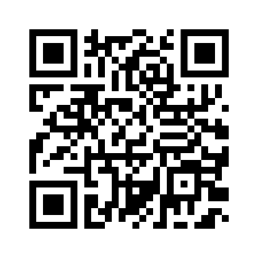
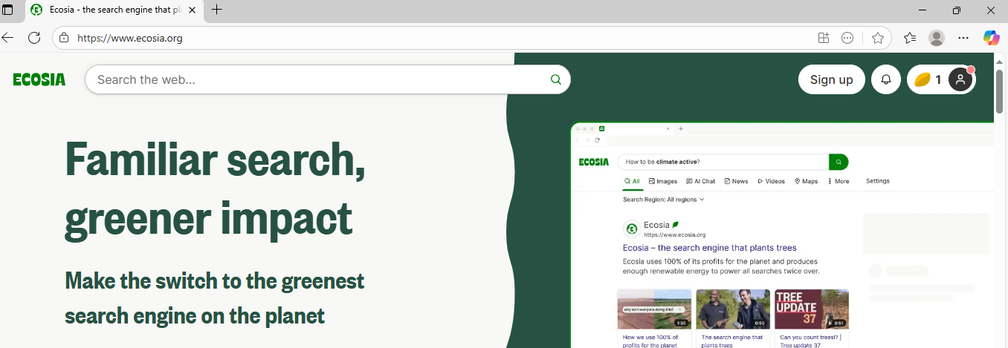
Quiz Time!
https://m3ybf0ex.forms.app/personality-quiz
Type this web address into the TOP SEARCH BAR. You’ll find it at the very top of the screen, no matter what.

Slide 22


Career Examples
River Health Officer
Beach School Leader
Tidal Power Engineer
Marine Biologist
Power Boat Ecotour Driver
Environmental Artist
SCUBA Diver Instructor
Lab Technician
Nature Education Officer
ROV Driver
Hydrologist

Slide 23

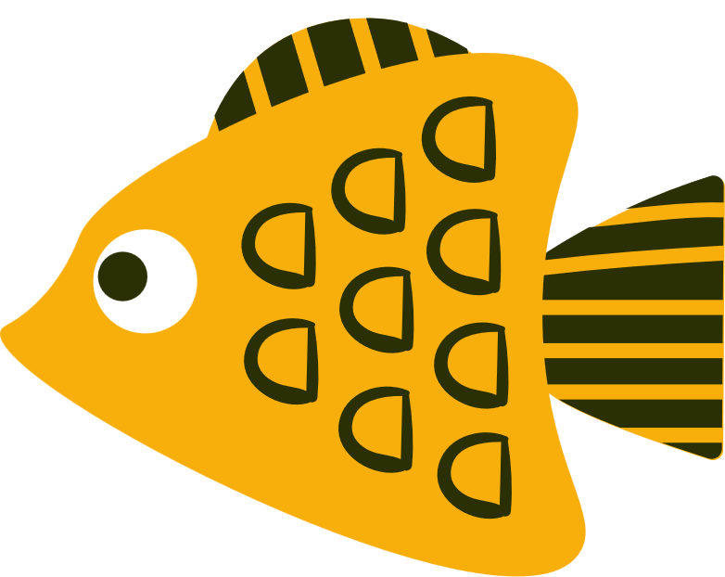
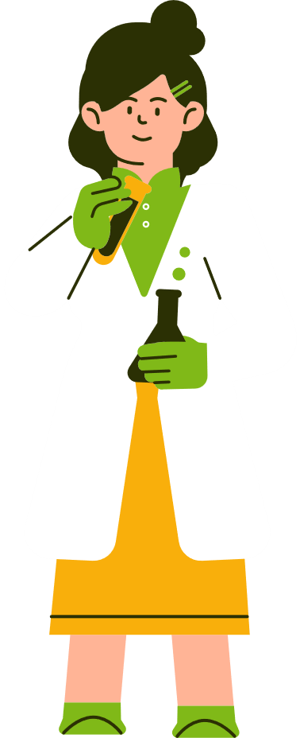
Your Job Profile
Where will you find trustworthy information to help you fill out your job profile?
How will you work as a group fairly?

Slide 24
Finding information online
Try typing in:
Type in www.prospects.ac.uk/job-profiles into the top search bar and see if your job is on there.
Annual salary of (career) e.g. Annual salary of River Health Officer
Job description of (career) e.g. Job description of Environmental Artist
(career) – and then click on ‘images’ to see what people might look like in the field. E.g. beach school leader

Slide 25
Which meta-skills are important for your job?

Slide 26
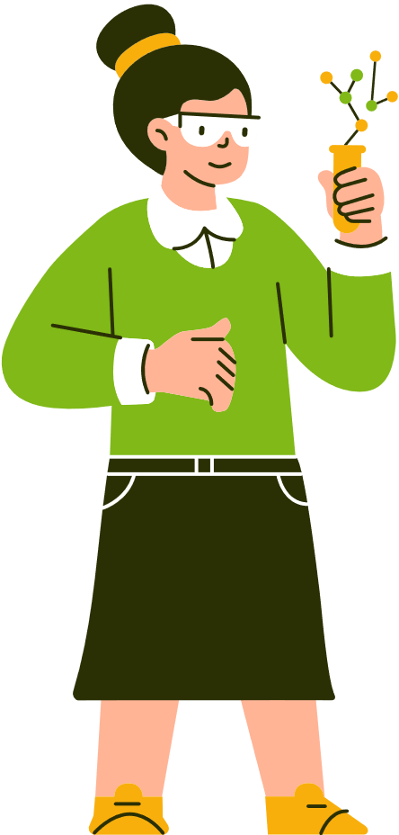
Technology
Technology is always advancing, especially in a scientific field like the aquatic sector. Let’s find out some of the latest technologies...

Slide 27
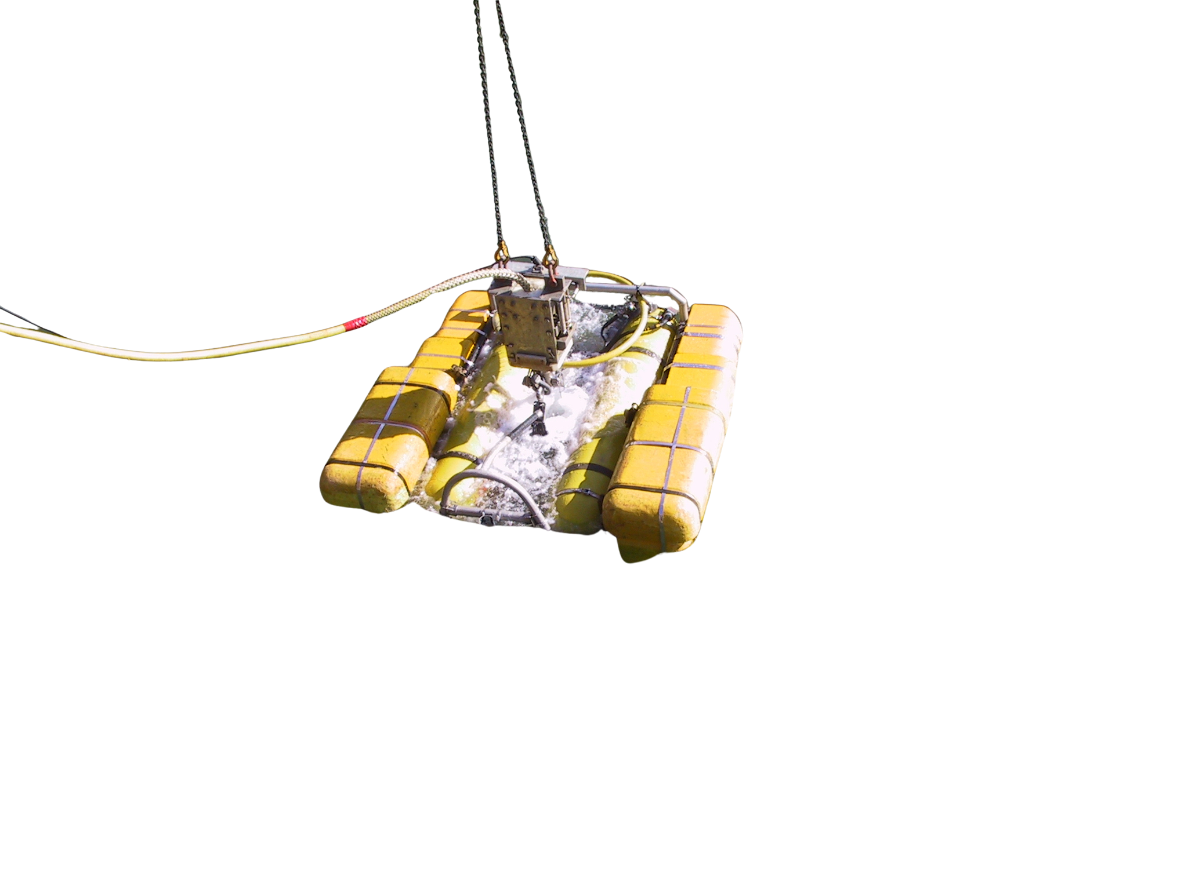
Underwater Robots
Most of the ocean is unexplored - we know more about space than our deep ocean! Underwater robots can go deeper than humans, and can find new species, monitor underwater structures for damage, and survey areas before renewable energy is built
https://www.youtube.com/watch?v=g9DOHpLS19E.

Slide 28
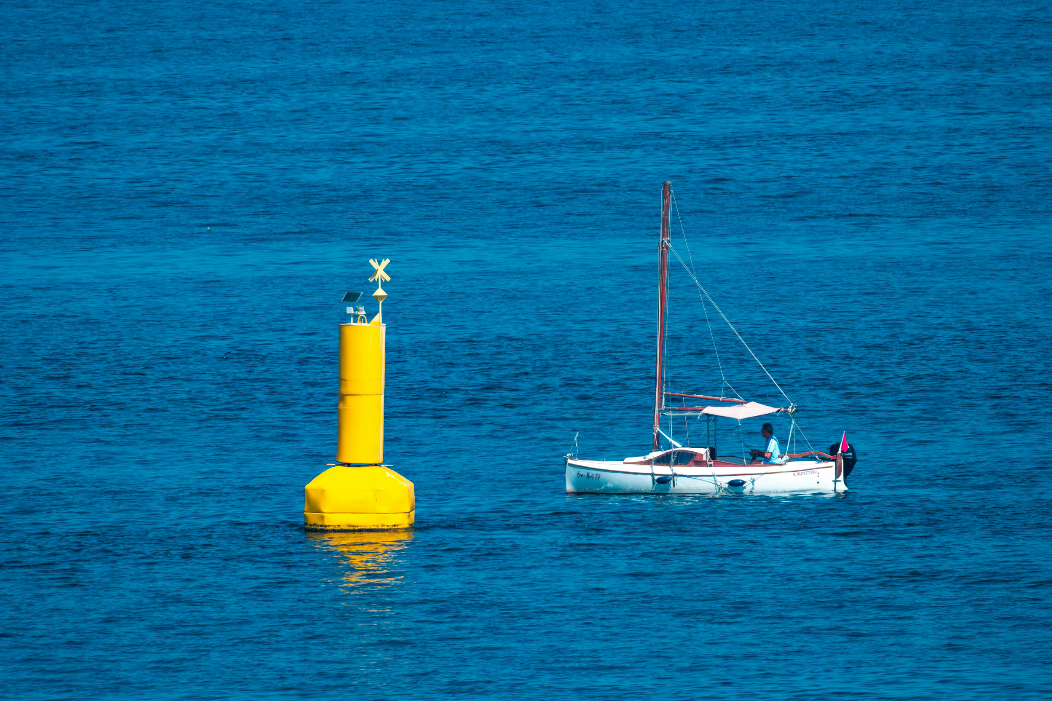

Smart Buoys
A network of buoys sends information back to labs constantly. They could be tracking whales, noting temperature changes, or monitoring ocean currents.

Slide 29

Satellite Monitoring
Satellites can protect huge areas of the ocean from illegal fishing, warn people about storms or tsunamis, detect big changes like coral bleaching.

Slide 30
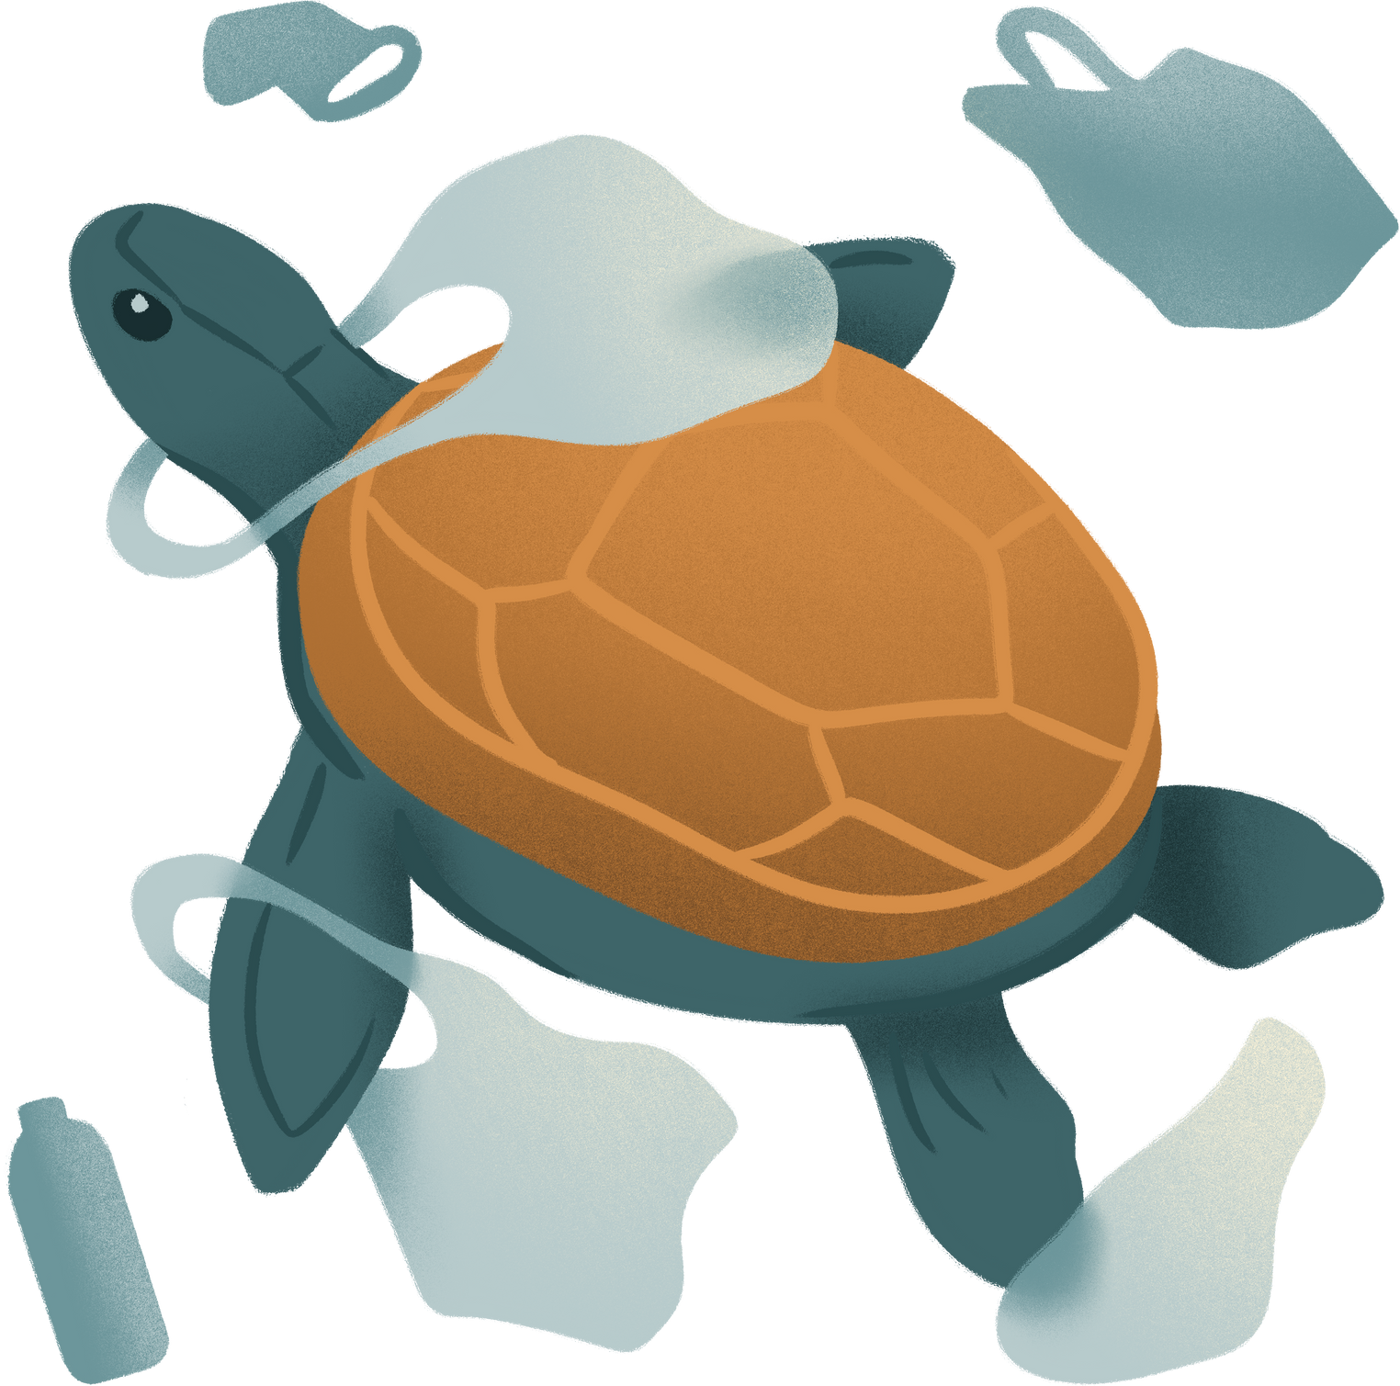
Automatic Ocean Cleanup
Artificial intelligence can help us clean up ocean pollution by automatically tracking, collecting, and sorting litter or oil spills.

Slide 31
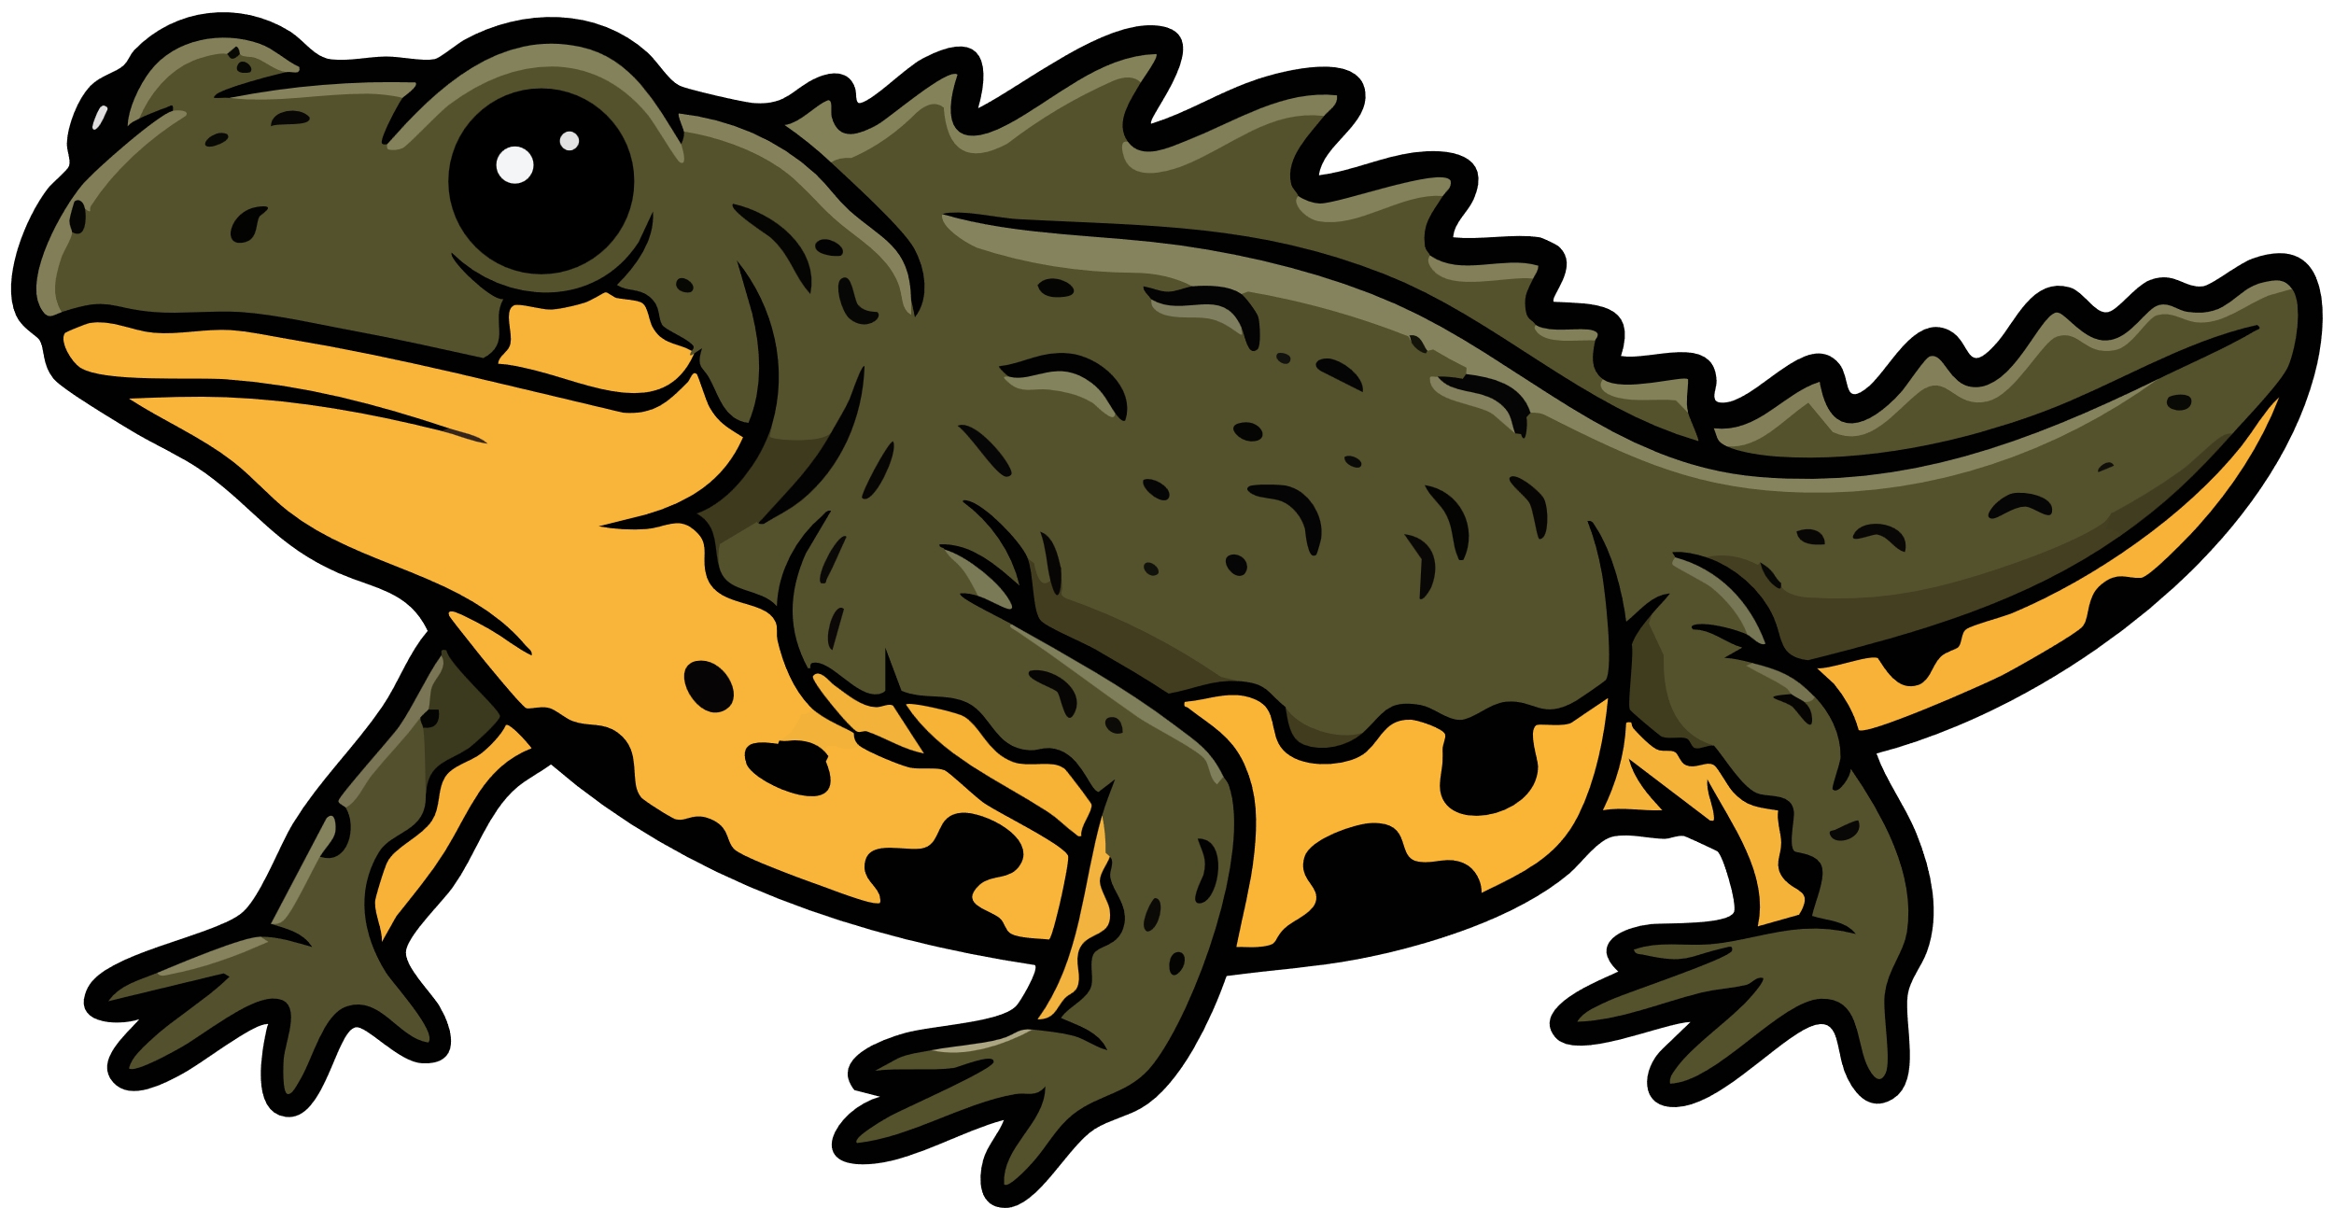
eDNA techniques
There are many species hard to survey like the rare great crested newt - but scientists have found ways of detecting them in ponds by sampling pond water! This will help protect the newts and improve conservation efforts.

Slide 32





What meta skills could these careers need?

